Slide 1
Online Project Monitoring System (OPMS)
ISE PI Meeting
March 14, 2012
Sandra Toro Martell, NSF
Gary Silverstein, Westat
Hannah Putman, Westat
Melissa Bryce, Westat

Slide 2
Overview of Presentation
Introduction
Overview of the ISE OPMS Baseline Survey
Navigating the OPMS
Questions

Slide 3
ISE Online Project Monitoring System
Web-based monitoring system completed by project PIs
Developed specifically for the ISE program
Collects data throughout a project’s lifecycle
  Baseline
  Annual
  Closeout
Currently includes data for projects funded since FY 2006

Slide 4
How do the OPMS and Fastlane differ?
Fastlane
EHR
OCI
BIO
CISE
GEO
OISE
OPP

Slide 5
OPMS Is Designed for ISE Program
ISE characteristics
ISE Program
PO information needs
Searchable and sortable

Slide 6
Information collected by the ISE OPMS
Baseline data
Lead organization, key personnel, and partners
Information about each project deliverable
Characteristics of anticipated audience
Anticipated reach and impact
Study designs and data collection methods
Annual/closeout data
Update baseline data (e.g., add new key personnel)
Actual number reached
Extent to which anticipated impacts were attained
Challenges encountered and lessons learned
Upload products (e.g., surveys, logic models)

Slide 7
OPMS data serve many purposes
Information about funded ISE projects

Slide 8
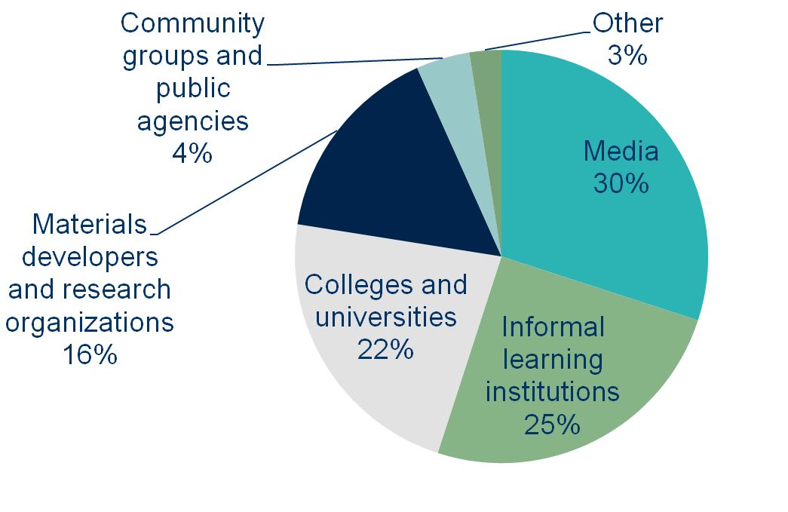
Lead Organization Type
(n=120 ISE projects funded between FY 2006-09)

Slide 9
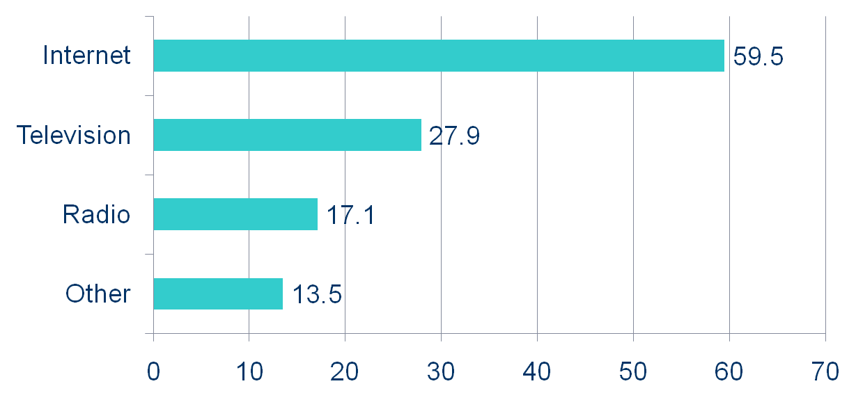
Methods for Reaching Public Audiences in Private Settings (n=111)
Percent of Projects

Slide 10
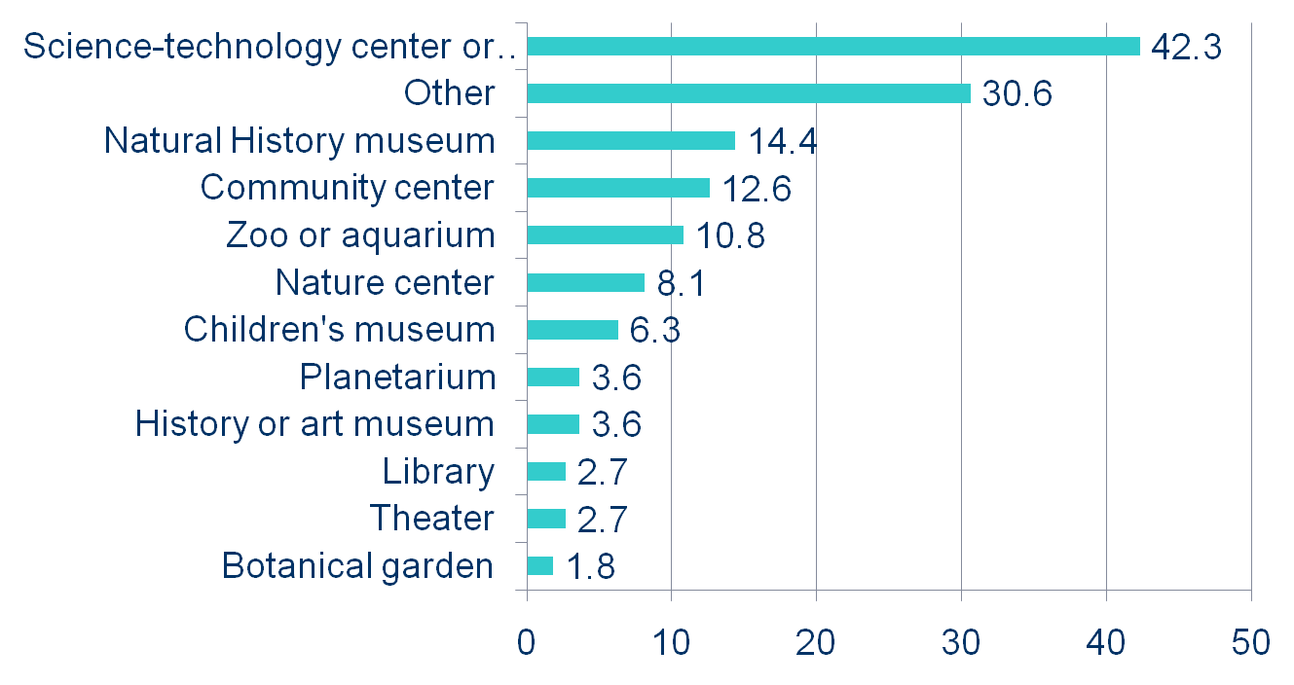
Methods for Reaching Public Audiences in Public Settings (n=111)
Percent of Projects

Slide 11
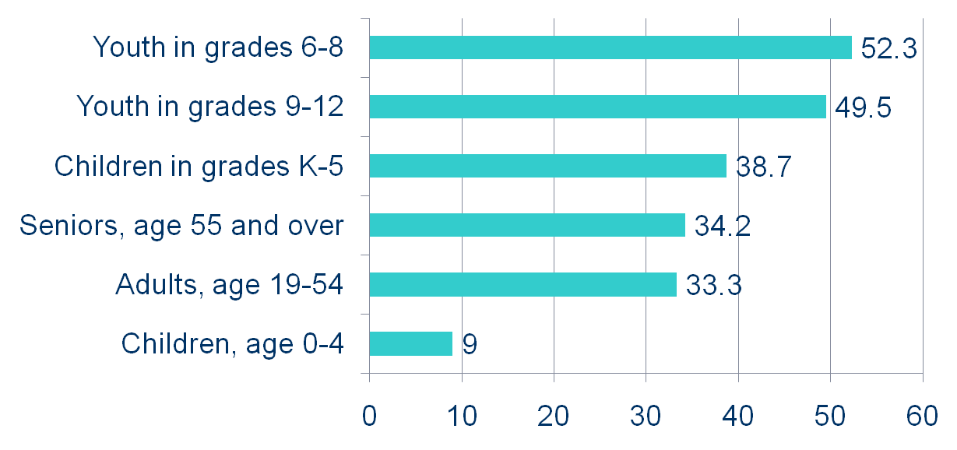
Anticipated Target Audiences: age groups (n=111)
Percent of Projects

Slide 12

OPMS data serve many purposes
Information about funded ISE projects
Information about what federal funding has accomplished

Slide 13
Impacts that Represent Significant Accomplishment: Public Audiences
“Elementary school children will increase their understanding of the evolutionary concept: variation”
“Participants will engage in dialogue about wolves and wolf conservation”
“Participating 6-10 year olds will be more inclined to pursue a career in a STEM field.”
“Adults with disabilities and older adults with age-related limitations will increase their interest/engagement in science.”
“Viewers gained understanding of how tornadoes are formed.”

Slide 14
“Adults with disabilities and older adults with age-related limitations will increase their interest/engagement in science.”
Indicators
Attendance by adults from partner organizations repeat over time.
Participants from partner organizations will demonstrate verbally or through active involvement that their participation in MarshAccess activities has engaged their interest in returning to the MEC to learn more about science.
Evidence
Attendance by the adults in our partner and visitor groups were voluntary. As the organizations repeated their visits the same individuals would attend as the organizations were always able to bring the maximum number of attendees who were almost always the same people. This is a significant accomplishment according to the group leaders because many times the participants were unable to participate or felt unwelcomed when attending programs at other facilities. This was not the case at our facility due to our understanding of the unique needs people with disabilities have with regard to program development and delivery therefore attendance was repeated over time.
The significant accomplishment met by the project was how participants with cognitive developmental psychiatric and communicative disabilities demonstrated their understanding and interest in learning about science. Through the use of body language communication boards and flip cards online journals and paper journals and through the successful completion of activities these participants were able to demonstrate their interest in MarshAccess programming and continued to voluntarily return for programs.
Study design:
Qualitative and quantitative, no comparison group
  Data collection methods:
Program attendance
Questionnaire/survey at informal venue
Direct observations of visitors’/participants’/educators’ conversations and/or behavior at informal venue

Slide 15
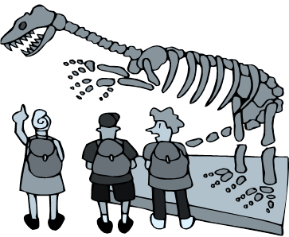
OPMS data serve many purposes
Information about funded ISE projects
Information about what federal funding has accomplished
Information about promising practices

Slide 16
More specific questions that can be addressed using OPMS data
How many people participate in ISE-funded science cafés?
Which ISE projects are reaching an international audience?
How many ISE-funded museum projects are targeting youth—and what strategies are these projects using to engage this population?
What are the most significant accomplishments of ISE projects focusing on biological sciences?
What are the anticipated and actual impacts of ISE projects employing games and other information and communication strategies?
What data collection activities are ISE projects using to assess the impact of their video products?

Slide 17
OPMS Modules
Baseline
  Completed when NSF award is made
  Anticipated project accomplishments
Annual
  Completed at beginning of calendar year
  Progress toward implementing deliverables and achieving impacts
Closeout
  Completed at end of grant award
  Extent of implementing deliverables and achieving impacts

Slide 18
OPMS Baseline Sections
Baseline Sections
Section A: Project and the Lead Organization
Section B: Key Personnel for the Project Team
Section C: Organizational Partners
Section D: Products, Programs, or Experiences for Public Audiences
Section E: Products, Programs, or Experiences for Professional Audiences
Section F: Formative and Summative Evaluation Questions

Slide 19
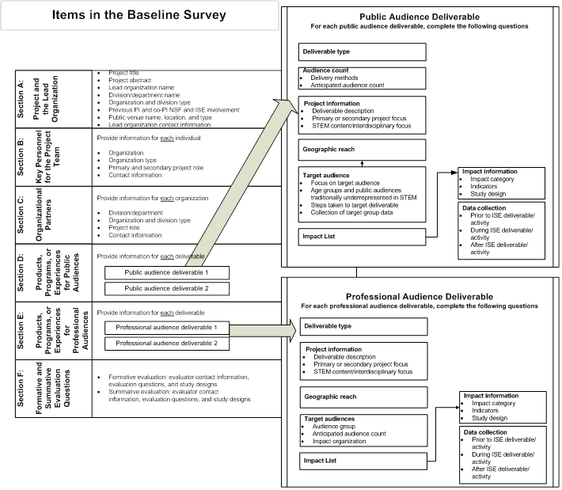
Find this helpful overview of the items in the OPMS with your handouts

Slide 20
Before You Begin the OPMS, Westat…
Identifies all ISE projects
Reviews project proposals
Pre-fills information about PI, partners, deliverables
Conducts series of webinars for projects completing a baseline survey
Ready for projects

Slide 21
Help Materials Can Save Time
OPMS
Downloads Page
Westat
Newsletters
Help page
CAISE website
Login email
Contact Melissa or Hannah
Other Resources
OPMS

Slide 22

Developing and Entering Impacts and Indicators
Developing and Entering Impacts and Indicators
For the National Science Foundation’s Informal Science Education Program

Slide 23
Example impact:
Developing and Entering Impacts and Indicators
Intended target population
  High school students who visit the exhibit will…
Type of change that will be observed
  …increase their interest in…
STEM content area that is the focus of the impact
  …the Earth’s moon.

Slide 24
Sample Impacts and Indicators:
Exhibit on the History of Man’s Exploration of the Moon
Developing and Entering Impacts and Indicators
Impact | Indicator
Visitors will increase their awareness of the people who shaped our evolving perception of the Earth’s moon | Visitors will be more likely than non-visitors to name the contribution of at least one individual (e.g., Copernicus, Galileo) who shaped our perception of the moon.
 | Visitors will be more likely than non-visitors to describe how an individual’s contribution shaped our perception of the moon.
Visitors will increase their interest in the Earth’s moon | During their visit to the museum, high school students will engage their parents in conversations about specific phenomena that are featured in the exhibit.
 | Visitors will indicate that the exhibit increased their interest in learning more about the moon and/or a related topic.
Visitors will seek out additional information about the Earth’s moon. | Visitors will share information about the exhibit and/ or the moon with family, friends, or colleagues.
 | High school students will go to the museum’s Internet site about the moon after attending the exhibit.
 | Adult visitors will join an astronomy club or attend a star party after attending the exhibit.

Slide 25
What makes a strong indicator?
Developing and Entering Impacts and Indicators
Indicators should be aligned with their impacts
  If an impact is about knowledge, the indicator should also be about knowledge (and not behavior)
  If an impact is about learning the phases of the moon, the indicator should also be about the phases of the moon (and not identifying other planets)
The best indicators are detailed, specific, and measureable

Slide 26
Tips for Using the OPMS
Multiple people can log into the same OPMS report at the same time
We recommend that no more than one person work in a section at a time
The OPMS will log you out after 10 minutes of inactivity

Slide 27
More Helpful Tips
Work with your evaluator during the OPMS process
Review and follow help materials on impacts and indicators so you won’t have to revise them later
Print a copy for your records

Slide 28
After you submit the OPMS
Complete!
Westat reviews revisions
You revise report
Westat sends you suggested revisions
Westat reviews your report

Slide 29
Accessing the sample OPMS
Website: http://www.iseopms.org
  ID: 105
  Password: Sample10
Caveats
  Do not edit or alter any information
  This is a basic example, not a sample of “excellent work”

Slide 30
Visit Our Table
Ask questions about the OPMS
Get help completing your OPMS report
If we’re not at the table, look for Gary, Hannah, and Melissa at the PI meeting through Friday
smartell@nsf.gov
GarySilverstein@Westat.com
HannahPutman@Westat.com
MelissaBryce@Westat.com

