Slide 1

Connected Learning Summit 2021
Revealing Impacts:
How does one long-term, statewide field trip program influence a community’s learning ecosystem?
Co-Presenters: Kimberley Preston¹ and Amanda Dickes²
¹Oregon State University STEM Research Center
²Gulf of Maine Research Institute

Slide 2
What you can expect from this presentation:
An introduction to Learning Ecosystems
Using the STEM Learning ecosystem theoretical framework to understand community impacts of a field trip
Implementing a mixed method research approach
Insights and challenges thus far
Concluding thoughts

Slide 3
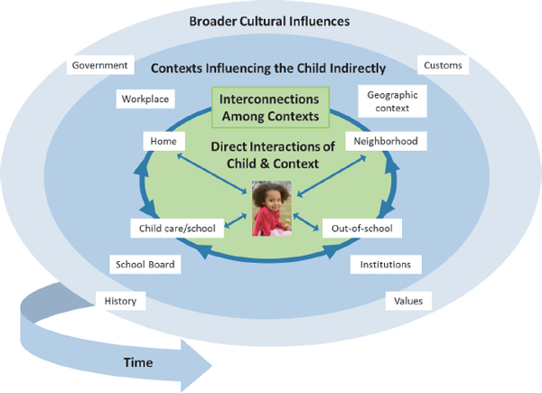
‘Ecosystems’ as a metaphor for STEM learning
NRC (2015), adapted from Liben (2014)

Slide 4
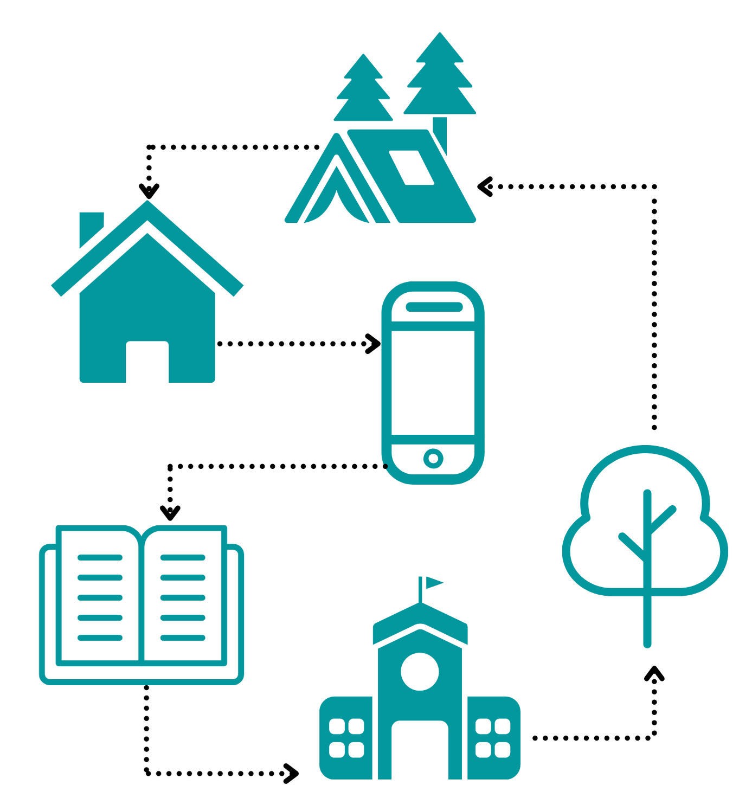

STEM Learning Ecosystems can help us understand learning pathways
STEM Resources
STEM Pathways
Family
Camp
Institutions
Camp
Geography
Family
Home
Home
Values
Media
Media
Park
Prior knowledge
Park
Library
Library
Prior knowledge
Values
Geography
School
Institutions
School

Slide 5


Field trips are promising mechanisms for connecting formal and informal STEM learning
In the classroom
Out-of-the classroom
Field Trip

Slide 6
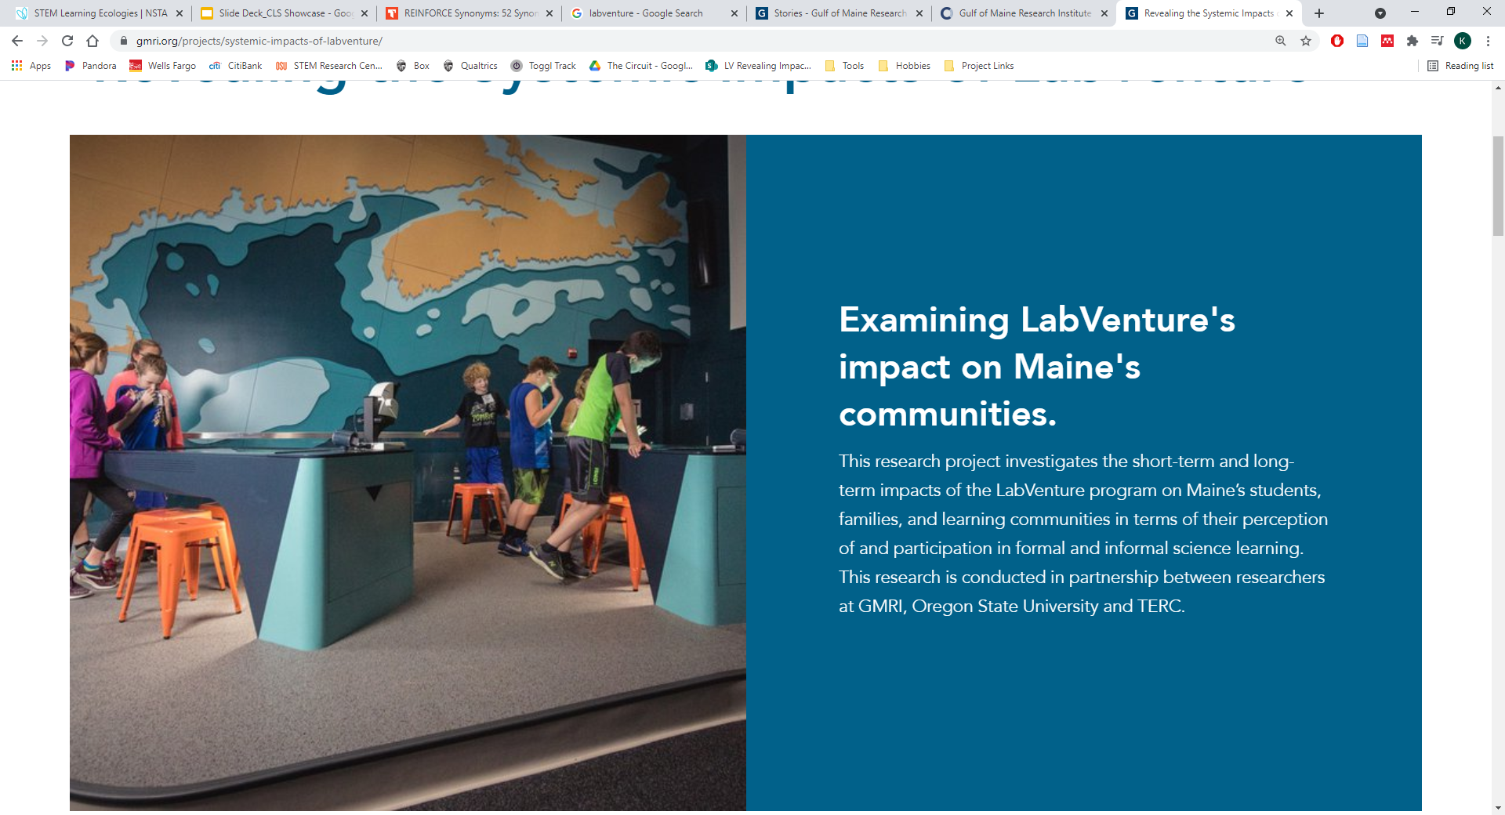
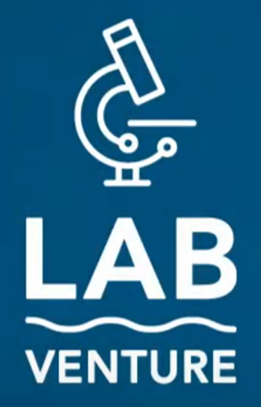
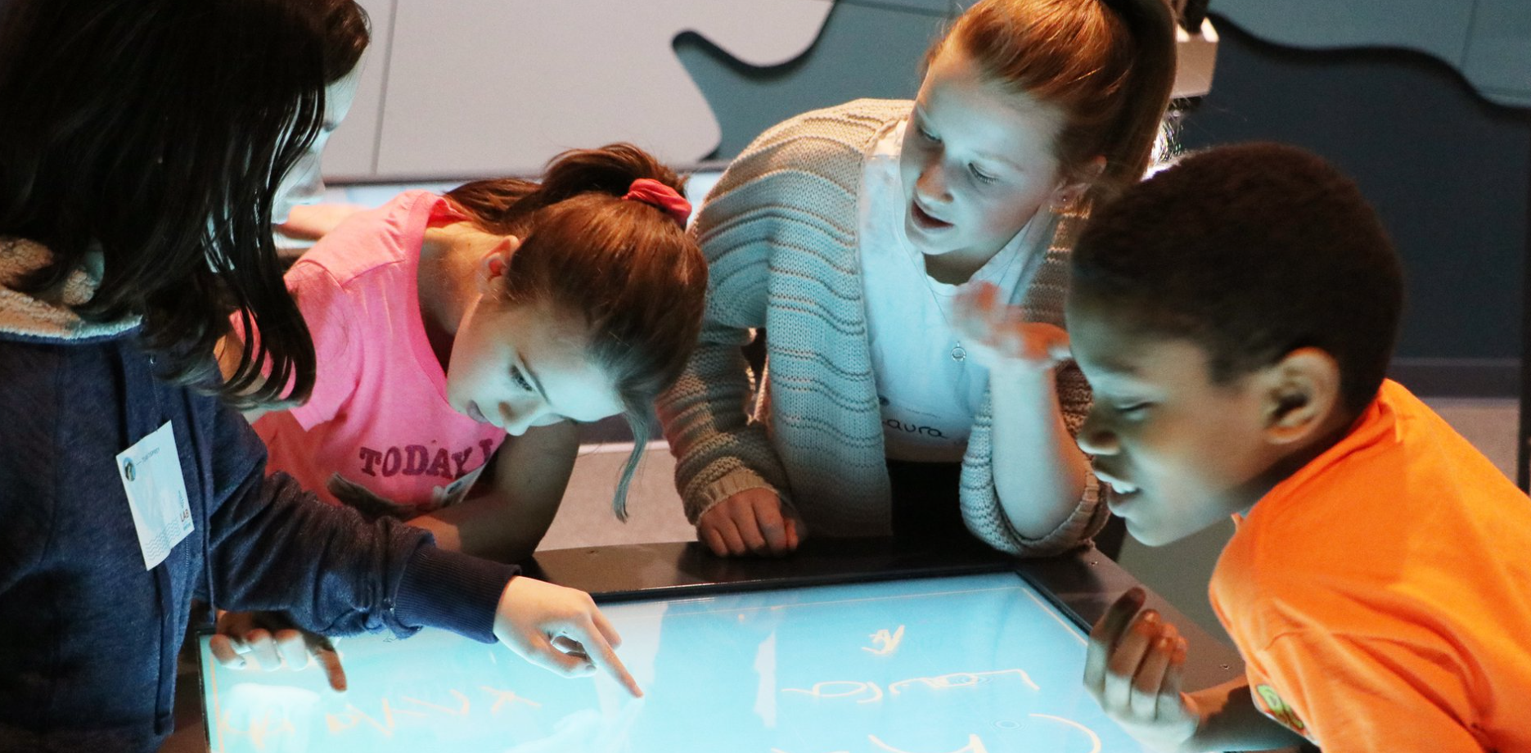
LabVenture is a promising field trip to study
LabVenture field trip hosted by the Gulf of Maine Research Institute
5th/6th graders learn about the Gulf of Maine marine ecosystem
Technology-enabled, hands-on
Free of cost to schools across Maine
Science practices: curiosity, persistence, critical thinking, collaboration, etc.
Photo credit: GMRI.org
Photo credit: GMRI.org

Slide 7
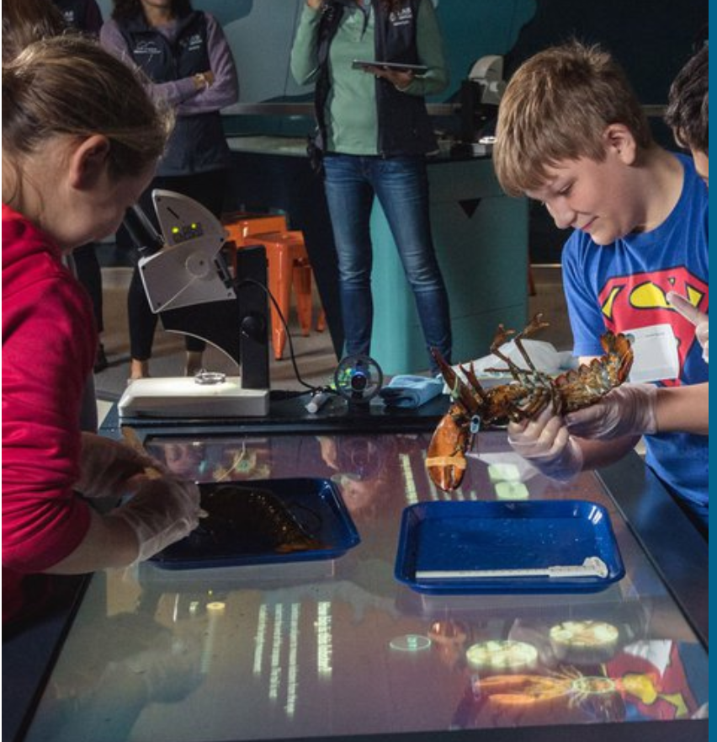
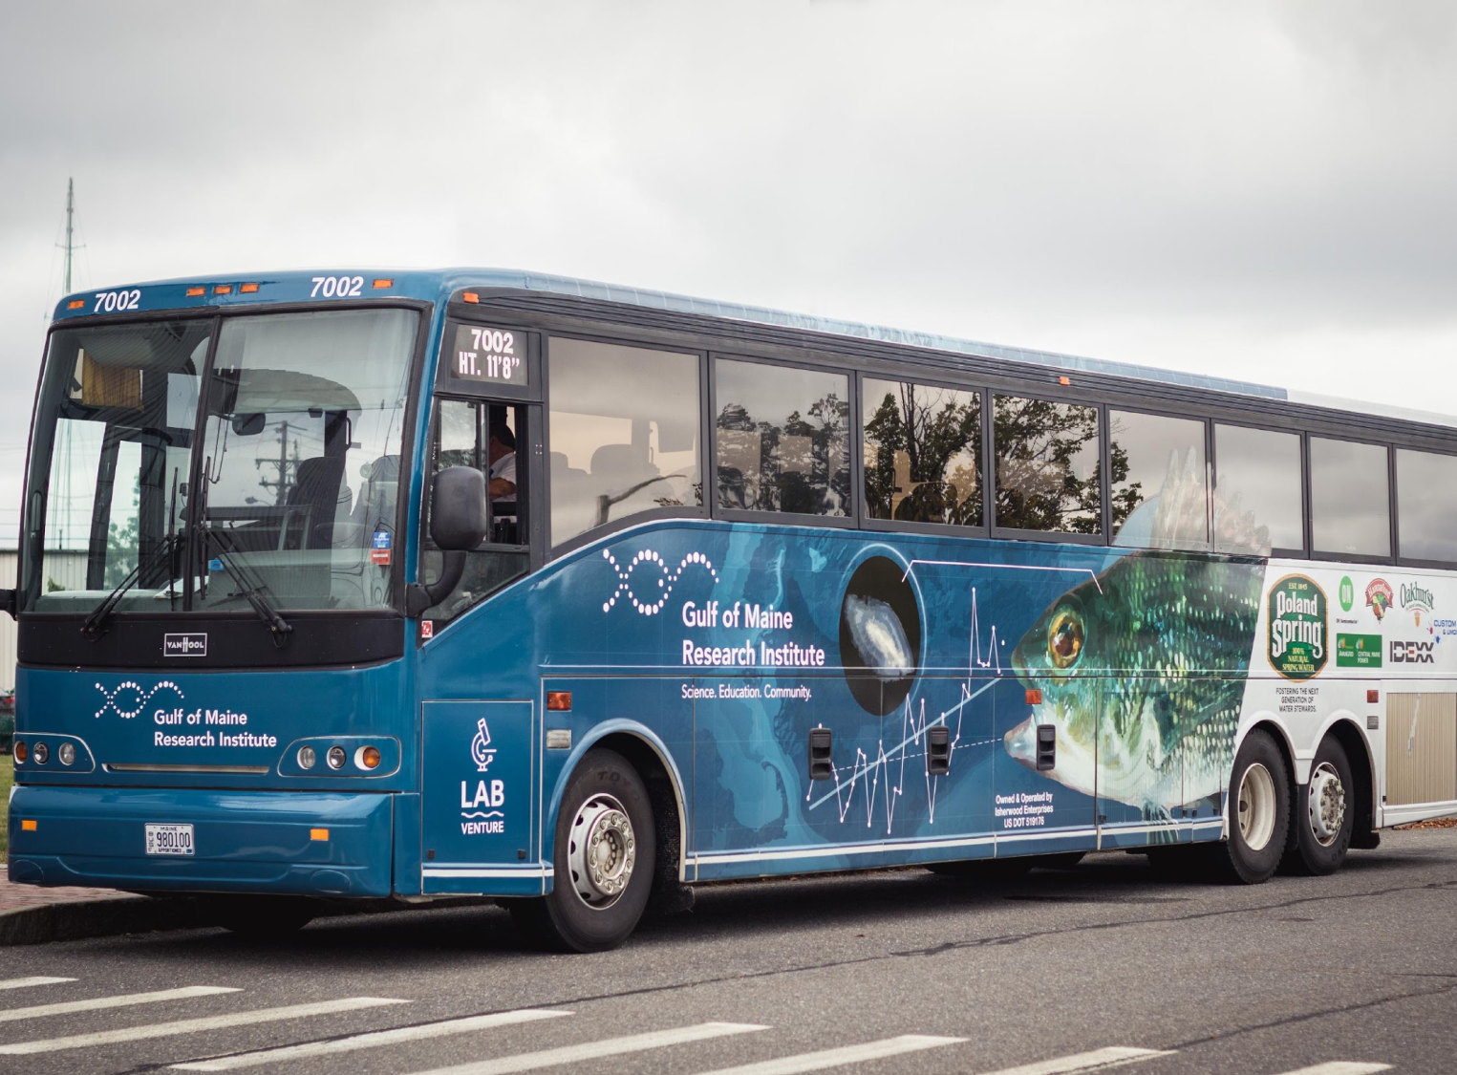
LabVenture is a promising field trip to study
Long term (16 years running)
Culturally embedded
Statewide, reaching ~65% of 5th and 6th grade students
Photo credit: GMRI.org
Photo credit: GMRI

Slide 8
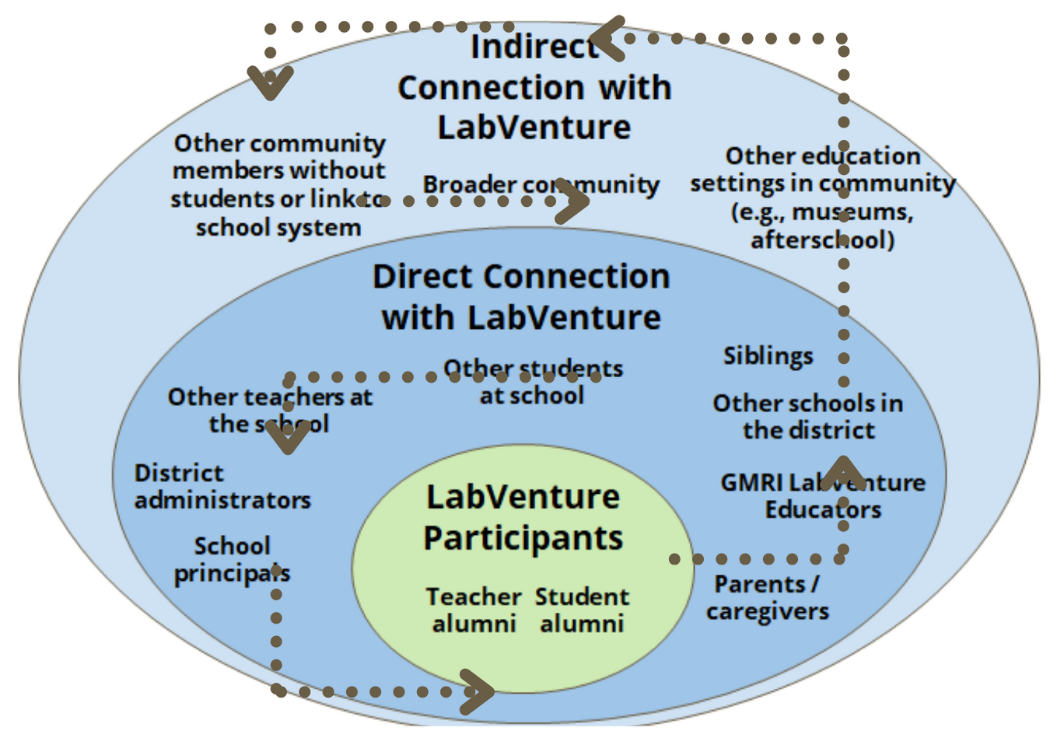
LabVenture is long-term, culturally embedded and statewide
Indirect Connection with LabVenture
Other community members without students or link to school system
Other education settings in community (e.g., museums, afterschool)
Broader community
Direct Connection with LabVenture
Other students at school
Siblings
Other teachers at the school
Other schools in the district
District administrators
LabVenture Participants
GMRI LabVenture Educators
School principals
Teacher alumni
Student alumni
Parents / caregivers

Slide 9
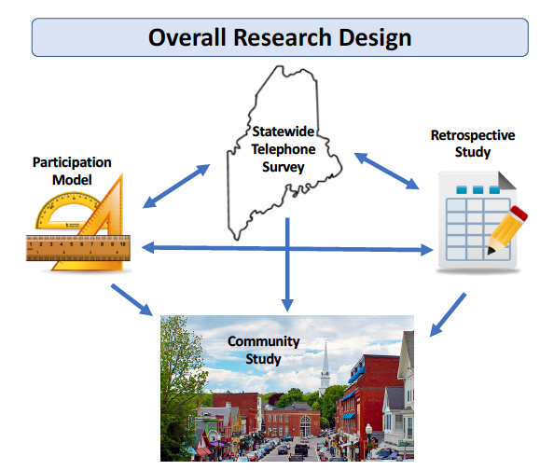
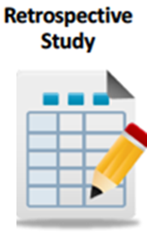
Using a multi-step, multi-method approach to the research design
Data Source
Findings
School attendance data
Existing evaluation and feedback data
Patterns of participation
Key characteristics that influence consistent, repeat visits
How is LabVenture described / perceived
Surveys (student, teacher, administrator, parents)
Interviews (student, teacher, administrator)
Field trip integration into classroom /teacher pedagogy
Identify norms and values for field trip
Memories, descriptors, tracers

Slide 10
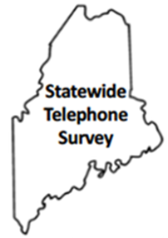
Using a multi-step, multi-method approach to the research design
Data Source
Findings
Statewide telephone survey
Broader community impact (scientific literacy and science narratives)
Identify norms and values for the field trip across Maine
Statewide telephone survey
Spot surveys
Focus group interviews
Community impact (scientific literacy and science narratives)
Identify norms and values for the field trip
Value-added for consistent, repeat field trip

Slide 11
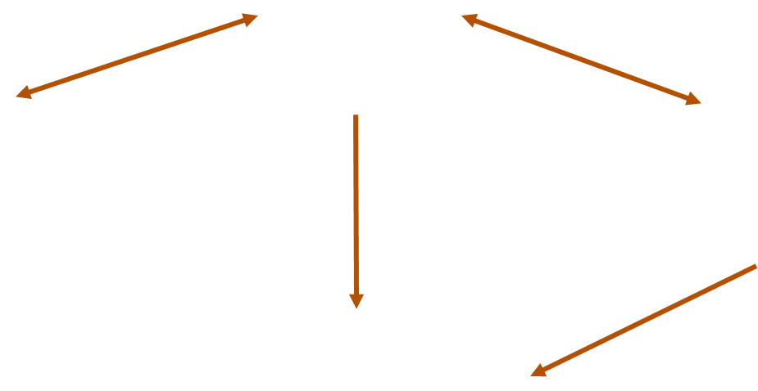

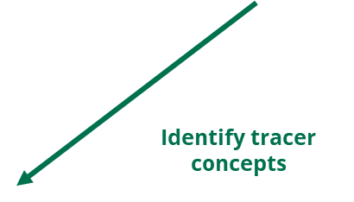
Using a multi-step, multi-method approach to the research design

Slide 12
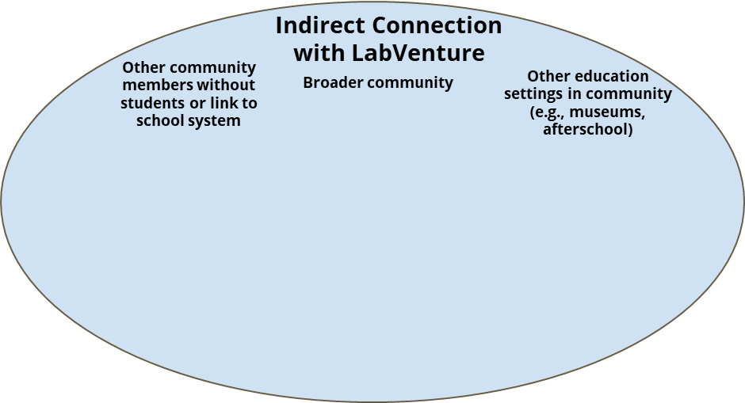
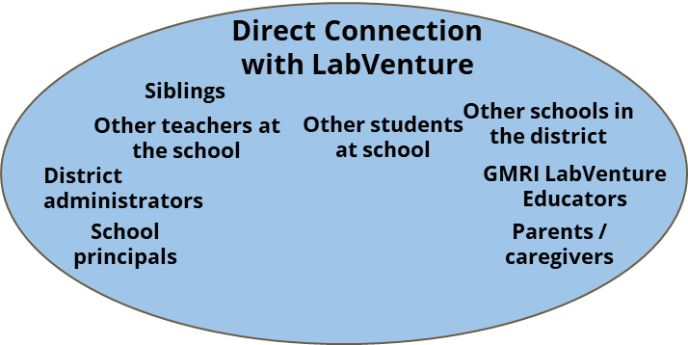
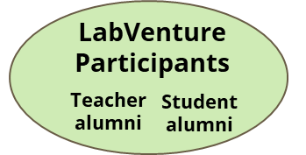
Using a multi-step, multi-method approach to the research design

Slide 13
Initial insights from retrospective interviews reveal interesting themes
Norms / Tradition:
Teacher “Champions”
Teacher Participants:
Motivations:
No cost, easy logistics;
Student experience
Classroom Integration:
Mixed responses
Possibly related to other GMRI engagement

Slide 14
Initial insights from retrospective interviews reveal interesting themes
Norm / Tradition:
“Sibling Effect”
Student Participants:
Memories:
Specific memories of events
General impressions
Shared culture:
Little recollection of discussing the trip at school

Slide 15
Concluding remarks

Slide 16

Acknowledgements
Contributions from:
Jessica Sawyer, Oregon State University STEM Research Center
Annie Fagan, Gulf of Maine Research Institute
Kelly Riedinger, Oregon State University STEM Research Center
This project is supported by the National Science Foundation (NSF) under award no. 1811452. Any opinions, findings, and conclusions or recommendations expressed are those of the authors and do no necessarily reflect the views of NSF

Slide 17
Thank you for Listening!
Please tune into the Connected Learning Ecosystems Showcase Session July 13th to continue the conversation!

