Slide 1
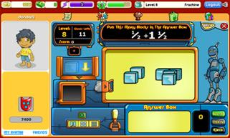
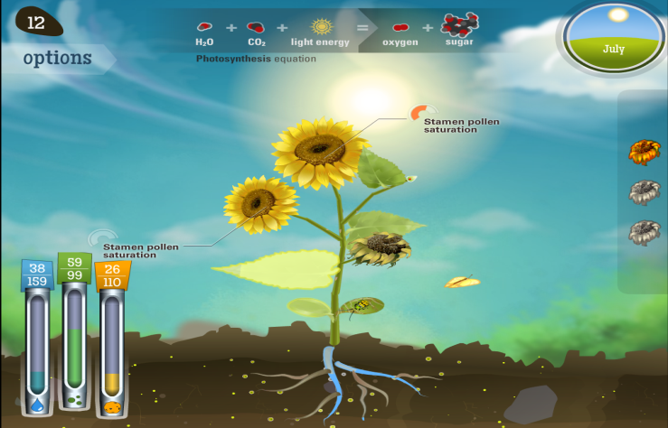
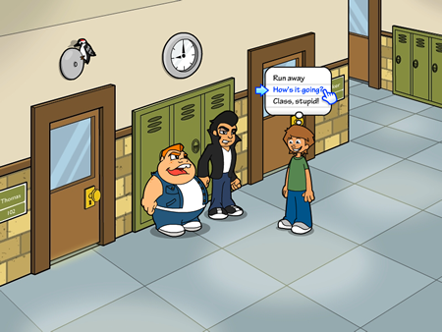
ED SBIR Driving Games for Learning
US Department of Education, Institute of Education Sciences
Small Business Innovation Research program
Edward Metz, Ph.D.

Slide 2
ED SBIR Games Intro
https://www.youtube.com/watch?v=ezAH_WY6a8I&list=PLrwM1ZVcvDhYy7N-XxRJfe0scbnbcTAkG

Slide 3
About SBIR
Legislated by Congress in 1982, reauthorized in 2011
11 Federal agencies across hundreds of offices offer competitive funding programs for for-profit small business firms
For R&D of commercially viable products to address critical national needs and strengthen the economy
A $2.5B program/year
See www.SBIR.gov for more info

Slide 4
About ED SBIR
$7.5M/year total; Phase I and II awards up to $1.05M
Funds start-ups to develop products to support student learning or teacher instruction across many areas
Some Key Program Elements:
  iterative refinement through in-classroom testing
  pilot testing to evaluate full product implementation
  stakeholder involvement
One annual competition per year; Internal review
Private sector dissemination and sustainability the goal

Slide 5
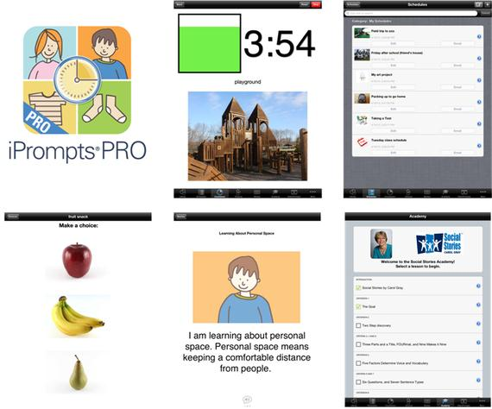
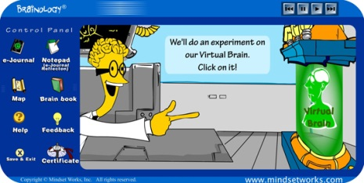

About ED SBIR
About half recent projects are on the market
About a quarter generating revenue to be sustained, mostly through: direct sales (app stores), licensing agreements; district contracts, and acquisition.
Currently ~2M students in tens of thousands of schools in 50 states are using ED SBIR products.

Slide 6
ED SBIR: Games Emerge
  Games for learning….
  “Off the grid” before 2007
    2004 to 2006, ~5% of all proposals were for games
    2001 to 2008: 1 of 32 projects awards for games
  “Emerge” after 2008
    In 2013 and 2014, ~35% of all proposals included a game or used gaming component
    2009 to 2014: 17 of last 41 awards were for a game, including 9 of the past 12

Slide 7
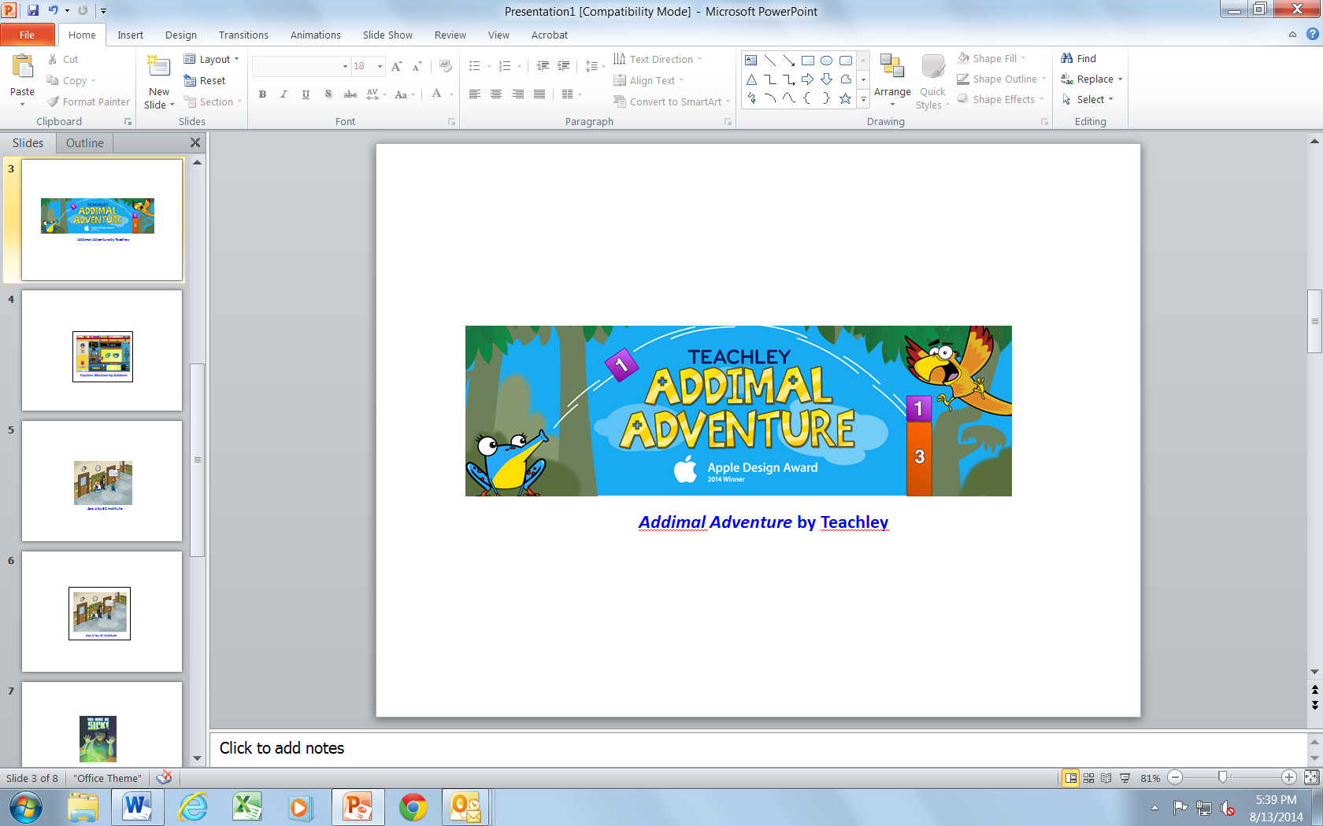
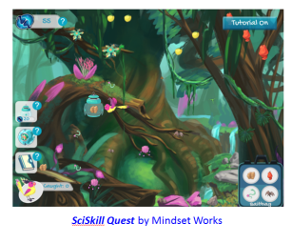
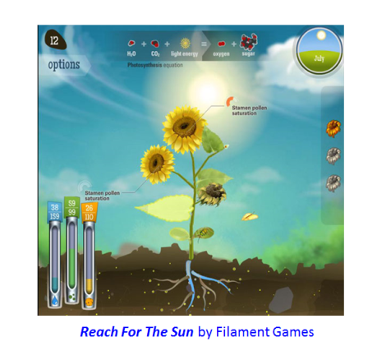
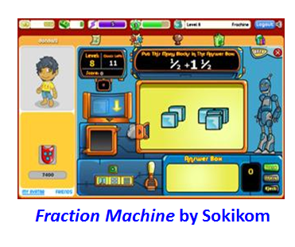
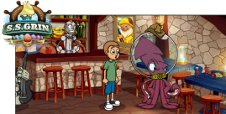
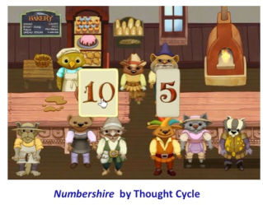
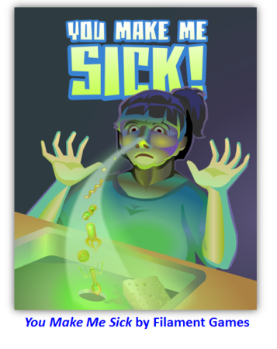
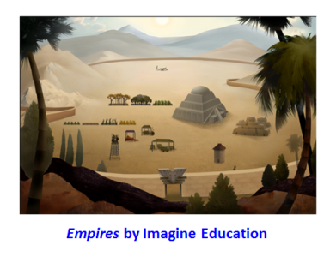
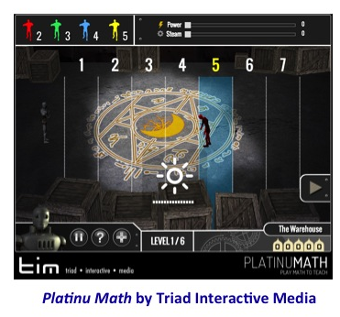
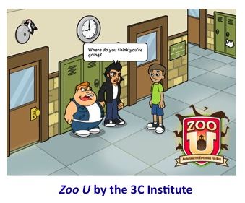
Games for Learning out of ED SBIR

Slide 8
ED SBIR: Why Games?
  Some factors that drove games at ED SBIR:
  Technological innovations – landscape changed forever after 2008
  Marketplace index platforms - direct to consumers & revenue
  The light finally went on!
    Out of school consumers (parents) looking for quality anytime/anywhere content
    In school teachers looking to engage students anyway possible - even games!
    All kids play and love games!
  Here at ED SBIR, significant OUTREACH to the game developer community
  Gamers looking for bigger social impact than just entertainment, start partnering with education content experts and researchers.
  In 2013, ED SBIR partnered with DARPA SBIR on games-only solicitation.
  Early successes build momentum…

Slide 9


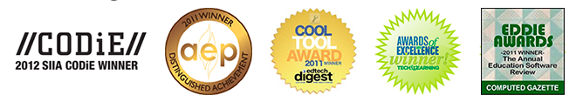

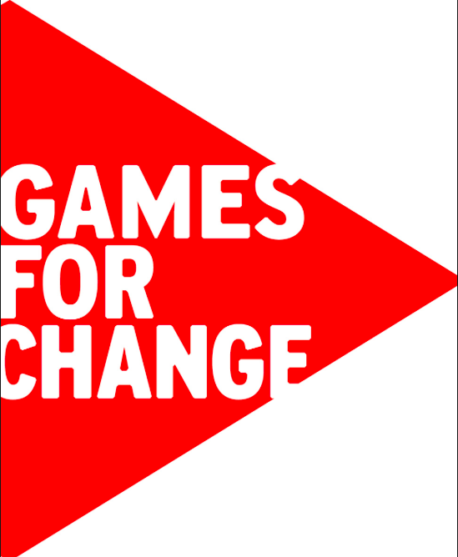
ED SBIR: Games Emerge
  Momentum Builder: ED SBIR Games Win Major Industry Awards

Slide 10
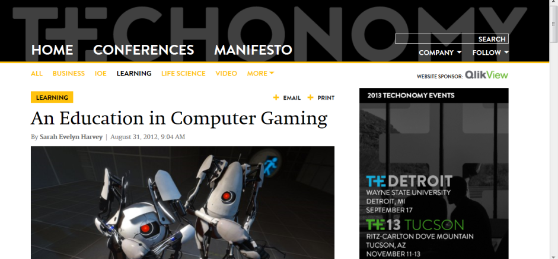
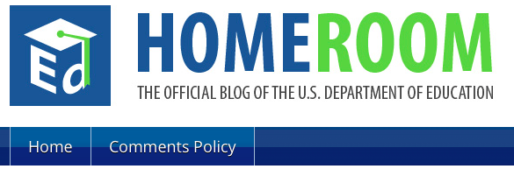
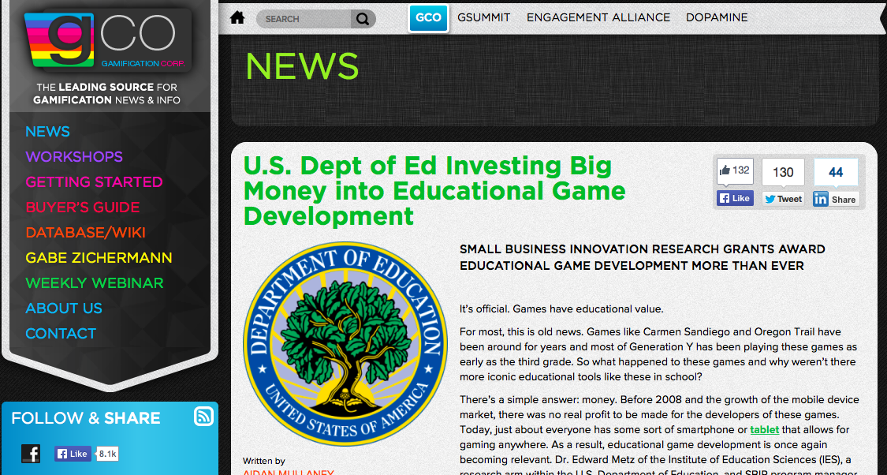
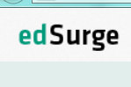
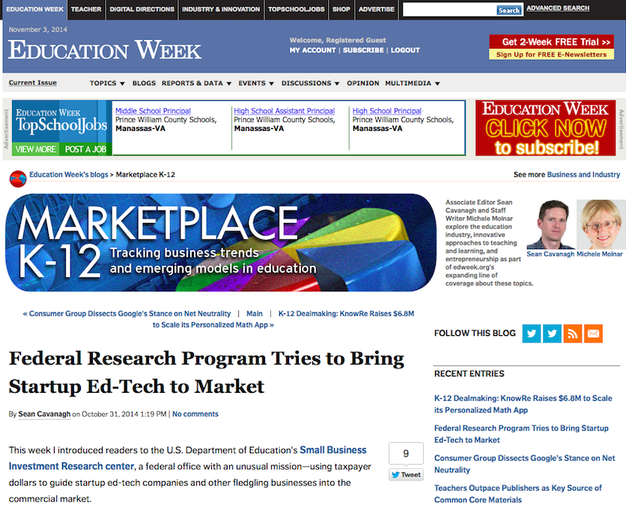
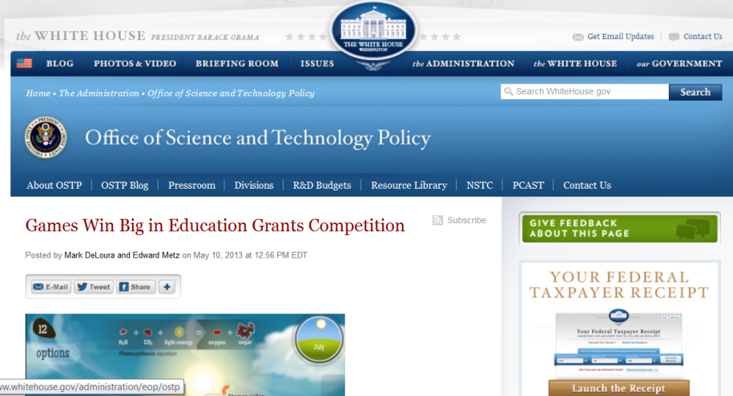
ED SBIR: Games Emerge
  Momentum Builder: ED SBIR in the news

Slide 11
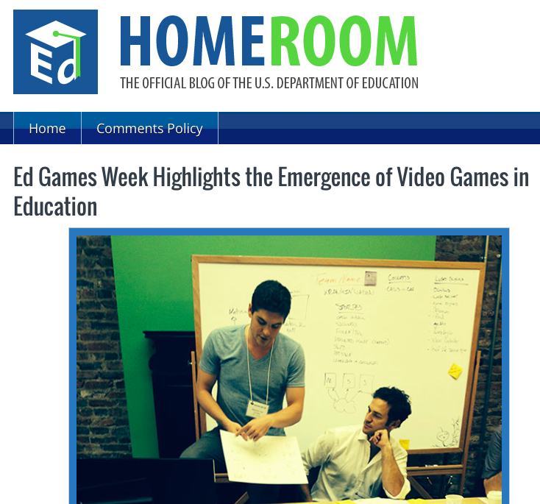
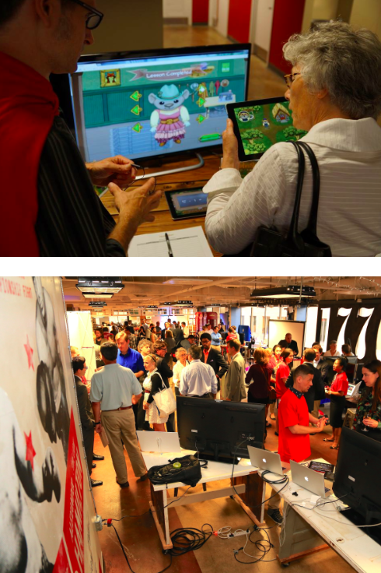
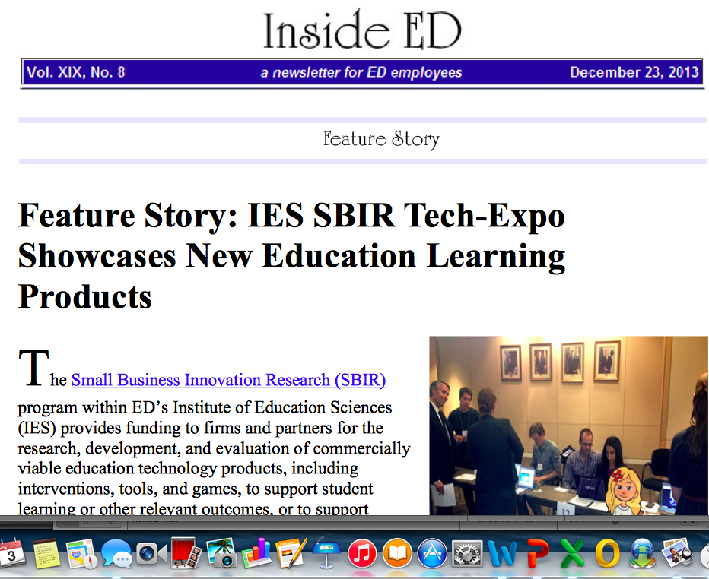
ED SBIR: Games Emerge
  Momentum Builder: ED SBIR Expos
Notes:
11

Slide 12
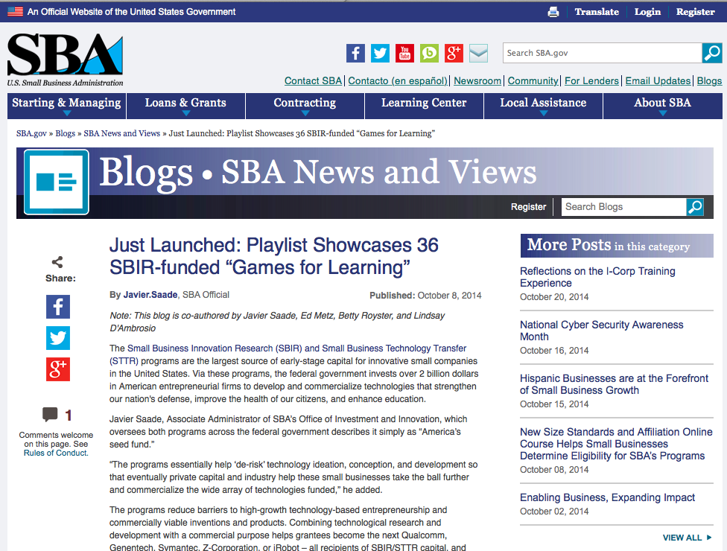
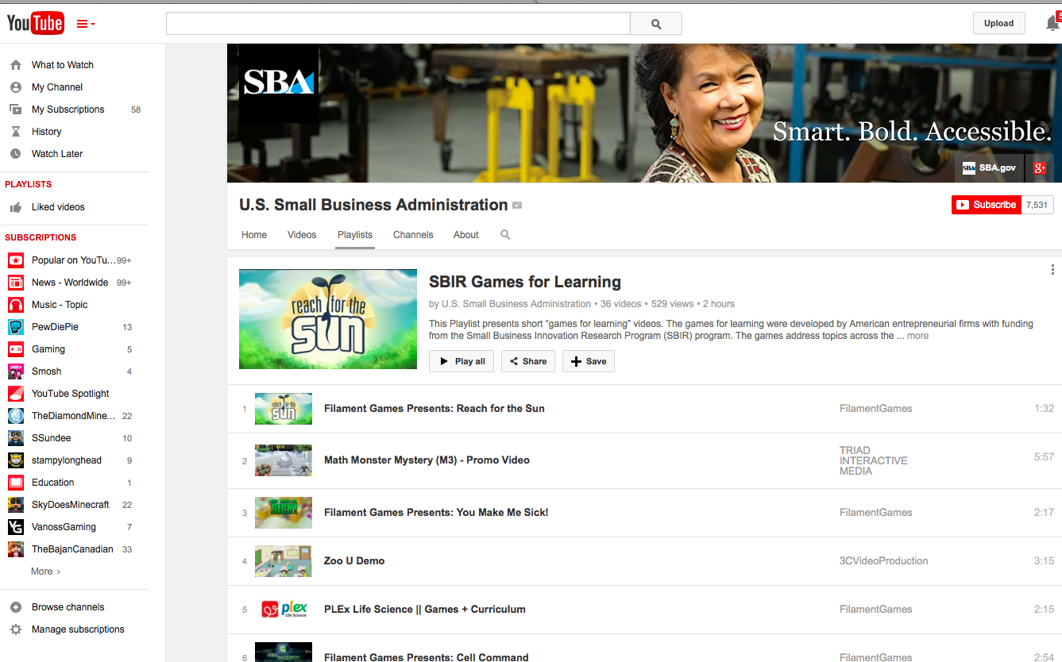
Across SBIR: Games Emerge
Notes:
12

Slide 13
ED SBIR DEMOS
Notes:
13

Slide 14
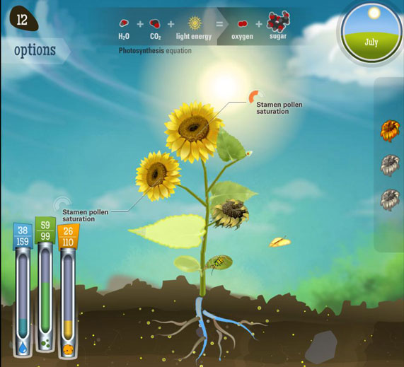
ED SBIR Video DEMOS
Filament Games
https://www.youtube.com/watch?v=jlZ9P8W6hkI
Notes:
14

Slide 15
ED SBIR Video Demos
Teachley
https://www.youtube.com/watch?v=0YZ7oKjicGI&index=26&list=PLrwM1ZVcvDhYy7N-XxRJfe0scbnbcTAkG
Notes:
15

Slide 16
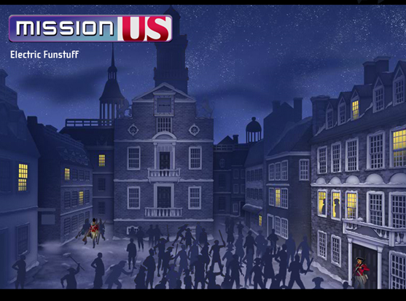
ED SBIR Demos
Electric Funstuff
https://www.youtube.com/watch?v=nwgw352wCFg
Notes:
16

Slide 17
Thank you!
Edward.Metz@ed.gov

