Slide 1
Mining the Field: The ISE Evidence Wiki
Notes:
Introduction: The first two presentations in this session approached the topic of “Mining the Field” through top-down data-driven applications. This presentation takes a different approach, featuring a crowd-sourced resource that harnesses the collective knowledge of the people who make up the ISE field.
1

Slide 2
ISE Evidence Wiki
Goal is to provide a place to provide short statements of evidence about Informal STEM Education (ISE).
Articles are written by ISE researchers and practitioners.

Slide 3
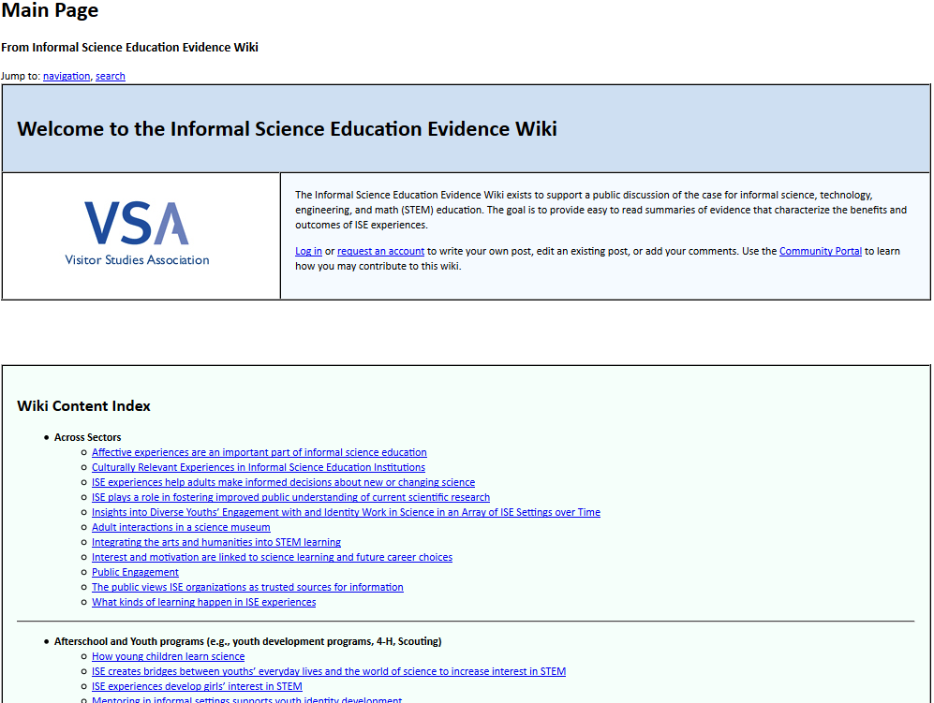
History
Conceptualized in 2010
Implemented through a sub-award with the Visitor Studies Association (VSA)
VSA produced 30 article stubs on a variety of topics related to ISE
Site launched using MediaWiki
IseEvidenceWiki.org at site launch

Slide 4
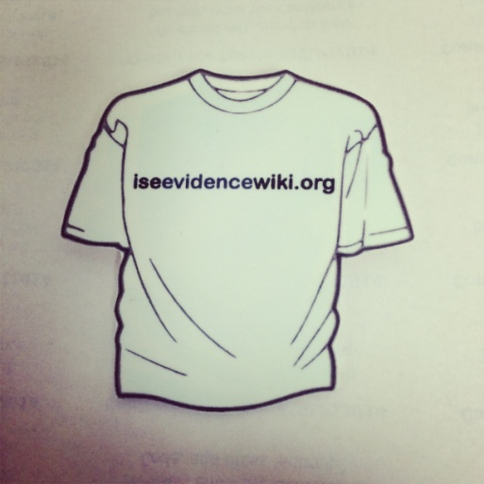
Publicity
Publicized at the 2012 PI Meeting
At the 2012 ASTC Conference, a team of “Wiki Ambassadors” shared information about the Wiki and asked people to contribute
Wiki has continued to be shared at relevant conferences and meetings, especially those related to evaluation
New articles are highlighted in the CAISE Newsletter

Slide 5
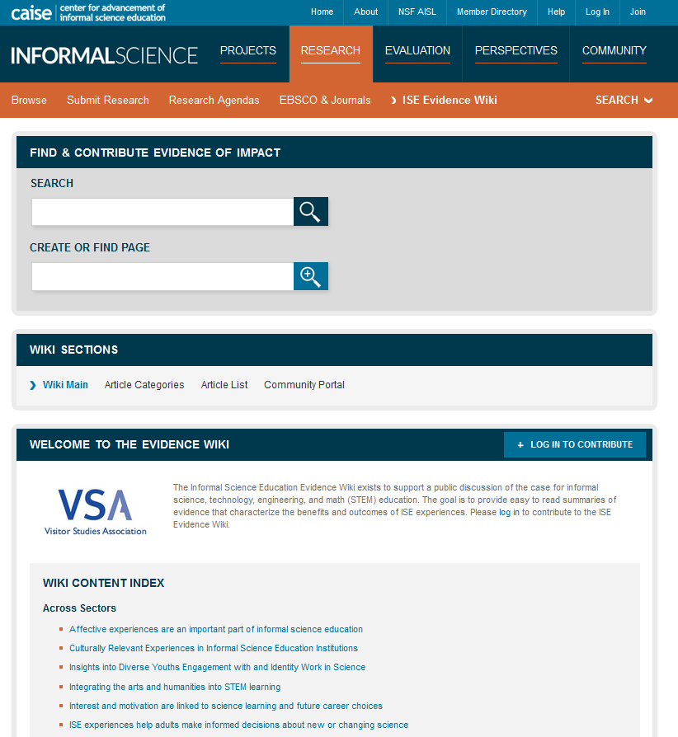
Migration to InformalScience.org
When CAISE was re-funded, the ISE Evidence Wiki was consolidated into the new InformalScience.org, which launched in 2013.
The Wiki is found in the “Research” section of the site.
ISE Evidence Wiki on InformalScience.org
Notes:
Talk about how the new InformalScience.org consolidated several existing sites – caise.insci.org, the old informalscience.org, the evidence wiki, and the informal commons were consolidated into one website that can act as a single point of access for the ISE knowledge base.
5

Slide 6
Recent Improvements
Migration to InformalScience.org allows people to contribute to the Wiki using a single login.
Many of the resources that are cited in the Wiki have been catalogued in the InformalScience.org repository.
In addition to articles that were generated by users, we worked with an independent contractor to create new article stubs on hot topics in the field.
Making and Tinkering Programs
Organizational Networks
Notes:
Talk about what’s in the repository – projects, research, and evaluation – and how the collection includes full-text articles from EBSCO that logged-in users can access for free. This makes research more accessible to practitioners!
6

Slide 7
Usage
The ISE Evidence Wiki represents about 5% of total traffic to InformalScience.org.
86% of the Wiki’s traffic comes from search engines.
The Wiki Article “Field Trips are Valuable Learning Experiences” is the single most popular piece of content on InformalScience.org, with 5,570 page views in the past year.
Statistics from Google Analytics, ranging from August 13, 2013-August 13, 2014
Notes:
Mention that the Wiki articles have a high concentration of views compared to other places on the site.
7

Slide 8
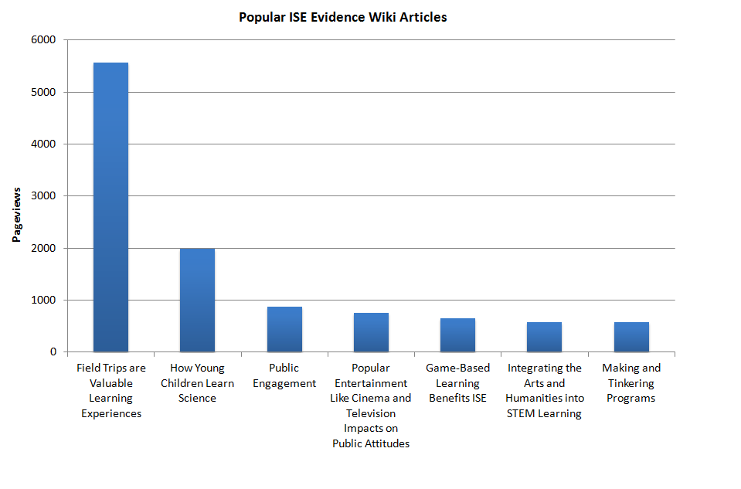
Statistics from Google Analytics
August 13, 2013-August 13, 2014

Slide 9
Potential Uses
Share project work and publicize your findings
Contextualize your work within the wider world of ISE
Learn about the field
Find citations/evidence about ISE topics
Notes:
How can YOU use the Evidence Wiki?
I tend to view the Wiki as a dynamic lit review. It’s a way of sharing resources and pointing people towards what’s already been done in the field, and people can add to it over time.
9

Slide 10
Challenges
How can the Evidence Wiki encourage participation?
HTML/Formatting
Notes:
Most people view the Wiki rather than edit it. The “1% rule” in internet culture – 90% of people just view content, 9% make small tweaks, and only 1% actively create content. A recent study of four online communities in the Journal of Medical Internet Research demonstrates that this rule is pretty consistent. Given the general nature of Wikis, how do we encourage more people to contribute to the Wiki? How do we harness the collective knowledge of the field?
Encouraging participation:
-One strategy that worked was conducting interviews with professionals in the field to generate content.
-Lowering the barrier to entry via single login with InformalScience.org.
HTML/Formatting:
-Created an instruction page (linked through the community portal) with detailed how-to pages for creating and formatting posts. Also willing to format posts for people if they e-mail them to us.
10

Slide 11
Live Demo
followed by
Q&A

