Slide 1
Formative evaluation, phase 2:
Native new York exhibition
Prepared for the
National Museum of the American Indian, New York, NY
March 2017
Stephanie Downey, Managing Director
Cathy Sigmond, Research Associate
Samantha Theriault, Research Assistant

Slide 2
Study Background

Slide 3
Study objectives
  Overall:
  Baseline knowledge
  What piques teachers’/ visitors’ interest, what is compelling
  Potential barriers (confusion or misunderstanding)
  Strategies to help make personal connections
  How/if teachers/visitors understand intended exhibition outcomes¹
For teachers specifically:
  Comfort presenting the ideas to students; support needed
  Teachers’ concerns about how the information will resonate with students
  Usefulness for teachers’ curriculum requirements
Notes:
1. Intended outcomes include:
Appreciate how heritage/history shape and articulate “culture,” in particular the diverse ways Native peoples practice and participate in their culture(s).
Appreciate who Native Americans are today.
Understand that Native peoples have powerfully shaped and defined New York’s geography, economy, and cultural identity over time.
Realize the incredible diversity and complexity of Native peoples of New York (including cultural, geographic, and linguistic diversity and complexity).
Think critically about contemporary Native life in New York, including the facts that a) Native individuals participate in every facet of modern New York life, and b) Native nations are still working to assert their sovereignty today.

Slide 4
Methodology
Focus Group:
One 90-minute group with teachers on January 19th
Targeted 4th grade teachers¹
Interviews:
Interviews with walk-in visitors on January 20th – 21st
Recruited from a random selection of visitors at NMAI in the rotunda
22 interviews with 37 participants were conducted²
Participation rate is 67%
Notes:
1. All focus group participants were recruited by NMAI. RK&A provided a brief overview before guiding teachers through the materials.
2. 33 groups were recruited and 22 groups agreed to participate in the study.

Slide 5
Teacher focus group

Slide 6
Participant characteristics
Nine teachers participated in the January 2017 focus group.
Grade levels: The majority teach 4th or 5th grade; one each also teach PreK-3rd grade and 3rd grade. One teaches 8th grade.
Teaching Experience: A few have been teachers for 15+ years, a few for 5-10 years, and two for 10-15 years.
Teaching these topics in the classroom: A few spend 1-3 hours teaching these topics in their classrooms per week; two spend 5-10 hours; one each spends 15+ hours, 3-5 hours, and less than 1 hour.
NMAI-NY Visitation: Two-thirds have visited NMAI-NY with students, and one has a trip planned.
General Museum Visitation Habits: A few spend 30-60 minutes in a gallery on museum field trips; a few spend 61-90 minutes; one spends more than 90 minutes.
  Two-thirds use pre- or post-visit materials provided by museums.

Slide 7
Testing scenario
Teachers were shown a PowerPoint presentation and a printed booklet of preliminary exhibition materials.
  Includes Exhibition Text, Diversity of Nations, Wealth of Nations, Power of Nations, Survival of Nations, and Pride of Nations.¹
RK&A guided teachers through the materials, asking questions from the interview guide and additional probes along the way.
The focus group lasted around 105 minutes.
Teachers received various NMAI promotional materials.
Notes:
1. Note that teachers were shown a slightly longer, more expanded version of the materials shown to walk-in visitors. The full set of materials shown to teachers is included at the end of this presentation in the “Testing Materials for Focus Groups” section.

Slide 8
Teaching about native Americans
What comes to mind when you think about teaching students about Native Americans of New York?
New York tribes – All said they introduce students to various tribes and/or nations native to New York (Lenape, Haudenosaunee “five nations”, etc.)
Dispelling myths – One-half said they try to understand students’ existing perceptions of Native Americans in order to dispel common myths and stereotypes students might have picked up from pop culture.¹
Relationship to the land – Two said they emphasize Native Americans’ “respect” for their land and natural resources.²
Comparing past and present – Two said they compare and contrast early and modern New York in their classrooms, touching on the effects of colonialism.
Notes:
For example, that Native Americans “all live in teepees,” or that they are “violent” “savages” who use bows and arrows. One added that she makes an effort to also ask herself, as an educator, “what do I know?” and that she tries to represent Native Americans “in a respectful manner.”
One also said she tries to tie Native Americans “very light” ecological footprint and to ecology and science lessons.

Slide 9
Exhibition introduction
Option 1 | This is an exhibit about living people. There are no extinct cultures in this exhibit. The Native nations of New York still exist alongside all of the other nations on earth. The customs shown here have stood the test of time. They help Native people define themselves and how they fit into the world. New York gave rise to many of them. Come see how they began, what they endured to survive, and how they are rising again today.
Option 2 | Nations have been rising from the place we know now as New York for millennia. Out of the place you now stand, Native people created diverse nations with unique cultures, long histories, and great contributions. New York has always been a nation-builder. Its economy and strategic position helped form the United States, fueled countries around the globe, and contributed to the expansion of democracy worldwide. Native New York is vibrant today, and Native nations rise again from this land.

Slide 10
Exhibition introduction
THOUGHTS ON OPTION 1 – “This is an exhibit about…”
Teachers generally preferred Option 1 because:
Native peoples are alive today – A few liked that Option 1 immediately states that Native Americans are “living peoples” because it makes native peoples feel “accessible” and dispels the common myth that they existed only in the past.¹
“Kid-friendly” language – A few preferred this version for its simpler, “kid-friendly” language; two said the last sentence in particular felt “inviting” and would make students feel like they could “jump right in.”
Native nationhood – One preferred this version because, unlike Option 2, it directly conveys that native peoples consider themselves to be part of “nations.”²
Notes:
One also liked this phrase because it also has the potential to dispel students’ misconception that museums are only full of “ancient old dead stuff.”
Though this teacher did not expound, presumably this is conveyed by the repeated use of the word “they” in reference to New York’s native nations, as well as the phrase “native peoples define themselves.” As he put it, “[Option 1 is] a comparison of native nations [and] to understand the different nations you have to think of them in that way. You don’t get that sense from Option 2, that the natives think of themselves as a nation.”

Slide 11
Exhibition introduction
THOUGHTS ON OPTION 2 – “Nations have been rising…”
Teachers commented on a few aspects of Option 2.
Emphasis on New York versus native peoples – Two said the second paragraph emphasizes New York over native peoples, to a fault – it “just talks about New York” and makes you “lose track of what this exhibit is about.”¹
“New York has always been a nation builder” concept – One preferred Option 2 because it conveys that “the first nation builders in New York were Native Americans” and gives native peoples “their place in history” by attributing New York’s modern greatness to its foundational native nations.²
Complex vocabulary – One worried that some words in this version are too complex for fourth graders (e.g., “they won’t know the word millennia.”)
Notes:
As one put it, “The second paragraph just talks about New York, [when] we’re here for Native Americans and we want to emphasize native impact on us and how they were instrumental in our world.”
She added that phrases such as “out of the place you now stand,” “native people created,” and “rise again” conveyed this feeling.

Slide 12
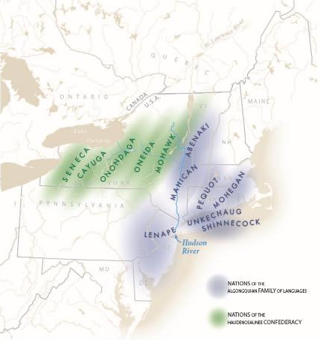
Diversity of nations map
NEW YORK NATIVE NATIONS
Many different Native nations have risen out of New York’s landscape for thousands of years. A number of these nations are still here – each with their own language, traditions, and governments. New York has always been culturally diverse.
Tribes that speak Algonquian languages are organized like a web of interrelated families. Each tribe has its own independent leadership and makes decisions for its individual nation. Their homelands are along the coast and the Hudson River.
The Haudenosaunee speak Iroquoian languages. They are a unified confederacy made up of six interdependent nations. Sometimes known as the Iroquois Confederacy, they live in upstate New York.

Slide 13
Diversity of nations map
WHAT IS APPEALING:
Aligns with standards – Several said the map aligns with 4th grade social studies standards, which emphasize teaching students to read maps, and said it would help students broaden their understanding of:
  The geographic “range” of New York’s native nations in the past (i.e., “how it originally was,” their homelands)
  How native nations fit in (or do not fit in) with modern state/national borders¹
  How geography may have influenced relationships between tribes/nations¹
Bold text – One liked that the names “Algonquian” and “Haudenosaunee” are bolded because students are “accustomed to looking for bold words.”
Notes:
A few, for example, said they could use this map to show students how native nations territorial boundaries (and even the concept of boundaries) do not correspond with familiar modern state and national borders and that their ranges extended beyond the land we today consider to be part of “New York.” One also imagined an inquiry-based conversation using the map as a guide (e.g., asking students questions such as “Do you think the Mohwak live in Canada? Do they distinguish between being American or Canadian?”)
One, for instance, said the map would help students see why “the two big nations couldn’t always come together, and why it was geographically easier for the Haudenosaunee to work together as a confederacy.”

Slide 14
Diversity of nations map
CONFUSING ASPECTS:
Timeframe depicted – Most assumed the map depicts the past (nations’ “original territories”); however, as discussion progressed, several expressed confusion about the timeframe because:
  The Option 1 introduction invites students to “see how it all began,” yet the map text is written in present tense, suggesting the map shows where people live today– so which is it here?¹
  They suggested a) adding dates to the map or b) including two maps (“how it was then, how it is now”) to clarify the timeframe for students.
Confederacy – One said students will be confused to see only five Haudenosaunee nations depicted on the map because the text mentions “six interdependent nations” (something they also learned in school).
Notes:
As one put it, “I’m a confused fourth grader here because if I went into this exhibit thinking this is about living people… if it is made clear that this was their original territories and where they would fall today… the language is in present tense, so I’m thinking everywhere [in New York state] except New York City is just natives.”

Slide 15
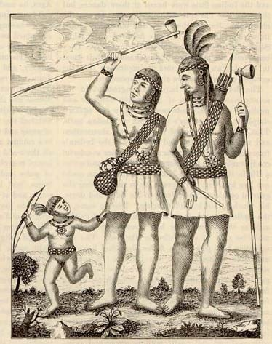
DIVERSITY OF NATIONS SECTION - ALGONQUIANS
The Lenape:
The Grandfather Nation of New York
Manhattan. Canarsie. Rockaway. Whenever you say these place names, you are speaking a language called Munsee. It belongs to the Lenape, a nation that rose from New York City long before Europeans arrived. “Lenape” means “real human beings.” Another name for them is the Delaware.
Native nations call each other by family terms, and many nations who speak Algonquian languages believe that they are descended from the Lenape, so they called them “the Grandfathers.”
The Lenape are the Grandfathers of New York.
Lenape Indians, 1702
Lenape people displayed tools of diplomacy—long-stemmed pipes and wampum belts—in this image of them by a Swedish author, Thomas Campanius Holm.
15

Slide 16
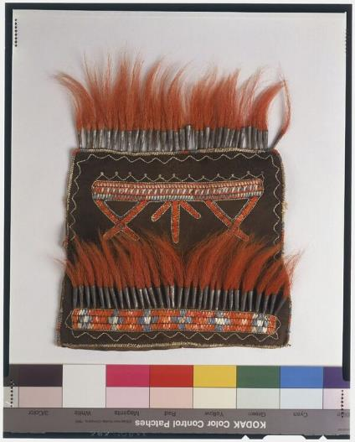
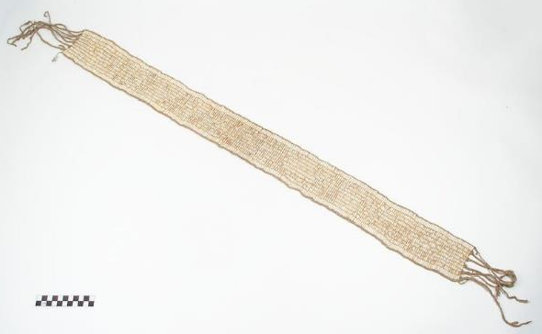
DIVERSITY OF NATIONS SECTION - ALGONQUIANS
Manhattan was an ideal location for trade and interaction. From here, the Lenape could go up the river, up the sound, and north or south along the coast. Diplomacy was the way the Lenape kept their relationships strong. They were the mediators and peacemakers of the Algonquian world. Maintaining balance was a central part of their art and philosophy, and still is.
Pouch, 1760-1800
To the Lenape, nature is a balance of opposing forces, symbolized by the colors red and black. The X motifs also represent intersection and balance. This bag is made of black-dyed deer skin decorated with red-dyed porcupine quills and deer hair.
Wampum belt, 1800-50
Lenape diplomats used woven belts of white wampum beads to convey a message of peace. This one was still being used in 20th-century Oklahoma by Lenape Chief Charlie Elkhair.
16

Slide 17
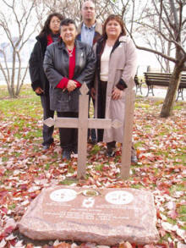
DIVERSITY OF NATIONS SECTION - ALGONQUIANS
Lenape Today
Today, Lenape people have communities in Oklahoma, Ontario, Wisconsin, New Jersey, Delaware, and elsewhere—but still feel a connection to their ancestral homeland in New York.
Lenape visitors at Ellis Island, 2003
A Lenape delegation participated in the reburial of their ancestors at Ellis Island.
17

Slide 18
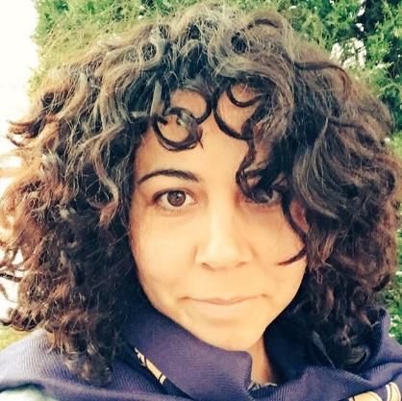
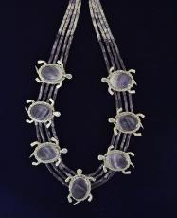
Diversity of nations section - algonquians
Unkechaug:
Wampum Makers
Lydia Chavez (Unkechaug)
Jewelry Designer and Businesswoman, 2015
My name is Lydia Chavez, and I am from the Unkechaug Nation of Long Island, New York. Our homeland is on the Atlantic coast. Since 1701, we have lived on a small portion of our territory called the Poospatuck Reservation.
Like my ancestors did for centuries, I make wampum beads. The word “wampumpeake” means a string of shell beads that speak. Wampum is a medium of alliance, memory, and truth.
My pieces embody aesthetic beauty and great historical value. My goal is to restore the significance that wampum once held while reinventing it with an original and contemporary twist.
Lydia is part owner of Wampum Magic, a company that produces wampum beads, jewelry, and other accessories

Slide 19

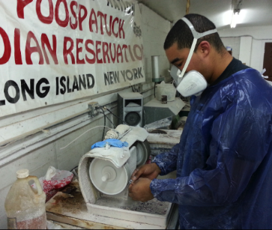
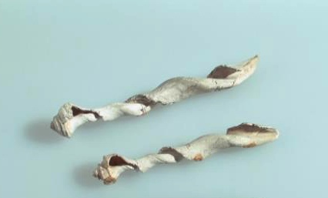
Diversity of nations section - Algonquians
      Wampum comes in two colors – purple made from the quahog clam and white made from the whelk shells. We consider wampum to be alive as it comes from the living ocean. My Unkechaug people have helped to restore wampum’s original meaning as a strong and empowering cultural messenger. Native nations trade wampum for diplomatic and sacred reasons.
Wampum Magic factory, 2015?
Today, Unkechaug workers make wampum using mechanical grinders and other tools. Chief Harry Wallace says that a person making wampum must be in a healthy state of mind, or the beads will shatter.
Shells being made into wampum, 1600-1700
The first step in making white wampum was to carve away all but the central spiral of a whelk shell. These were found by archaeologists in Staten Island.

Slide 20
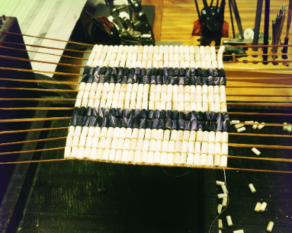
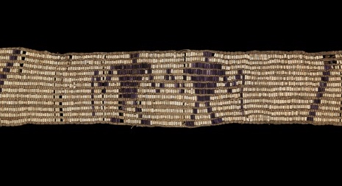
Diversity of nations section - Algonquians
      Wampum has been characterized as one of the original forms of currency used in the United States. Early Dutch and English settlers adapted wampum from coastal Algonquian peoples as an exchange system during early settlement times. The Europeans valued wampum differently – using it more like money – than our people who saw it as a way to transmit meaning.
Wampum belt loom, 2016
At Wampum Magic, wampum belts are still woven on hand looms. This one will be a replica of a famous belt named the Guswenta, or Two-Row wampum belt.
Wampum belt, 1600-50
This historic belt conveyed a message of alliance. Purple beads are associated with tension, white with peace. The two colors show the balance of natural forces.

Slide 21
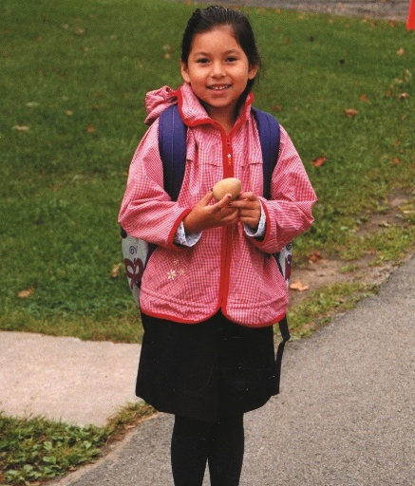
Diversity of nations - Haudenosaunee
The Haudenosaunee:
Confederacy of Nations
Nya weh skannoh (nya-way-skanoh), or Greetings! My name is Angel and I am Seneca. I am Heron clan. My people are one of the six nations of the Haudenosaunee (hoe-dee-no-sho-nee) or Iroquois Confederacy.
I live in upstate New York, and in many ways my life is like yours. But because I am Seneca, I also belong to a nation that has its own culture and government. My people have an ancient history that is very important to me today.
One of the most important events that shaped the Haudenosaunee was the creation of the Great Law of Peace. The Great Law of Peace created the Haudenosaunee Confederacy and directs us how to run our government.
Angel (Seneca)
Angel grew up in the new, reestablished Seneca community of Ganondagan. She is the first child to grow up there in 300 years!

Slide 22
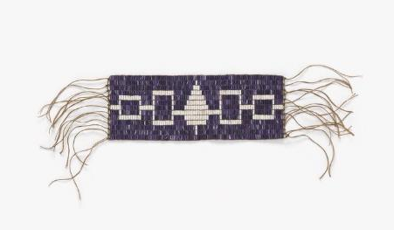
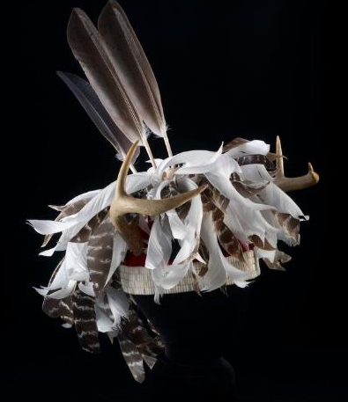
Diversity of nations - Haudenosaunee
The Haudenosaunee Confederacy is a union of six independent nations that live in upstate New York. Each nation governs itself internally, but they come together to make decisions that affect all of them. The original members are (east to west) Mohawk, Oneida, Onondaga, Cayuga, and Seneca; the Tuscarora joined in 1722.
Hiawatha Belt (replica), 1990-2010
The design on this wampum belt shows the original members of the Haudenosaunee Confederacy, like the U.S. flag shows the original 13 colonies. A tree of peace represents the Onondaga. The original belt dates before 1722. The Confederacy presented this replica to Senator Daniel Inouye.
Gustoweh, 2009
In the Grand Council of the Haudenosaunee Confederacy, the chief of each nation wears a unique emblem of office called a Gustoweh, a headdress. This one, made by Skahendowaneh (Jake) Swamp, is for a Mohawk representative.

Slide 23
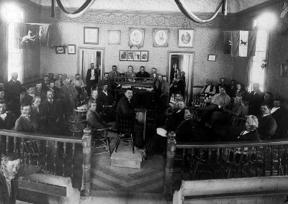
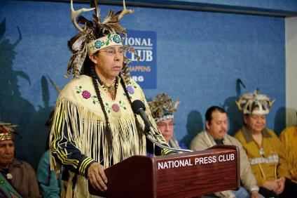
Diversity of nations - Haudenosaunee
The Haudenosaunee system of government has been in continual existence from ancient times to today. The fifty chiefs making up the Grand Council still bear the names of the original founders.
Tadodaho Sidney Hill and Grand Council members, 2012
The Grand Council keeps old traditions alive, but they also lead on issues vital to the people today. Here, the council leader who takes the ancient title of Tadodaho spoke at the National Press Club in Washington when appealing a legal decision on Onondaga land rights.
Grand Council meeting, 1890
After the American Revolution, the Haudenosaunee Confederacy kept going even though the border between Canada and the U.S. divided them. This photo shows the Grand Council meeting in Canada.
23

Slide 24
Diversity of nations cultural practices
WHAT IS APPEALING:
Emphasis on continued traditions – Several liked how this section communicates the continuation of native peoples’ heritage and traditions and said it will help dispel students’ misconception that native peoples are “extinct” through:
  Presenting past and present native artifacts and ceremonies side-by-side (e.g., wampum belts, Grand Council meetings)¹
  The “flow:” providing “background” on a tribe, examples of older customs, followed by material on “today”
Seeing contemporary native peoples – Several said the materials “came alive” from the pictures of contemporary native peoples. They felt students would immediately identify with the first person narratives (especially Angel, who “looks like them”) that provide an “access point to history.”¹
Notes:
Two also liked that the materials emphasize multiple perspectives on familiar objects and/or traditions; for example, that wampum is “more than money.”
One, for example, said that when students see “real people” they think “that could be me,” which overall would encourage their thinking and discovery around these topics. Another explained that her students always connect more to first person narratives, which help them “feel that identity.”

Slide 25
Diversity of nations cultural practices
CONCERNS:
Grand Council – A few said these materials would be “tricky” to teach and doubted fourth grade students could understand nuance related to distribution of power.² Additionally:
  One said the black and white photos of Grand Council members do not “jump off the page” so they will not interest students.
Interactivity – A few hoped this section would include “hands-on” or “experiential" elements that will help students “digest, process, and relate [the materials] to other things;” a few added that students “don’t just want to read.”¹
Teaching about unfamiliar tribes – When probed, none were concerned about teaching about unfamiliar tribes because teaching unfamiliar topics is “part of being a teacher.”³
Notes:
Suggestions of “experiential” activities include making and/or holding wampum belts or watching videos depicting the wampum-making process.
One teacher, for example, said the topic would be “difficult” to approach with fourth graders– “the [Grand Council] continues to meet but the United States supersedes them and the Grand Council is like a club with less power… I think they could comprehend it but I think that it could be a more tricky topic to approach.” Another said the topic was “less concrete and accessible” and “doesn’t apply to fourth graders” as much as “kids [Angel] and making jewelry.” Still another shared similar concerns, but suggested relating the Grand Council to her class’ morning meetings to help them understand the core concepts: “The Grand Council may be over their heads, but we come together every morning at school to set goals– if we’re meeting them or need to change them. So that compares, what’s best for the tribe or nations… they can relate to that.”
(What, if any, concerns do you have about teaching your students about tribes you don’t normally teach?) “Before you teach something unfamiliar you school yourself, do research, draw up lesson plans, find an interesting way to implement it, and create things that will facilitate learning and [students’] own discoveries. That’s part of being a teacher.”

Slide 26
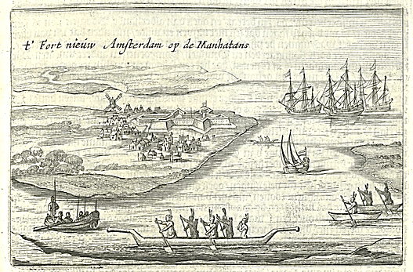
Wealth of nations section
The Fur Trade
When the Dutch first arrived on the Hudson River, they were looking for trade, not conquest or settlement. Native trade networks already existed, and the Dutch soon benefitted from them. Native people seized the opportunity to channel their own products to the Dutch in return for the manufactured goods of Europe.
T’Fort Nieuw Amsterdam op de Manhatans, ca. 1626-28
Native canoes and European ships crowded around the tip of Manhattan in this 1651 print, showing the nature of the trade the Dutch came for.

Slide 27
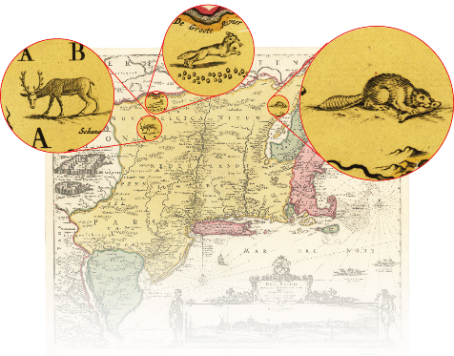
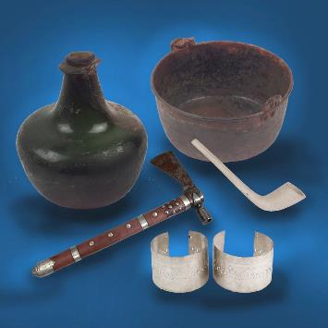
Wealth of nations section
Two economic systems came together in the fur trade. Native people produced goods based on their natural resources. The Dutch sold them manufactured articles and imported luxuries. The mercantile system increased the power, wealth, and empire of the Netherlands and brought global wealth to Native nations of New York.
Game animals, c. 1650
The main products the Dutch wanted were the processed pelts of beavers, bears, foxes, deer, minks, fishers, and other fur-bearing animals. These engravings are from Nicolaes Visscher, Novi Belgii Novæque Angliæ, the most influential Dutch map of New York.
Trade goods, 1600s-1700s
Merchants shipped in goods from all over the world—Italy, England, Brazil, India, China—to be purchased by Native people of New York.
27

Slide 28
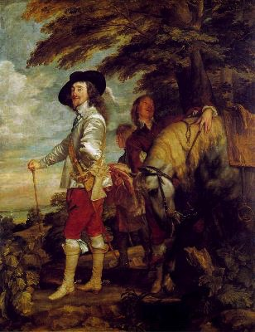
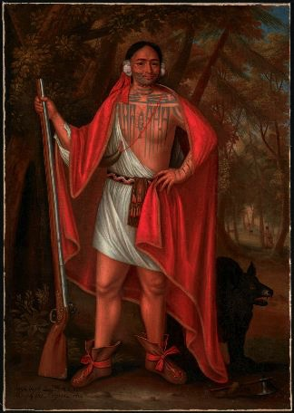
Wealth of nations section
Trade transformed both sides. Soon Europeans wore the furs of North American sables, ermines, and minks, and beaver felt hats. Native Americans wore the cloth, silver, and beads of Europe, and enjoyed using copper pots and scissors. Those who benefitted from trade felt richer than before.
Charles I at the Hunt, 1635
The King of England showed off his beaver felt hat in this portrait by Anthony Van Dyck.
Sa Ga Yeath Qua Pieth Tow (baptized Brant), King of the Maquas, 1710
This Mohawk chief showed off his trade musket and cloak in this portrait painted in London by John Verelst.
28

Slide 29
Wealth of nations section
WHAT IS APPEALING:
Benefits of trade and cultural exchange – Most liked this section because it emphasizes how trade immensely benefitted both Europeans and native peoples. More specifically:
  A few suggested this section communicates positive messages on cultural sensitivity and diversity to students. For example, a few said the side-by-side images of “Charles I” and “King of the Maquas” show native peoples and Europeans portray “showing off what they got with pride” rather than “looking down on each other.”¹
  Native peoples’ agency – A few others liked that both text and images emphasize native peoples’ agency in shaping trade with Europeans.²
Notes:
One, for example, said “It’s great to show neither side looking down on each other. Just each side showing off what they got with pride, and that it’s okay to share culture.” Another explained that this sections shows “…natives with other cultures and how they get along. And that they can coexist. So cultural sensitivity.”
Two, for example, said the phrase “native peoples seized the opportunity” communicated this idea (“it gives them credit that they accept the deal for trading rights and [shows] there’s evidence of them working together; they weren’t stupid.”) Another similarly said he “loved” the 1651 print because it shows native peoples “on the water as equal partners with [European] ships.”
Concerns about this section (listed below) were idiosyncratic:
Trade among native nations– One wished this section expanded more on native trade networks that existed prior to Europeans’ arrival– “make it more about them, not just when Europeans are involved” – “This isn’t talking about trade between nations where there’s a lot they traded among them. It might be nice to see that they already traded with each other and that those trades were part of what they did, and they Europeans came and they traded with them. So make it more about them, not just when the Europeans are involved.”
Role of waterways – One wished this section included a map so students could better understand how waterways and geography influenced trade (something she already discusses in her classroom).
Everyday life – One suggested including “drawings of towns and villages” to ground this section in everyday life, which might make the concept of trade more “relatable” for students. While this teacher did not expand on this idea, presumably he is interested in discussing how traded goods were used in everyday, in order to make the broader concept of trade more relatable and tangible to fourth grade students.
Trade of animal goods – One said this section suggests native peoples only used animals “as a commodity” and said his students would likely “ask questions” about animals’ spiritual importance. “My students would ask questions about how the animal spirit was part of their lives. [This is] making it look like they just use them for trade.”

Slide 30
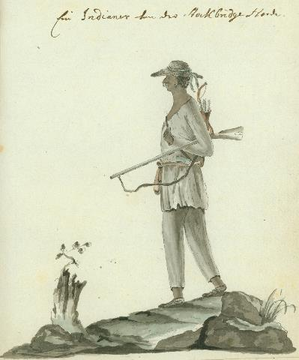
Power of nations section
The Stockbridge Militia:
Ambushed in Battle and at Home
The American Revolution changed the world forever, establishing an independent, democratic nation. Native nations strategically decided to ally either with the British or the Americans to defend their own traditional homelands.
Most of the Stockbridge Mohican chose the American side because the British displaced them from their prime lands in the Hudson Valley. They had relocated to a Christian mission in Massachusetts’ Berkshire Mountains, trusting white missionaries for protection. The Stockbridge thought that their service would secure peace for their own community.
Ein Indianer von der Stockbridge Horde (An Indian of the Stockbridge Tribe), 1778
A Hessian soldier fighting for the British, Johann von Ewald, painted a Stockbridge soldier he faced in battle in the Bronx.

Slide 31
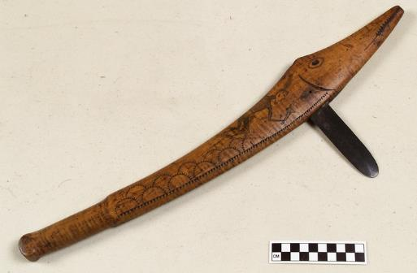
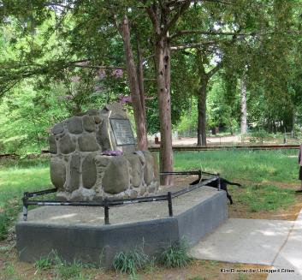
Power of nations section
On August 31, 1778, the Stockbridge troop under Abraham Ninham was tracking British movements on Mile Square Road, now Van Cortlandt Park in the Bronx. The British ambushed them, killing seventeen of the finest warriors.
War club, ca. 1750
This Mohican club is in the shape of a sturgeon, a Hudson River fish that may have reminded the club’s maker of a lost New York home.
Mohican Memorial, 2016
This monument in Van Cortlandt Park marks the mass grave of the Mohicans killed fighting for America in 1778.

Slide 32
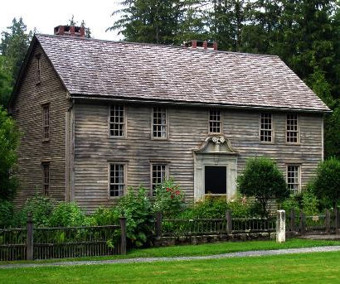
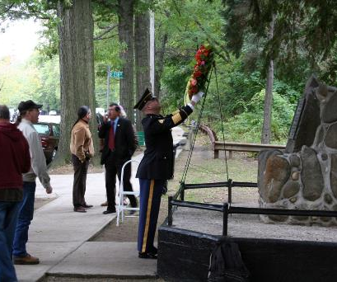
Power of nations section
Instead of supporting them, the white missionaries back in Massachusetts seized Native homes, leaving the soldiers’ families without land. While the Americans won independence, the Stockbridge Mohicans lost theirs in the Revolutionary War.
Stockbridge Mission House, 1739-42
Stockbridge was an experimental community where Christianized Mohican, Lenape, and Wappingers as well as whites would live and farm side by side. The only building from that era to survive is the home of the missionary.
Honoring Mohican Patriots today
The Stockbridge Munsee Band of Mohican Indians were removed to Wisconsin 200 years ago. Here, Mohican veterans returned to New York to honor their ancestors who died in the American Revolution.

Slide 33
Power of nations section
WHAT IS APPEALING:
Choosing sides – All liked the emphasis on the difficult choices native people had to make after the arrival of Europeans, and imagined using this section to discuss making difficult choices with their students.¹ However:
  Most felt the story of the Stockbridge Mohicans primarily conveys a sense of “loss and betrayal” and a “shift in power” away from native nations, and that consequently, the title “Power of Nations” does not adequately reflect the section’s content.²
War Club – A few thought this “beautiful and powerful” object would feel “native” to students and be a favorite because “kids love weapons.”
Familiar places – Two suggested the photograph of the Van Cortlandt Park memorial might appeal to students because the park is a familiar place; one said it would put history at students’ “fingertips.”³
Notes:
One teacher, for instance, imagined conducting a discussion with students on how native peoples chose sides in the Revolutionary War (“For the most part [we’ve had] peaceful trading, but now we’ve got a problem– whose side do we choose?). Another said the Stockbridge Mohican’s story could be used to help students think about relationships in their personal lives– “It demonstrates betrayal, when they put trust and faith in a friend, and it connects to their own lives and how they see their relationships. You get involved in something that you shouldn’t because someone talked you into it, and you lose in the end.”
For the most part, teachers agreed after the Wealth of Nations section, this section conveyed a distinct “loss of” or “shift in” power amongst native peoples. One, for instance, said “It’s interesting that it’s called ‘Power of Nations’ [because] it doesn’t reflect that– it shows British and Dutch power.” They agreed that phrases such as “the Stockbridge Mohicans lost their [independence] in the revolutionary war” helped convey this feeling. One suggested a better section title might be “Change of Nations” to highlight the transformation of and difficult choices faced by native nations during this period. Overall, teachers did not seem off-put by this sense of “loss of power” or hesitant to talk about it with their students; rather, they simply seemed to feel a disconnect between the section title and the message conveyed by the content.
“Some might be from here [Bronx] and they’ll connect to the parks where they play. They might want to go back and see what monuments are in their parks. It puts history at their fingertips.”

Slide 34
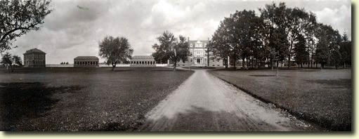
survival of nations section
Thomas Indian School
From the beginning, the United States tried to use forced assimilation to wipe out Indian culture. To the government, “civilization” meant Christianity, English language, and Western values. A key part of its “civilization” program was the boarding school. All across the country, Native children were forcibly removed from their families. In New York, the most infamous boarding school was the Thomas Indian School.
Thomas Indian School, c. 1910
Almost 2,500 Indian children attended the Thomas Asylum for Destitute Children - later called Thomas Indian School - from 1855 until it closed in 1957.

Slide 35
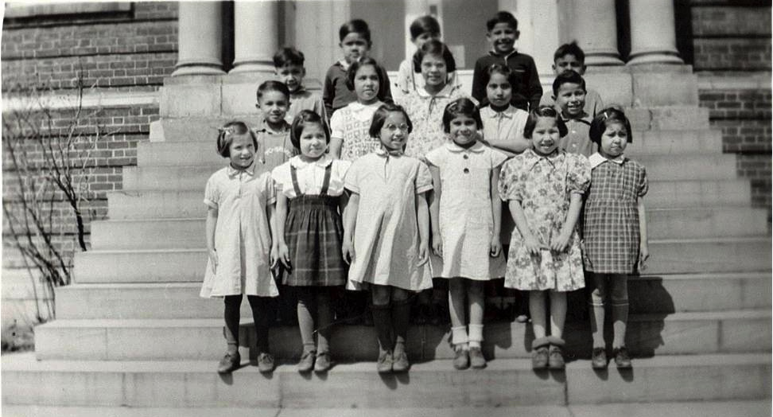
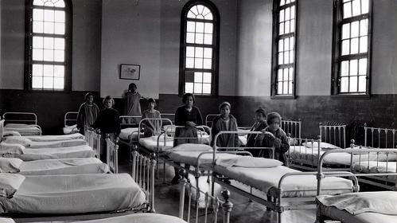
survival of nations section
Marlene Bennett went to Thomas Indian School at five years old. For the next ten years she had almost no contact with her family. She was raised in the strict discipline of a military-style institution—no hugs or kisses, no terms of endearment. Years later, she learned that her aunt tried to adopt her, but the school refused.
Girls’ dormitory, Thomas Indian School, 1930s
Growing up in a dormitory instead of a house, Marlene learned to make beds in a military style, and later required her children to do the same.
Girls at Thomas Indian School, 1940s
Marlene Bennett is second from the left in the middle row.

Slide 36
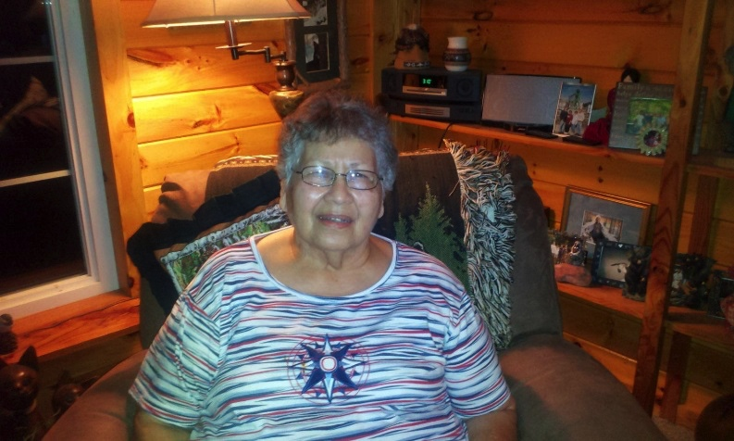

survival of nations section
Marlene’s family still copes with the legacy of trauma. Her daughter Lori was raised with the same military discipline and lack of affection that her mother experienced, and did not find out why until she was an adult. With other children of boarding school survivors, she now works to heal and revitalize the Seneca community through truth and reconciliation.
Lori Quigley, Marlene’s daughter, 2016
Lori has dedicated her life to remaking the education system to one that helps, not hurts. “We lost family—the whole sense of it—and are trying to regain that again,” she says.
Marlene Bennett Johnson, 2012
Marlene’s daughter describes her as a strong and independent person who taught her children to rely on no one but themselves. Marlene is now sharing her story with her family.

Slide 37
Survival of nations section
WHAT IS APPEALING:
Emphasis on trauma and survival – All appreciated the museum’s effort to illustrate the “rejection” of native cultures by the United States government, primarily because it provides students evidence and context for why we see so few “living [native] cultures” today.¹
Marlene’s story – All agreed this section is the most “emotionally powerful” because it includes a “real,” “truthful” story that “connects directly to your heart.” Most felt their students would be able to engage with Marlene’s story and enthusiastically imagined how they might use it to stimulate discussion.²
Notes:
However, one felt the phrase “From the beginning the United States tried to use forced assimilation to wipe out Indian culture” was a “really strong” statement for which the prior materials did not provide evidence, and that it felt like a “big shift” in tone from the previous sections.
Teachers alluded to a few factors that made this section feel “emotionally powerful.” One, for instance, said “when children are involved in the photos it really gets at your emotions– I think it should be there.” Another said she might ask students to compare and discuss how their school is run with the harsh, military-like environment of the Indian schools (“it’s not that nurturing environment [students] are used to… we would definitely be able to talk about it”), and another brought up how the story affects people still alive today (“it is real, these people are alive, and they open up by showing a 5-year-old taken away from home. You can tell students to imagine it– it hits home.”) Still another said that children could access and connect with the “familial love” in this story (primarily conveyed on the last slide, which discusses Marlene and her daughter.)

Slide 38
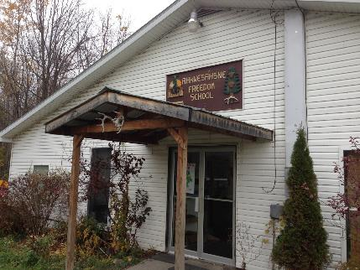
Pride of nations section
Speaking to the World Again:
Akwesasne Freedom School
For nearly two centuries, American policies and practices worked to erase Native culture and identity. Schools taught generations of Mohawk children that their languages, ways of life, and histories should be silenced.
In the 1970s, Mohawks joined the movement for American Indian rights. Restoring culture and language topped the list to bring back pride. In 1979, a group of Mohawk parents created the Akwesasne Freedom School. They used Mohawk language and cultural immersion to teach all subjects.
Akwesasne Freedom School, 2014
Today, the Akwesasne Freedom School offers year round, full day classes for grades pre-k to grade 9 to ensure the continuation of Mohawk culture.

Slide 39
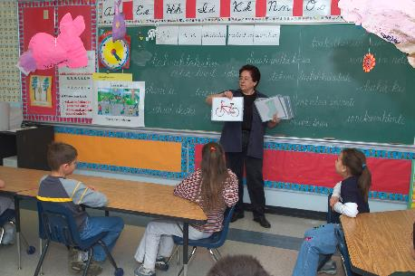
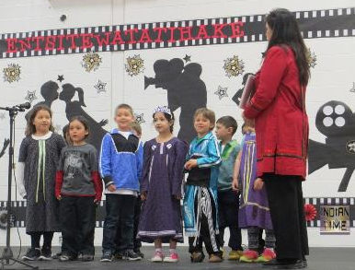
Pride of nations section
Evidence shows that the children who go through the eighth grade in Mohawk immersion perform better in the public high school – even in English – than their peers who go to public school. Today there is an entire generation more fluent in language and more confident in culture than their parents.
And they have something significant to say.
Tentewakieronnion Language Program, 2015
In this annual event, students perform skits entirely in Kanienkeha, the Mohawk language.
Class at Karonhianonhnha Ionterihwaienstahkhwa
Students learn Kanien’keha at Karonhianonhnha Ionterihwaienstahkhwa, a Mohawk-language immersion school for preschool to sixth grade.

Slide 40
Pride of nations section
WHAT IS APPEALING:
Celebrating culture and diversity – All liked this section because it sends a broader message that native peoples are “not just surviving, but thriving.”¹ They named a few ways their students might relate to the native students in the Freedom school:
  Learning that native students are bi- or multi-lingual, just like them²
  Seeing photographs that show native students’ classrooms look “no different” than their own
  Undergoing similar struggles and “resilience”³
Curiosities – One wondered about the “significant” things native students have to say, while another wondered how older generations are “reclaiming their pride.”⁴
Notes:
They said seeing students perform skits in their native languages and the phrase “they have something significant to say” primarily conveyed these ideas.
One, for instance, said “In a country and city where we speak so many languages, I like how they can access and connect to this. Even if they aren’t bilingual, the world speaks [many languages] and they hear them.” Another, who teaches deaf students, said her students would be able to personally relate because many of them speak a different native language (ASL) than their parents (English)– “My kids would identify with them because they use sign language, so they would know about having a native language different than what their parents use.”
However, this teacher discussed this more in terms of being “put down” in a single instance, like failing a test, rather than broader cultural or societal struggles– “Being put down, you can come back, and the children can use that in their own lives. On things that happen to them– they don’t do well on a test or whatever– there is such a thing as resilience. Strive for what [they] want, and they can get it.”
The first of these teachers wondered if the exhibition might include video interviews with native students so visitors could learn more about what the “significant” things these students have to say. The second teacher wondered if this section could better balance the ways both younger and older generations of native peoples are “reclaiming their pride” in their cultures (though he agreed his students would be able to relate to children – “It’s great to see children and what they’re doing, but I want to see the adults reclaiming their pride in native nations too. What else can you see in the communities in New York state to show it’s not just the children, but the whole family of nations?”

Slide 41
Overall FEEDBACK
EXHIBITION OUTCOMES:
How the past shapes culture today – All said the exhibition materials will convey how the past shapes culture today because they highlight traditions passed down though generations (e.g., making wampum) and provide examples of how natives’ heritage practices are still in use today (e.g., Grand Council meetings).¹
Contemporary native peoples’ lives – All enthusiastically said the exhibition materials will help students understand that Indians are contemporary peoples, and they imagined different ways they might use the materials as a jumping off point for discussion.²
Notes:
For example, one explained that “In the snapshots of how all these people are living today we get to meet ancestors from different nations and see how it’s all passed down through generations, from the beads to the schools to the Seneca girl.” Another added that this outcome was emphasized by the “overall flow” that came “full circle” in terms of emphasizing diversity– “(What, if anything, prompted you to think about how the past shapes “culture” today?) “Trade, and in a roundabout way, diversity. At the beginning we’re talking about the Dutch and the English trading [with natives] on an even level, and then things transpired, and now we’re coming back to having…. they’re living and beginning to thrive and diversity is being more accepted and celebrated an honored, so it’s coming full circle.”
One, for example, imagined linking Marlene and her daughter’s stories to the broader concept of oral tradition– “[Their story] could be linked in the classroom to oral tradition. We all have heard family stories.” Another added that students will be able to identify with “how we borrow ideas from other cultures and adapt them. Still another said seeing contemporary peoples in the exhibition would “inspire [students’] curiosity and push them to discover more on their own.”

Slide 42
Overall feedback
EXHIBITION OUTCOMES (cont’d):
Diversity and complexity of New York’s native peoples – Teachers agreed that the exhibition materials hint at this, but generally felt they could do much more to drive home this point; perhaps by elaborating on 1) goods made by native peoples (other than wampum), 2) the complexity of early native trade networks, and/or 3) the differences in how various native families, villages, and tribes were/are governed.¹
Shaping New York over time – Most felt this outcome came across, to an extent, especially in the Wealth of Nations section. However, they desired more concrete examples of contributions made by specific native tribes to peoples, places, and entities in modern New York.²
Notes:
Comments include “I want to know more about other things they made, not just wampum;” “I would like to see more than just artwork [because] that’s not all that differentiates them. How are the villages, government, and families set up? Show the distinctions;” “It says they had established trade amongst themselves, so what [were] they trading?”
Their tone around this idea was generally positive, and they explained that while they came away with a general sense of how native people have shaped New York, they were eager to learn more. One, for instance, alluded to Mohawk construction workers “If they could include more contributions the native tribes have had… we talk [in the classroom] about construction workers who came to wherever the jobs were, and look what we have now. We have iconic photographs.”

Slide 43
Overall FEEDBACK
Overall, teachers were excited about the exhibition and said it would enhance students’ knowledge of Native Americans, foster discussion, and inspire curiosity. However, they shared a few concerns:
Too much information – Several agreed the materials felt like “a lot” and worried it would require a lot of time to cover these topics “cohesively and coherently.” A few emphasized the importance of doing “prep” work.¹
Concept of “nation” still unclear – A few remained unsure about how the term “nation” is defined in this exhibition.²
Conveying “struggle” to preserve traditions – One suggested the museum include “a little more struggle” in confronting how native traditions have “stood the test of time” (evoked in the introduction text); others agreed.³
Notes:
A few, for instance, said it would be helpful if the museum provided online videos featuring contemporary native peoples– “If the videos or photos have artifacts or people in them… student will be excited to come here and [will] get excited that they saw it [in] the video.”) Another similarly asked for “videos of storytellers” because “it’s a great tradition and gives you a sense of the culture[s].” A few others asked for “graphic organizers” and “packets to pre-teach” that feature questions about comparing and investigating cultures (“language, culture, appearance, values”) and/or activities to do in the gallery, such as drawing artifacts or completing a scavenger hunt.
“The definition of nation… what does it mean in the context of this exhibit? [others nod and agree] ‘Nation’ to someone today means different things, so [you need to] clarify.”
As he put it, “The introduction says [their] customs have ‘stood the test of time’ [but] it doesn’t talk about the struggle of doing that. If you’re going to bring that along, you have to decide how much struggle will be [included]. I think we suggest a little more struggle. [others nod]”

Slide 44
Walk-in visitors

Slide 45
Participant characteristics
Of the 37 visitors who participated in testing:¹
  Gender: More than one-half are female and about one-half are male.
  Age: Participants range in age from 18 to 77 years; the median age is 30.
  Residence: Most are U.S. residents; one-quarter are foreign tourists.² About two-thirds reside in New York.
  NMAI-NY Visitation: Many are first time visitors; about one-third are repeat visitors.
  Group Type: Most visited in adult-only groups or alone; one group visited with children.
  Identity: A few identify as Native American.
Notes:
The sample of walk-in visitors is extremely similar to the sample from the first round of visitor testing. The few notable differences are:
This sample trends younger (median age of 30 years v. 50 years), but the overall age range is similar.
This sample includes slightly more New York residents than the last round.
This sample includes a few visitors who identify as Native American; last round no visitors identified as Native American.
2. Foreign tourists are from Brazil, China, and France.

Slide 46
Testing scenario
22 groups of walk-in visitors participated in testing.
Walk-in visitors were shown a condensed version of the materials shown to focus group participants.¹
  Includes Introduction Text, Diversity of Nations, Wealth of Nations, Power of Nations, Survival of Nations, and Pride of Nations.
Participants were given a brief overview of the exhibition and asked to view the introduction text, then the rest of the prototypes, at their own pace.²
Each group received either a calendar or exhibition catalog.
Notes:
Materials shown to walk-in visitors are included in this presentation, for easy reference.
RK&A alternated versions of the introduction text during test. One-half of testing groups saw Option 1 as part of the mock-up, while the other one-half saw Option 2. In all cases, participants were shown the alternative version and asked about it during the interview, in addition to commenting on the version they first saw as part of the mockup exhibition.

Slide 47
Baseline knowledge
WHAT COMES TO MIND WHEN YOU THINK OF THE NATIVE PEOPLES OF NEW YORK?
No knowledge – Several said nothing came to mind or that they “don’t know much” about native peoples of New York.
Way of life – Several said they think of places that Native Americans have lived, their food, homes or camps, artwork, trade, and dependence on the Hudson River.
Names – Several listed familiar places with Indian names, such as Montauk and Canarsie, or said they live in places like Long Island with an awareness of “their history because it was linked to names we would hear.”
Displacement – A few said they think of “lost identity” or “forgotten” history in relation to colonialism.

Slide 48
Most interesting/enjoyable aspects (overall)
When asked to think about all that they saw and read, visitors shared aspects they liked the most:
Personal stories – Many said they enjoyed hearing about the Nations through personal stories because it “puts faces and names to an entire culture, makes it personalized and relatable.”
  Several were particularly interested in Lydia’s wampum jewelry as a demonstration of the “ingenuity of the Unkechaug.”
  Several said the Thomas Indian and Akwesasne Freedom schools specifically prompted them to think about assimilation and survival.¹
Diversity of Nations – A few said they liked both the map and gallery because it made them think about the “difference between the contrast of the nations.”
New York – Three said they liked that “history that is relevant to the state” is highlighted in the materials.
Notes:
1. “Honestly I loved the school aspects. Showing the forced assimilation that happened. I do wish there was more detail on what happened to those children and then the end result on how we're trying to, not fix it, but kind of change the whole mentality of it. I think that brought in what happened to the children that has resonated to people today. I remember coming here before and there used to be a school that you can walk through, you could see that, seeing that was always very powerful, the idea that colonization never stopped.”

Slide 49
Exhibition introduction
Option 1 | This is an exhibit about living people. There are no extinct cultures in this exhibit. The Native nations of New York still exist alongside all of the other nations on earth. The customs shown here have stood the test of time. They help Native people define themselves and how they fit into the world. New York gave rise to many of them. Come see how they began, what they endured to survive, and how they are rising again today.

Slide 50
Exhibition introduction
OPTION 1 – “This is an exhibit about living people…”
Many preferred this option. They named a few reasons, including:
Contemporary focus – Almost all said the phrases “living people” and “no old extinct cultures,” are appealing because they emphasize that Indians are “still here,” which they do not traditionally expect of civilizations featured in museums. A few said this made them think of how Indians “fit into the modern world.”
Emphasis on Native Americans over New York – Several said they prefer this version because the text focuses on Native people rather than New York. A few said this made the text feel more specific to the exhibition.
“Come see…” – A few said this phrase feels “inviting,” as if the museum is “bringing the person into the exhibit.”¹
Notes:
1. “I like how it says ‘come see how it began’ because when I think of Native Americans, it's always how they are displaced, murdered, etc. but never about how they started out, what their life was like before contact.”

Slide 51
Exhibition introduction
OPTION 1 – “This is an exhibit about living people…”
A few named aspects of Option 1 they dislike:¹
Museum voice:
  “No extinct cultures in this exhibit…” – One said this sentence was negative because it is “telling me what isn’t rather than what is.”
  Tone – One said the tone felt inauthentic and biased.
New York – One said this version doesn’t mention New York enough times.
Notes:
1. None said Option 1 was confusing.

Slide 52
Exhibition introduction
Option 2 | Nations have been rising from the place we know now as New York for millennia. Out of the place you now stand, Native people created diverse nations with unique cultures, long histories, and great contributions. New York has always been a nation-builder. Its economy and strategic position helped form the United States, fueled countries around the globe, and contributed to the expansion of democracy worldwide. Native New York is vibrant today, and Native nations rise again from this land.

Slide 53
Exhibition introduction
OPTION 2 – “Nations have been rising …”
Most said they did not like this version, for two reasons:
Does not emphasize Native peoples – Several said this version emphasizes New York rather than “focusing more on the people,” so that the “message about Native Americans gets lost.”¹
Not specific – A few said the text felt vague or generic.
“Where nations rise…” – One said this phrase is confusing for non-native English speakers.
Notes:
“[Option 1] focuses more on the people, not just New York. I guess that's why we're here, to learn about the people, not so much the city and the area. (What makes it seem like it is more about NY?) How many times it says ‘New York,’ out of the place you now stand, ‘New York is a nation builder.’ Always starts with the city.”

Slide 54
Exhibition introduction
OPTION 2 – “Nations have been rising …”
Several preferred this version because it emphasizes:
New York as a nation builder – A few liked this idea because “it speaks about the diversity and how native New Yorkers helped build this nation from the ground up.” One said she “forgot how New York was in such a strategic position…that it’s connected so many cultures together.”
New York focus – Two said this version was “more engaging for a New Yorker” because the first sentence is about New York.
Historical focus – Two said this version is “more about history” because it “shows the expansion of democracy.”

Slide 55
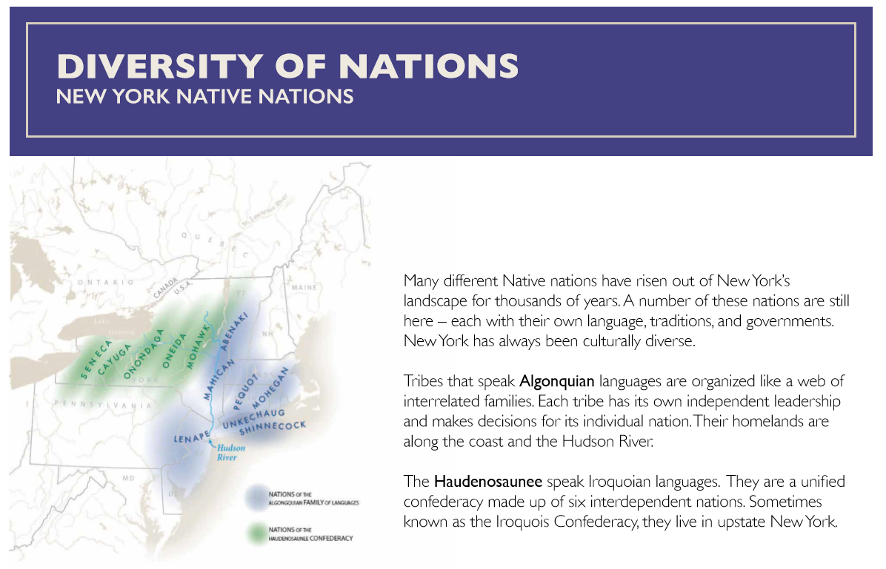
Diversity of nations map

Slide 56
Diversity of nations map
OVERALL TAKEAWAYS:
Names and location of Native New York peoples – All understood that there are two main groups of Native nations originally from New York, each comprised of many tribes. More specifically:
  Many said the text communicated that these groups are “diverse” because they have different ways of governing and speak different languages.¹
  A few said the number and names of tribes native to this region was new information.
  A few others thought about native trade networks after seeing the Hudson river on the map.²
Personal connections – A few were reminded of personal connections to upstate New York.³
Notes:
At this point, most of their takeaways around this idea were fairly general, but on message. For instance, (What thoughts or ideas did you have when you looked at the map?) “That they existed all over New York state. *That they were diverse, many, and different.” Others briefly mentioned differences in governance and language– “It’s interesting to see how they’re split up. They’re kind of grouped along with what language they speak. Sometimes you think of a bunch of different ones being independent, not a unified state.” One, by contrast, compared the number of native peoples and native languages in the New York region to her native Brazil– “I come from Brazil, and you have a very small number of [native] groups but an enormous amount of languages– 600,000 Indians and 250 languages. Here you have a larger population but fewer languages, so that is interesting that they were able to keep a large group together. Many nations but a few languages, that must make them stronger.”
One group, for instance, thought about “the connection to the culture and the land, and the area that they are all in. Some are closer to the river and some are further west. *It looks like they all branch off the two. ***They go off the line of the river and it acts as a trade network.”
One, for example, said s/he goes to upstate New York frequently but never thought “anything about the culture or where the names come from,” so was interested to learn more information.

Slide 57
Diversity of nations map
CURIOSITIES / CONFUSING ASPECTS:
Nothing – One-third said nothing was confusing.
Pronunciation – A few desired phonetic spellings of the terms “Haudenosaunee” and “Algonquian.”
Understanding tribes’ geographic ranges – A few shared difficulties encountered in trying to understand tribes’ geographic ranges using the map.¹
Complex language – A few said the text is complex and felt like “reading a textbook” and named words/phrases they did not understand.²
Nation v. tribe – One said there is a “disconnect” between how the terms “nation” and “tribe” are used in the text and desired clarification.
Time period depicted – One was unclear whether the map depicts historical or modern distribution of tribes/nations.³
Notes:
One pair of foreign tourists, for instance, said it was generally difficult for them to understand “where exactly” the map shows because they are not from the United States and are unfamiliar with its geography. Another was curious which tribes were/are located in New York City, but said it is difficult to understand this from the map. Related to this, one also asked why the sixth Haudenosaunee tribe (Tuscarora) is not pictured on this map and another wondered about each tribes’ modern-day population.
One foreign tourist (non-native English speaker), for instance, said she did not understand the terms “confederacy” and “family of languages,” while another pair similarly thought the terms “interdependent” and “unified confederacy” might be difficult for children to understand.
Primarily because the text first mentions that these tribes “still exist” but then mentions “their homelands,” so as a result it is unclear what period in time the map depicts.

Slide 58
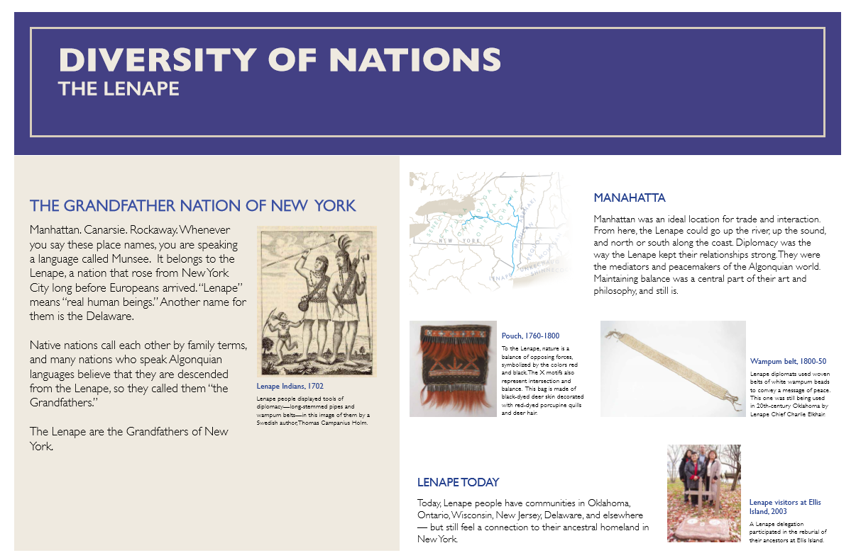
Diversity of nations

Slide 59
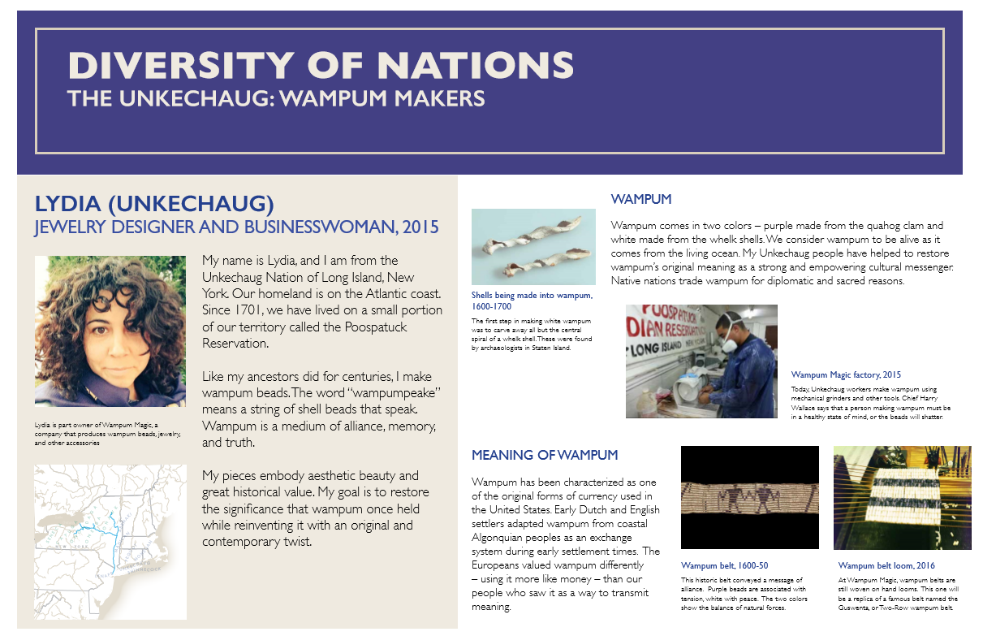
Diversity of nations

Slide 60
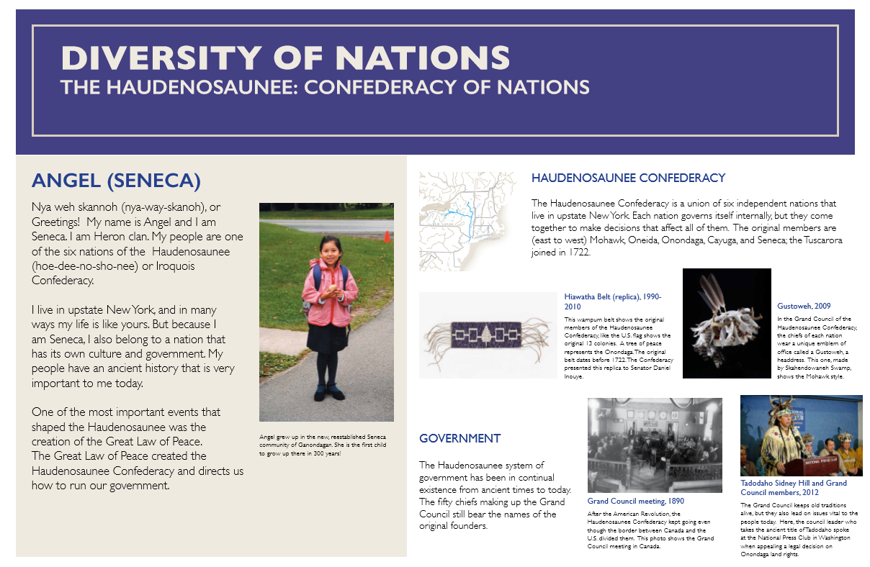
Diversity of nations

Slide 61
Diversity of nations cultural practices
OVERALL TAKEAWAYS:
Continued presence of native peoples – Many said the inclusion of contemporary people and stories (e.g., Lydia, Angel) in this section conveyed that native peoples are “still practicing their cultures;” one added that these stories made everything feel “relatable.”¹
“Grandfather nation” text – A few said it was “eye-opening” to learn that familiar places (Manhattan, Carnarsie, Rockaway) have Indian names.
Lenape diplomacy – One enjoyed learning that the Lenape were “the mediators and peacemakers of the world” and about their philosophy of “maintaining balance.”
Notes:
Some spoke about this generally, while others pointed to examples from the materials that conveyed this idea. A few, for instance, said it was “fascinating” to read about Lydia’s business, while a few others enjoyed viewing the Grand Council photographs and learning about modern-day Seneca communities through Angel’s story. A few also mentioned that native peoples today still practice their traditions but “look like” other modern people--- “(What thoughts or ideas did you have when you looked at this part?) How they look so different today. You have to change when the world changes. When you think Native Americans you look for a specific look, but obviously they look totally different today. *They look more modern.* They change as the time changes.”

Slide 62
Diversity of nations cultural practices
MOST INTERESTING OBJECTS/IMAGES/STORIES:¹
Lydia – More than one-half were intrigued by Lydia’s story, but the focus of their responses varied:
  Several wondered about process, design, and symbolism in wampum-making²
  A few were curious how Lydia sustains her business and who purchases wampum³
  Two are working artists so related personally
Grand Council materials – A few were interested in these because the text/photographs sparked questions about how native tribes are governed today, and how those governments “fit” into the United States government.⁴
Angel – Two were interested to learn that Angel is the first child to grow up in Ganondogan in 300 years, and were curious to learn more about this community.
Headdress and pouch – One each enjoyed viewing these “beautiful” objects.
Notes:
Note that participants were not asked to name specific objects, images, or stories they found interesting; rather, these findings emerged as participants shared their overall takeaways from this section.
A few, for instance, were curious to know more about what, if any, “rituals” exist in wampum-making and to see videos of the design process (especially of how the beads are shaped).
More specifically, they wondered who invests in the business, whether wampum is primarily manufactured for and purchased by tourists, etc.
One, for instance, was curious what decisions the Grand Council has to make today and about the problems they face, while another similarly wondered how many similar native councils still operate today, who is in charge (“who runs them?”), and the extent to which they have influence in Washington.

Slide 63
Diversity of nations cultural practices
CURIOSITIES / CONFUSIONS:
Nothing – One-half said nothing was confusing.
Wampum-making – A few shared confusions related to these materials.¹
“Disconnect” between history and contemporary stories – A few mentioned or alluded to this.²
Other “native” jobs – One wished the materials painted a “wider picture” of jobs held by contemporary native peoples.³
Tone of Angel’s story – One said this text did not sound “like a little girl was saying it” and wondered if her words were changed.
The remaining curiosities/confusions are idiosyncratic.⁴
Notes:
One said there is “no strict definition” of what is meant by the term wampum, so the concept feels “vague”– “I guess I understand more now but I never quite grasped what wampum was.” Another similarly said this section felt “hodgepodge, like a real mix of topics,” but did not expound. And, one was confused about process after viewing the pictures– how do the shells pictured (“Shells being made into wampum,” 1600-1700) become a belt (“Wampum belt loom,” 2016)?
One, for instance, said “It’s about what’s going on today in the different communities upstate. You go from history to contemporary, but it feels disconnected. I think there should be more emphasis on history before jumping to the present.” Along these lines, one suggested incorporating Angel’s story alongside the Diversity of Nations map since in her story she elaborates on the creation of the Haudenosaunee Confederacy, which is first evoked in the map text.
“I thought it was interesting, but I also thought that there were only two stories they were focusing on, and it doesn't paint a wide picture of the many types of life I'm sure they're living. The jewelry maker is nice but I'm sure there are many Native Americans who have jobs as bankers and nurses or whatever that's also as much part of native culture.”
Other idiosyncratic curiosities / confusions:
“The Lenape are the Grandfathers of New York” – One was confused by this phrase (“not defined very well”).
Gustoweh – One said it is not obvious from the image that a Gustoweh is a headdress and suggested changing the title to “headdress.”
Haudenosaunee Confederacy– One wondered when the original confederacy was formed.

Slide 64
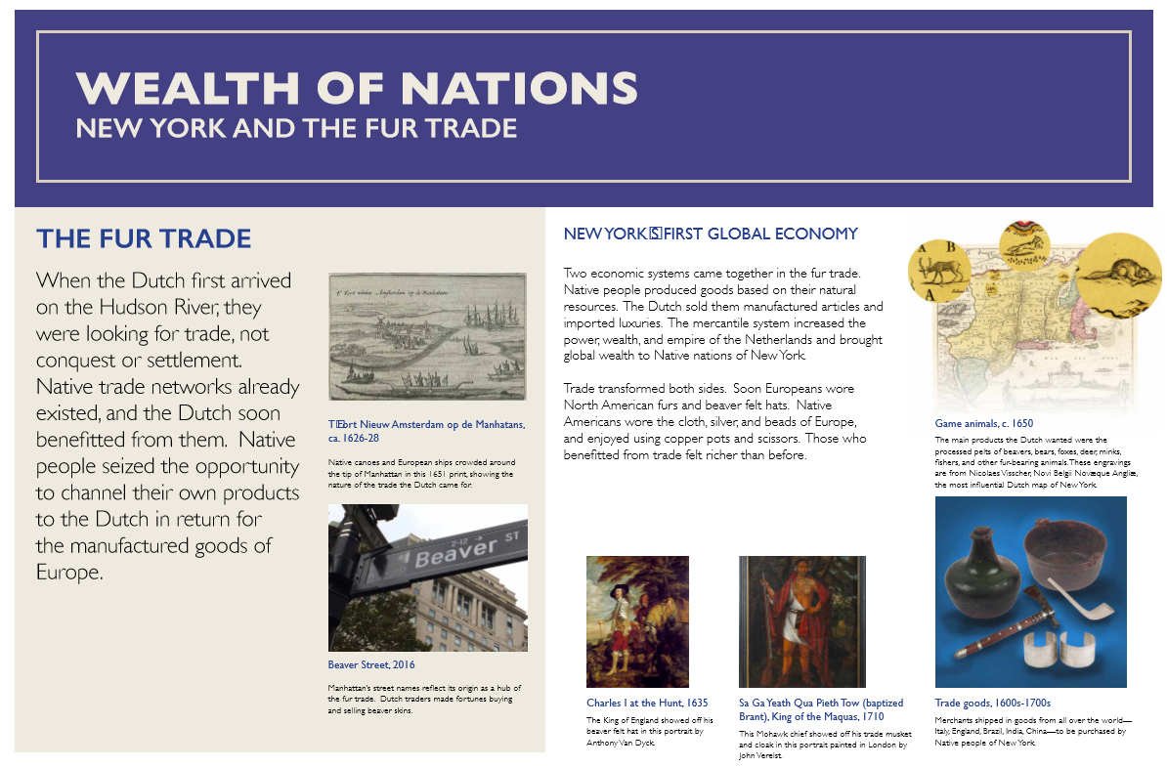
Wealth of nations

Slide 65
Wealth of nations section
OVERALL TAKEAWAYS:
Trade – Most said it was “fascinating” to learn about the “intense” trade that took place in early New York and how it “transformed” both the Dutch and native peoples’ ways of life. More specifically: ¹
  One-third said the artifacts made them think about motivations for trade.
  Another one-third discussed the relationship between New York’s native peoples and the Dutch; the majority perceived it as “positive” and mutually beneficial, but a few were skeptical of whether native peoples really “seized the opportunity” to trade with the Dutch. ²
Manhattan place names – Almost one-half were intrigued that these often stem from Manhattan’s origins as fur trade hub (e.g., Beaver St.).³
Portraits – A few enjoyed these because seeing images of people proudly displaying traded goods made the fur trade feel more “relatable” and “present.”
Notes:
Most said they desired “more details” about how each side was “transformed,” especially regarding rituals, practices, “trends,” and goods adopted by each side. A few also shared questions about each side’s motivations for trade, especially from natives’ perspectives– “’Trade transformed both sides’ is interesting- go more into those details of ‘how.’ Historically you don’t really think of the Native Americans benefitting from the settlers, so I think [the fact] that they did is fascinating. Just going into more details of how that worked in their cultures.” One added that seeing these goods and reading the text made him think more about the origins of objects in museum collections– “sometimes I'd see the objects they use in the museum of natural history, and I thought, how did they get those things? So many European materials - how did they get them? now I know, so that was new for me, I never thought about it.”
A few, for instance, explained that the materials conveyed that the relationship between NY’s native peoples and the Dutch during this early period of trade was positive and mutually beneficial, with “no hostility” or violence, and that the two sides “liked each other”; as one pair put it, “it talks about how the two different systems came together and the trade between the two. *That the Dutch didn’t come and kill them, they just came for business, and they actually worked together and benefitted each other. They show Charles I with the hat and [King of the Maquas] with the cloak. So they liked each other, no violence.” A few others, however, seemed skeptical of native peoples’ agency in trading with the Dutch– “I’m curious about who wrote this. It sounds like such a relationship of symbiosis, everyone's so happy, but I really wonder how true that is. ‘Native people seized the opportunity’... I wonder how much they really wanted those goods. It just makes it seem like everything's really good and there was no negative impact whatsoever.”
One New Yorker, for instance, said “we live here, we always pass by this street,” while another said “I’m here everyday and I didn’t know.” Still another suggested adding a photograph of the beavers featured in the Astor Place subway station to emphasize this point and provide a tie-in with “who made the money.”

Slide 66
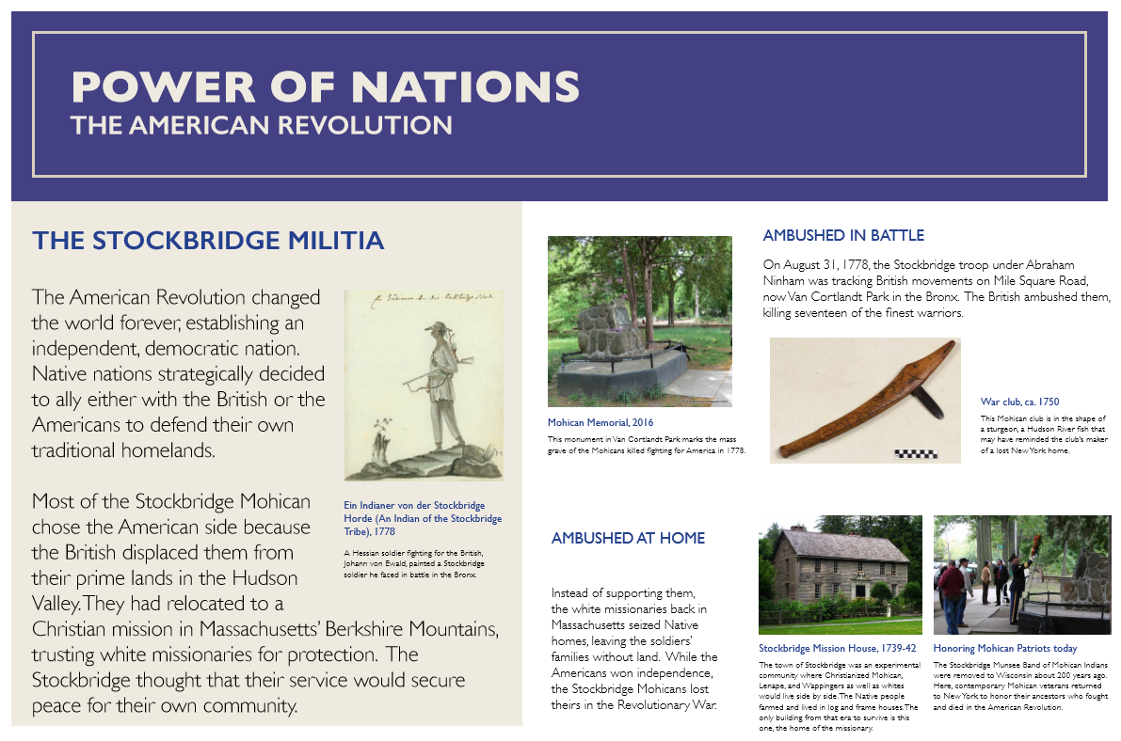
Power of nations

Slide 67
Power of nations section
OVERALL TAKEAWAYS:
Choosing different sides – More than one-third noted that native tribes chose different sides in the American Revolution, and they wondered how each tribe made their decisions.
Van Cortland Park memorial – One-third (mostly New Yorkers) said they had “no idea” this memorial existed and liked that it is “something we could go see.”¹
Stockbridge Mission House – Several were curious to learn more about how the “experimental” Stockbridge Mission House operated.
Taking advantage of natives – A few came away with a sense that the British and the missionaries at Stockbridge were “horrible” because they ambushed the Stockbridge militia and seized natives’ homes.²
Notes:
The majority of their comments related simply to the fact that a memorial exists in the park, and were less about the event that is memorialized itself. A few, however, were curious to learn more about the “ambush,” though they did not elaborate. And, two were curious to learn if there are other, similar memorials elsewhere in New York.
One, for instance, said reading about how white missionaries seized natives’ home reminded her of Japanese internment. Another, who is Native American, similarly said it made her feel “sad” to read how native peoples’ “put their trust” in institutions like missionaries– “they thought they would be helped and protected but they really weren’t.”

Slide 68
Power of nations section
CONFUSING ASPECTS:
Nothing – More than one-third said nothing is confusing.
Flow unclear – One-third said the narrative in this section felt “choppy,” “contradictory,” and “hard to piece together” because the text quickly shifts from describing how native peoples chose sides in the American Revolution to how one group was “ambushed;” they wondered how this came about.¹
Not interesting – A few said that overall, this section was “not interesting,” either because the narrative of colonization felt too familiar (and thus boring) or because they do not like learning about wars.²
Section title – One said the section title, “Power of Nations,” does not adequately reflect the content because it primarily describes native nations’ “loss of power.”
Stockbridge militia – One remained confused about this group.³
Notes:
As one put it, “it's a little confusing because it says the native nations wanted to side with British or Americans, but then it says they were ambushed. Unclear what happened there.”
As one explained, “To be honest it wasn't really that interesting because it's just standard practice for the British to go in and displace. The British have traveled across the globe doing it to many nations, so wasn't really new.”
“I’m still not sure what the Stockbridge militia is. I read a few times and it went over my head, not sure why. I guess it's a group of Indians that fought for America? Still not sure.”

Slide 69
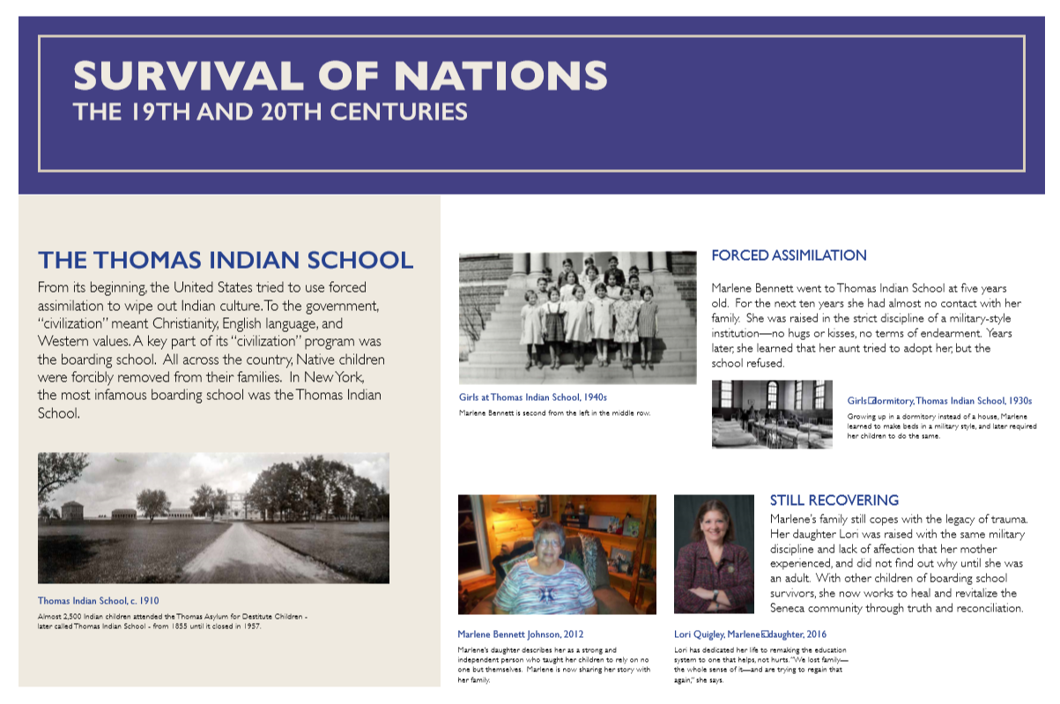
Survival of nations

Slide 70
Survival of nations section
OVERALL TAKEAWAYS:
Effects of forced assimilation – All said this section made them think about the effects of “forced civilization” and the “horrible, abusive” Indian schools, but the focus of their responses varied:
  Almost one-half liked the “personal” approach and wanted to learn more about the effects of this “trauma” on Marlene and her daughter, as well as hear about others’ experiences with Indian schools.¹
  One-third had never heard of Indian schools and simply liked being exposed to these “fascinating and disturbing” institutions.
  One, who is Native American, connected personally because her grandfather attended Indian schools and said these stories made her “sad.”²
  One said framing the “entire notion of survival” around the story of one Indian school felt like a “narrow approach,” but did not expound.³
Notes:
As one put, it “It’s interesting to see the effect it had from generation to generation. This mother and daughter, how each of them experienced different trauma. I thought it was interesting to see that she didn't even know it was something her mom went through– to see the generations and the effects it had on each of them.” Another desired to hear more from Lori, Marlene’s daughter: “The stories of Marlene and daughter - it's being touched upon with the forced assimilation, but for Marlene it doesn't say as much about her. Was there anything else from her? A journal, or more from her experience to be shared? Or just what her daughter has to say.” And, one said this section best “connected the history” to New York: “This was one of the most interesting parts of the whole exhibit. I've always heard about it, but never in new York, so it’s interesting that it also happened here and that someone who went there its still alive. This one connected the history the most to New York.”
Earlier in the interview, this participant shared that her grandfather attended an Indian school, and in response to these materials said “I felt like it was really sad and traumatic… for me it was sad. I felt very sad just because I know how much abuse happened. I think they were a peaceful nation, they were trusting that these people were protecting and helping them.”
“This entire notion of survival is framed around the one Indian school in New York, but again that's a very narrow way to address the problems that native Americans have faced in the United States.”

Slide 71
Survival of nations section
CURIOSITIES / CONFUSING ASPECTS:
Administration of Indian schools – One-half shared curiosities about the administration of Indian schools, including:
  How were native children “forced” to attend the schools?
  How many students attended Indian schools? From which tribes?
  Did boys also attend Indian schools?
  What was the process of closing the schools like?
Nothing – Almost one-half said nothing was confusing about this section.
Section title – Two felt the section title was a “misnomer,” for different reasons.¹
Lori’s work – One wondered how exactly Lori is working to “heal and revitalize” the Seneca community through “truth and reconciliation.”
Notes:
One said the content does not explain “how to survive,” but instead just conveys that “they were forced to assimilate.” Another pair explained that the word “survival” did not feel in keeping with the idea of “forced assimilation,” though their response was somewhat vague: “The word assimilation is a complex term. It's a complicated issue and should be explained more. *It's pretty self-explanatory, but survival is kind of a misnomer.* Surviving is not the same thing as forced assimilation and making it through that. There's a disconnect.”

Slide 72
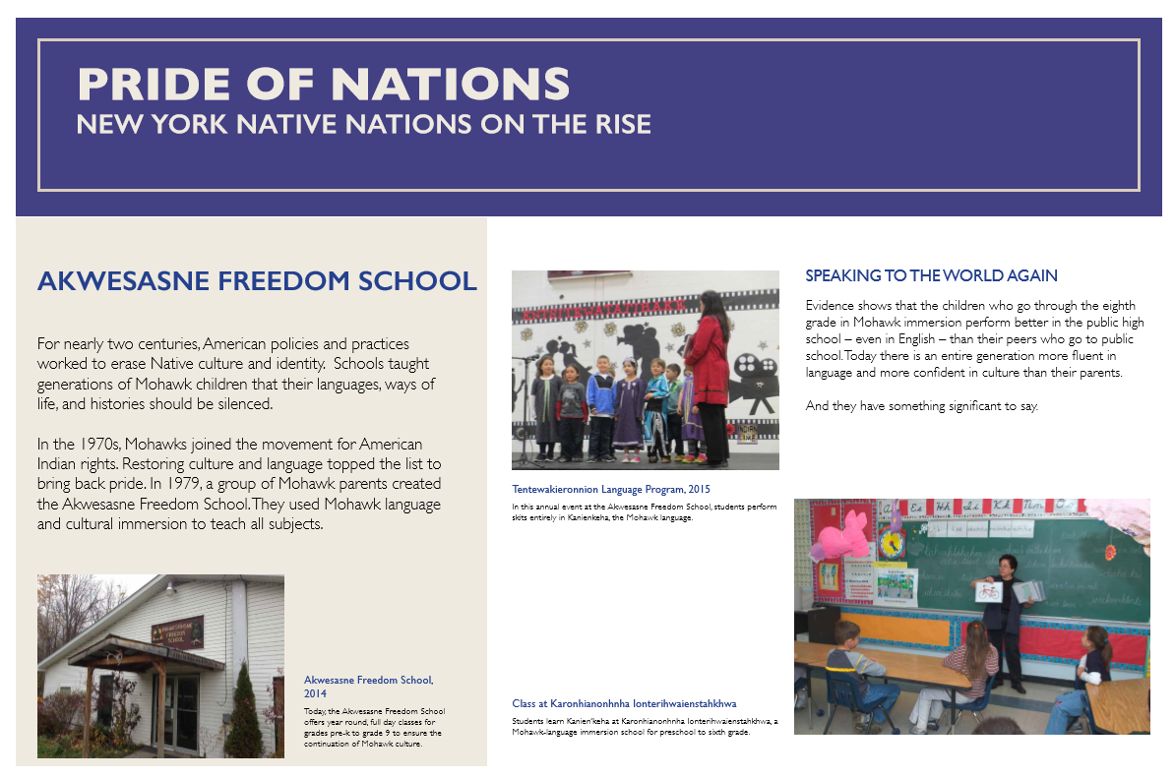
Pride of nations

Slide 73
Pride of nations section
OVERALL TAKEAWAYS:
Revitalization of New York’s native cultures – Many said this section captures the “pride” native peoples are experiencing in revitalizing their cultures today, which they said was conveyed primarily through the “Speaking to the World Again” paragraph and the images of children in the Akwesasne school. Additionally:
  A few were curious to hear personal accounts of students’ experiences in the schools.
  A few had not realized native immersion schools exist in New York state.¹
  Two said this section was a “refreshing balance” to Survival of Nations because it shows native peoples “controlling” their own lives.
Notes:
“I never knew they were happening in New York - I thought it was in just the West or Alaska where there are more indigenous people.”

Slide 74
Pride of nations section
CURIOSITIES / CONFUSING ASPECTS:
Nothing – One-third said nothing was confusing.
Akwesasne Freedom School – A few each wondered:
  Where the Akwesasne Freedom School is located (“on a reservation?”)
  What, if any, relationship exists between this school and other nearby (non-Indian) schools?
  Do similar native immersion schools exist outside of New York state?
Curriculum – Two were curious about students’ curriculum at the schools.¹
Boring – One said he was “bored” by this section because it is “too modern” and does not include historical photographs or artifacts.
Notes:
One of these participants said she is an ESL teacher, so has a professional interest in immersion programs.

Slide 75
Perception of Museum’s intentions
When asked what they thought the museum hoped visitors would think about or feel while visiting this exhibition:
Native peoples still exist today – All said the museum hoped to “raise consciousness” of native peoples in New York and that visitors would understand that native peoples “still exist” and “are not gone.” More specifically:
  That native peoples have made “huge contributions” to New York and remain “connected” to the region¹
  That native cultures are diverse and complex (in the past and today)²
  That native peoples have had a continual presence in New York over time³
  That, though they continue to practice their heritage, modern native peoples are “just like us”⁴
Takeaways related to specific intended outcomes are detailed on the next few slides.
sdfds
Notes:
Several mentioned this as a perceived goal of the museum. As one put it, visitors will understand “That New York was and still is the home of diverse Indian peoples or nations that are in confederacies and they continue to thrive and contribute to the culture in New York.” However, a few of these visitors also said the material more heavily convey native peoples presence and influence in upstate New York, rather than New York City.
A few emphasized this point. For instance, “Getting closer to the culture. Knowing that there are separate identities of completely different cultures; the different things that they had. They want to be unique as a tribute while also depending on each other.”
A few emphasized this point. As one put it, the museum wants visitors “to feel like native culture is still alive in New York and it's been alive for a long time.”
A few emphasized this as a goal: “I think [visitors will] understand that Native Americans are just like us. They're people who just have another layer to them culturally. You think they're on reservations and so separate, but they are among us– everyday people.”

Slide 76
shaping new York over time
When asked what, if anything, prompted them to think about how Native peoples have powerfully shaped New York’s geography, culture, and economy over time:
Message unclear – More than one-half said the materials hint at this message, but felt it was not particularly strong because it is unclear how modern native businesses (e.g., Lydia’s wampum factory), native schools (e.g., Akwesasne), and broader efforts to revitalize native cultures affect non-native peoples today. ¹
  Several also said native peoples’ influence on New York City today (vs. upstate New York) did not come across.
Came across – Several said this message comes across because the materials describe how native peoples influenced New York’s early economy (fur trade), participated in national conflicts (American Revolution), and how they live today in modern New York.²
Notes:
For the most part, they felt the idea that native peoples have powerfully shaped and defined New York came across strongly in the materials about early trade with the Dutch (Wealth of Nations section), but as the materials moved into modern times, this idea became “fuzzy.” As one put it, “I guess when I think about place names, but I'll tell you, based on the mockup I think that goal has not achieved very well. It’s kind of fuzzy. What's the actual contribution to today's New York? I mean, what do they do? What is substantive? It seems kind of vague. I think it could be a lot stronger. This woman makes wampum jewelry-- big deal. Is that impacting my life today? I'm not so sure. Or there's this school, it's doing cool stuff, but does that impact the typical New Yorker? It’s important, but I’m not sure it impacts our culture, or economy, etc. I think that tie, if it's a goal of the exhibition, needs to be strengthened.” Another similarly said that the materials “show a lot about Native Americans, but not how they influence Americans themselves.”
However, their responses were somewhat vague and did not point to specific ways they understood native peoples to have shaped New York based on the exhibition materials. For example, (What, if anything, prompted you to think about how Native peoples have powerfully shaped and defined New York’s geography, culture, and economy over time?) “I think all of it - just reinforces that idea of the historical aspects of how we ended up where we are today, and really reinforcing where the culture is today - I think that [Gallery 2] really shows the movement through history through present ending where we are today and shaped it.”

Slide 77
Diversity and complexity of native peoples
When asked what, if anything, prompted them to think about the incredible diversity and complexity of the Native peoples of New York:
Diversity message met mixed responses –
  Many said the diversity of New York’s Native peoples was conveyed primarily through the map in Diversity of Nations, which shows the “different names” and “language groups” of tribes that live in or are traditionally from New York.
  However, almost all said the message of diversity could be stronger; that is, they “got a sense” of the different nations/tribes in New York but did not feel they understood much about how they are different from one another.¹
Complexity is not explicit – A few named aspects of the materials that conveyed a sense of the complexity of native cultures, but many others said this did not come across.²
Notes:
Most of these participants felt strongly that the Diversity of Nations conveyed a sense that there are many, diverse native cultures in New York. However, they felt the remainder of the materials did not provide enough detail on these various nations/tribes for them to come away with a strong sense of how they differ from and/or are similar to one another. As one put it, “For diversity, again, I go back to the map. It has the different names, the two big language groups, and I think that shows diversity. But I think it could be substantiated better. What's the difference between a Pequot and a Mohican? I don't know. If that's one of the principle goals I think they need to go into more detail of the nation groups and what makes them diverse.” Another similarly said “The fact that there are so many tribes in New York, each with their own traditions, I'd like to see all the differences. I didn't see too many differences between them, just examples from the tribes, so not sure about how Seneca is different from Unkechaug.”
A few said the materials that discuss Haudenosaunee democracy (including Grand Council meetings), Lenape philosophy, trade with the Dutch, and the variety of native languages helped convey that native cultures are complex; one also said drawing attention to the fact that Native peoples participate in “two cultures at once” helps convey this idea– “The complexity - combining, having two cultures, having to combine native and American culture at the same time is complex, being part of two nations at once - their nation and the US.” Despite this, the majority said the materials simply provided “breadth, not depth,” and thus they had difficulty understanding the complexity of native cultures: “It all seems rather simple. Based on this mockup I'm getting breadth but no depth. And therefore, if you're talking about documenting complexity based on the mockup, it doesn't do it that well.”

Slide 78
Contemporary native peoples’ lives
When asked what, if anything, prompted them to think about the lives of contemporary people in or traditionally from New York:
Most considered contemporary native peoples – Almost all enthusiastically said the materials made them consider contemporary Native peoples, and pointed to one or two aspects of the materials that communicated this; primarily, 1) personal accounts (Lydia and Angel’s stories, Marlene’s and Lori’s story), and 2) the Pride of Nations section.¹
  One also said while she was interested to learn about contemporary native peoples, she remained “shocked” how “invisible” they are in her daily life.²
Unsure – One was unsure whether this came across, but did not expound.
Notes:
Overall, their tone was very positive around this message, and they said they enjoyed getting a sense of contemporary native peoples’ experiences. Several had questions about continued cultural practices of New York’s native peoples that are briefly mentioned in, but not elaborated, in the materials. For example, what are Grand Council meetings like? Do business like Lydia’s only operate on reservations? Are there other, similar schools to the Akwesasne Freedom school? Where do they operate? A few added that they would like to see videos of contemporary native peoples discussing their cultures and experiences.
“What shocks me more is how I don't see them. They are invisible in New York. You never think about Native Americans. So the most striking thing is this, I cannot see them or their culture in my daily life.”

Slide 79
Summary & suggestions

Slide 80
teachers
Consider the following:
Baseline knowledge and comfort: The exhibition content mostly resonated and made sense to teachers, and they appear comfortable discussing native peoples and the issues and ideas surrounding them with students. However, findings suggest teachers tend to default to discussing “Native Americans” generally (as one group) rather than framing them as a variety of distinct cultures.
Content aligns with classroom goals: Teachers are excited that the exhibition will support core tenants of the social studies curriculum; especially, reading maps and conveying the continued practice of native peoples’ heritage and traditions.
Diversity message recognized but could be stronger: Similar to the last round of testing, teachers appreciated the exhibition’s attempt to “celebrate” the richness and diversity of native cultures. However, their comments reveal that most need help understanding these cultures’ complexities a) in the past and in modern times, and b) of New York’s native nations specifically.

Slide 81
teachers
Consider the following:
Shaping New York over time recognized but not central: Even though teachers recognized the museum’s attempt to show that native peoples have shaped New York over time, their responses indicate that this point is too abstract. Consider providing more concrete examples of the ways native peoples have contributed to the region (especially New York City).
Contemporary message comes across: The contemporary message was enthusiastically received by teachers. They believe modern native peoples’ stories will help students understand that native peoples “still exist.” However, results suggest that examples of continued traditions (e.g., wampum making, Grand Council meetings) may reinforce a historic over a contemporary message.
Tension between historical and contemporary: Teachers responses indicate a tension between following a more historically-based curriculum and the desire to teach students about contemporary native peoples lives. Consider ways to mitigate this so native peoples’ contributions over time are clear and so the contemporary stories do not feel like an add-on.

Slide 82
Walk-in visitors
Consider the following:
Low Baseline Knowledge: Visitors have relatively simplistic understandings of native peoples compared to educators. Positively, however, most were able to pinpoint the intended messages of the exhibition, though they often felt these messages could be clarified and strengthened.
Contemporary message comes across: Visitors were enthusiastic about the “personal,” contemporary stories and said the exhibition clearly communicates that native peoples “still exist” and are “thriving” today.
Relevance to non-native peoples “fuzzy:” While visitors understand that native peoples’ “still exist” today, many remain uncertain how (or whether) continued practice of native traditions affect non-native peoples and New York City today. Consider providing concrete examples of how native peoples’ lives and traditions might be relevant to non-native visitors’ lives in more than superficial ways (e.g., walking past a street named after native peoples) to help illustrate this idea.

Slide 83
Walk-in visitors
Consider the following:
Diversity somewhat recognized: Similar to the last round of testing, visitors were excited to learn more about the “diverse” and “rich” cultures native to New York. However, most of their comments indicate that the exhibition provided only a general sense of diversity and that messages around complexity were missed. Consider strategies that allow for both a deeper picture of the complexity and diversity of native cultures.
Power of Nations Section Confusing: Most visitors struggled with this section. They felt the flow of events was “choppy” and that “power” has positive connotations, which contradicts the “loss of power” described in this section.
Survival of Nations Section clearly conveys “survival:” Focusing on the Thomas Indian School more successfully communicated a sense of “survival” to visitors than the story of Handsome Lake featured in the first round of testing; largely because the story was “personalized” through Marlene. Move forward with this content.

Slide 84
Exhibition introduction
Option 1 | This is an exhibit about living people. There are no extinct cultures in this exhibit. The Native nations of New York still exist alongside all of the other nations on earth. The customs shown here have stood the test of time. They help Native people define themselves and how they fit into the world. New York gave rise to many of them. Come see how they began, what they endured to survive, and how they are rising again today.
Option 2 | Nations have been rising from the place we know now as New York for millennia. Out of the place you now stand, Native people created diverse nations with unique cultures, long histories, and great contributions. New York has always been a nation-builder. Its economy and strategic position helped form the United States, fueled countries around the globe, and contributed to the expansion of democracy worldwide. Native New York is vibrant today, and Native nations rise again from this land.

Slide 85
Diversity of nations map
NEW YORK NATIVE NATIONS
Many different Native nations have risen out of New York’s landscape for thousands of years. A number of these nations are still here – each with their own language, traditions, and governments. New York has always been culturally diverse.
Tribes that speak Algonquian languages are organized like a web of interrelated families. Each tribe has its own independent leadership and makes decisions for its individual nation. Their homelands are along the coast and the Hudson River.
The Haudenosaunee speak Iroquoian languages. They are a unified confederacy made up of six interdependent nations. Sometimes known as the Iroquois Confederacy, they live in upstate New York.

Slide 86
DIVERSITY OF NATIONS SECTION - ALGONQUIANS
The Lenape:
The Grandfather Nation of New York
Manhattan. Canarsie. Rockaway. Whenever you say these place names, you are speaking a language called Munsee. It belongs to the Lenape, a nation that rose from New York City long before Europeans arrived. “Lenape” means “real human beings.” Another name for them is the Delaware.
Native nations call each other by family terms, and many nations who speak Algonquian languages believe that they are descended from the Lenape, so they called them “the Grandfathers.”
The Lenape are the Grandfathers of New York.
Lenape Indians, 1702
Lenape people displayed tools of diplomacy—long-stemmed pipes and wampum belts—in this image of them by a Swedish author, Thomas Campanius Holm.
86

Slide 87
DIVERSITY OF NATIONS SECTION - ALGONQUIANS
Manhattan was an ideal location for trade and interaction. From here, the Lenape could go up the river, up the sound, and north or south along the coast. Diplomacy was the way the Lenape kept their relationships strong. They were the mediators and peacemakers of the Algonquian world. Maintaining balance was a central part of their art and philosophy, and still is.
Pouch, 1760-1800
To the Lenape, nature is a balance of opposing forces, symbolized by the colors red and black. The X motifs also represent intersection and balance. This bag is made of black-dyed deer skin decorated with red-dyed porcupine quills and deer hair.
Wampum belt, 1800-50
Lenape diplomats used woven belts of white wampum beads to convey a message of peace. This one was still being used in 20th-century Oklahoma by Lenape Chief Charlie Elkhair.
87

Slide 88
DIVERSITY OF NATIONS SECTION - ALGONQUIANS
Lenape Today
Today, Lenape people have communities in Oklahoma, Ontario, Wisconsin, New Jersey, Delaware, and elsewhere—but still feel a connection to their ancestral homeland in New York.
Lenape visitors at Ellis Island, 2003
A Lenape delegation participated in the reburial of their ancestors at Ellis Island.
88

Slide 89
Diversity of nations section - algonquians
Unkechaug:
Wampum Makers
Lydia Chavez (Unkechaug)
Jewelry Designer and Businesswoman, 2015
My name is Lydia Chavez, and I am from the Unkechaug Nation of Long Island, New York. Our homeland is on the Atlantic coast. Since 1701, we have lived on a small portion of our territory called the Poospatuck Reservation.
Like my ancestors did for centuries, I make wampum beads. The word “wampumpeake” means a string of shell beads that speak. Wampum is a medium of alliance, memory, and truth.
My pieces embody aesthetic beauty and great historical value. My goal is to restore the significance that wampum once held while reinventing it with an original and contemporary twist.
Lydia is part owner of Wampum Magic, a company that produces wampum beads, jewelry, and other accessories

Slide 90
Diversity of nations section - Algonquians
      Wampum comes in two colors – purple made from the quahog clam and white made from the whelk shells. We consider wampum to be alive as it comes from the living ocean. My Unkechaug people have helped to restore wampum’s original meaning as a strong and empowering cultural messenger. Native nations trade wampum for diplomatic and sacred reasons.
Wampum Magic factory, 2015?
Today, Unkechaug workers make wampum using mechanical grinders and other tools. Chief Harry Wallace says that a person making wampum must be in a healthy state of mind, or the beads will shatter.
Shells being made into wampum, 1600-1700
The first step in making white wampum was to carve away all but the central spiral of a whelk shell. These were found by archaeologists in Staten Island.

Slide 91
Diversity of nations section - Algonquians
      Wampum has been characterized as one of the original forms of currency used in the United States. Early Dutch and English settlers adapted wampum from coastal Algonquian peoples as an exchange system during early settlement times. The Europeans valued wampum differently – using it more like money – than our people who saw it as a way to transmit meaning.
Wampum belt loom, 2016
At Wampum Magic, wampum belts are still woven on hand looms. This one will be a replica of a famous belt named the Guswenta, or Two-Row wampum belt.
Wampum belt, 1600-50
This historic belt conveyed a message of alliance. Purple beads are associated with tension, white with peace. The two colors show the balance of natural forces.

Slide 92
Diversity of nations - Haudenosaunee
The Haudenosaunee:
Confederacy of Nations
Nya weh skannoh (nya-way-skanoh), or Greetings! My name is Angel and I am Seneca. I am Heron clan. My people are one of the six nations of the Haudenosaunee (hoe-dee-no-sho-nee) or Iroquois Confederacy.
I live in upstate New York, and in many ways my life is like yours. But because I am Seneca, I also belong to a nation that has its own culture and government. My people have an ancient history that is very important to me today.
One of the most important events that shaped the Haudenosaunee was the creation of the Great Law of Peace. The Great Law of Peace created the Haudenosaunee Confederacy and directs us how to run our government.
Angel (Seneca)
Angel grew up in the new, reestablished Seneca community of Ganondagan. She is the first child to grow up there in 300 years!

Slide 93
Diversity of nations - Haudenosaunee
The Haudenosaunee Confederacy is a union of six independent nations that live in upstate New York. Each nation governs itself internally, but they come together to make decisions that affect all of them. The original members are (east to west) Mohawk, Oneida, Onondaga, Cayuga, and Seneca; the Tuscarora joined in 1722.
Hiawatha Belt (replica), 1990-2010
The design on this wampum belt shows the original members of the Haudenosaunee Confederacy, like the U.S. flag shows the original 13 colonies. A tree of peace represents the Onondaga. The original belt dates before 1722. The Confederacy presented this replica to Senator Daniel Inouye.
Gustoweh, 2009
In the Grand Council of the Haudenosaunee Confederacy, the chief of each nation wears a unique emblem of office called a Gustoweh, a headdress. This one, made by Skahendowaneh (Jake) Swamp, is for a Mohawk representative.

Slide 94
Diversity of nations - Haudenosaunee
The Haudenosaunee system of government has been in continual existence from ancient times to today. The fifty chiefs making up the Grand Council still bear the names of the original founders.
Tadodaho Sidney Hill and Grand Council members, 2012
The Grand Council keeps old traditions alive, but they also lead on issues vital to the people today. Here, the council leader who takes the ancient title of Tadodaho spoke at the National Press Club in Washington when appealing a legal decision on Onondaga land rights.
Grand Council meeting, 1890
After the American Revolution, the Haudenosaunee Confederacy kept going even though the border between Canada and the U.S. divided them. This photo shows the Grand Council meeting in Canada.
94

Slide 95
Wealth of nations section
The Fur Trade
When the Dutch first arrived on the Hudson River, they were looking for trade, not conquest or settlement. Native trade networks already existed, and the Dutch soon benefitted from them. Native people seized the opportunity to channel their own products to the Dutch in return for the manufactured goods of Europe.
T’Fort Nieuw Amsterdam op de Manhatans, ca. 1626-28
Native canoes and European ships crowded around the tip of Manhattan in this 1651 print, showing the nature of the trade the Dutch came for.

Slide 96
Wealth of nations section
Two economic systems came together in the fur trade. Native people produced goods based on their natural resources. The Dutch sold them manufactured articles and imported luxuries. The mercantile system increased the power, wealth, and empire of the Netherlands and brought global wealth to Native nations of New York.
Game animals, c. 1650
The main products the Dutch wanted were the processed pelts of beavers, bears, foxes, deer, minks, fishers, and other fur-bearing animals. These engravings are from Nicolaes Visscher, Novi Belgii Novæque Angliæ, the most influential Dutch map of New York.
Trade goods, 1600s-1700s
Merchants shipped in goods from all over the world—Italy, England, Brazil, India, China—to be purchased by Native people of New York.
96

Slide 97
Wealth of nations section
Trade transformed both sides. Soon Europeans wore the furs of North American sables, ermines, and minks, and beaver felt hats. Native Americans wore the cloth, silver, and beads of Europe, and enjoyed using copper pots and scissors. Those who benefitted from trade felt richer than before.
Charles I at the Hunt, 1635
The King of England showed off his beaver felt hat in this portrait by Anthony Van Dyck.
Sa Ga Yeath Qua Pieth Tow (baptized Brant), King of the Maquas, 1710
This Mohawk chief showed off his trade musket and cloak in this portrait painted in London by John Verelst.
97

Slide 98
Power of nations section
The Stockbridge Militia:
Ambushed in Battle and at Home
The American Revolution changed the world forever, establishing an independent, democratic nation. Native nations strategically decided to ally either with the British or the Americans to defend their own traditional homelands.
Most of the Stockbridge Mohican chose the American side because the British displaced them from their prime lands in the Hudson Valley. They had relocated to a Christian mission in Massachusetts’ Berkshire Mountains, trusting white missionaries for protection. The Stockbridge thought that their service would secure peace for their own community.
Ein Indianer von der Stockbridge Horde (An Indian of the Stockbridge Tribe), 1778
A Hessian soldier fighting for the British, Johann von Ewald, painted a Stockbridge soldier he faced in battle in the Bronx.

Slide 99
Power of nations section
On August 31, 1778, the Stockbridge troop under Abraham Ninham was tracking British movements on Mile Square Road, now Van Cortlandt Park in the Bronx. The British ambushed them, killing seventeen of the finest warriors.
War club, ca. 1750
This Mohican club is in the shape of a sturgeon, a Hudson River fish that may have reminded the club’s maker of a lost New York home.
Mohican Memorial, 2016
This monument in Van Cortlandt Park marks the mass grave of the Mohicans killed fighting for America in 1778.

Slide 100
Power of nations section
Instead of supporting them, the white missionaries back in Massachusetts seized Native homes, leaving the soldiers’ families without land. While the Americans won independence, the Stockbridge Mohicans lost theirs in the Revolutionary War.
Stockbridge Mission House, 1739-42
Stockbridge was an experimental community where Christianized Mohican, Lenape, and Wappingers as well as whites would live and farm side by side. The only building from that era to survive is the home of the missionary.
Honoring Mohican Patriots today
The Stockbridge Munsee Band of Mohican Indians were removed to Wisconsin 200 years ago. Here, Mohican veterans returned to New York to honor their ancestors who died in the American Revolution.

Slide 101
survival of nations section
Thomas Indian School
From the beginning, the United States tried to use forced assimilation to wipe out Indian culture. To the government, “civilization” meant Christianity, English language, and Western values. A key part of its “civilization” program was the boarding school. All across the country, Native children were forcibly removed from their families. In New York, the most infamous boarding school was the Thomas Indian School.
Thomas Indian School, c. 1910
Almost 2,500 Indian children attended the Thomas Asylum for Destitute Children - later called Thomas Indian School - from 1855 until it closed in 1957.

Slide 102
survival of nations section
Marlene Bennett went to Thomas Indian School at five years old. For the next ten years she had almost no contact with her family. She was raised in the strict discipline of a military-style institution—no hugs or kisses, no terms of endearment. Years later, she learned that her aunt tried to adopt her, but the school refused.
Girls’ dormitory, Thomas Indian School, 1930s
Growing up in a dormitory instead of a house, Marlene learned to make beds in a military style, and later required her children to do the same.
Girls at Thomas Indian School, 1940s
Marlene Bennett is second from the left in the middle row.

Slide 103
survival of nations section
Marlene’s family still copes with the legacy of trauma. Her daughter Lori was raised with the same military discipline and lack of affection that her mother experienced, and did not find out why until she was an adult. With other children of boarding school survivors, she now works to heal and revitalize the Seneca community through truth and reconciliation.
Lori Quigley, Marlene’s daughter, 2016
Lori has dedicated her life to remaking the education system to one that helps, not hurts. “We lost family—the whole sense of it—and are trying to regain that again,” she says.
Marlene Bennett Johnson, 2012
Marlene’s daughter describes her as a strong and independent person who taught her children to rely on no one but themselves. Marlene is now sharing her story with her family.

Slide 104
Pride of nations section
Speaking to the World Again:
Akwesasne Freedom School
For nearly two centuries, American policies and practices worked to erase Native culture and identity. Schools taught generations of Mohawk children that their languages, ways of life, and histories should be silenced.
In the 1970s, Mohawks joined the movement for American Indian rights. Restoring culture and language topped the list to bring back pride. In 1979, a group of Mohawk parents created the Akwesasne Freedom School. They used Mohawk language and cultural immersion to teach all subjects.
Akwesasne Freedom School, 2014
Today, the Akwesasne Freedom School offers year round, full day classes for grades pre-k to grade 9 to ensure the continuation of Mohawk culture.

Slide 105
Pride of nations section
Evidence shows that the children who go through the eighth grade in Mohawk immersion perform better in the public high school – even in English – than their peers who go to public school. Today there is an entire generation more fluent in language and more confident in culture than their parents.
And they have something significant to say.
Tentewakieronnion Language Program, 2015
In this annual event, students perform skits entirely in Kanienkeha, the Mohawk language.
Class at Karonhianonhnha Ionterihwaienstahkhwa
Students learn Kanien’keha at Karonhianonhnha Ionterihwaienstahkhwa, a Mohawk-language immersion school for preschool to sixth grade.

Slide 106
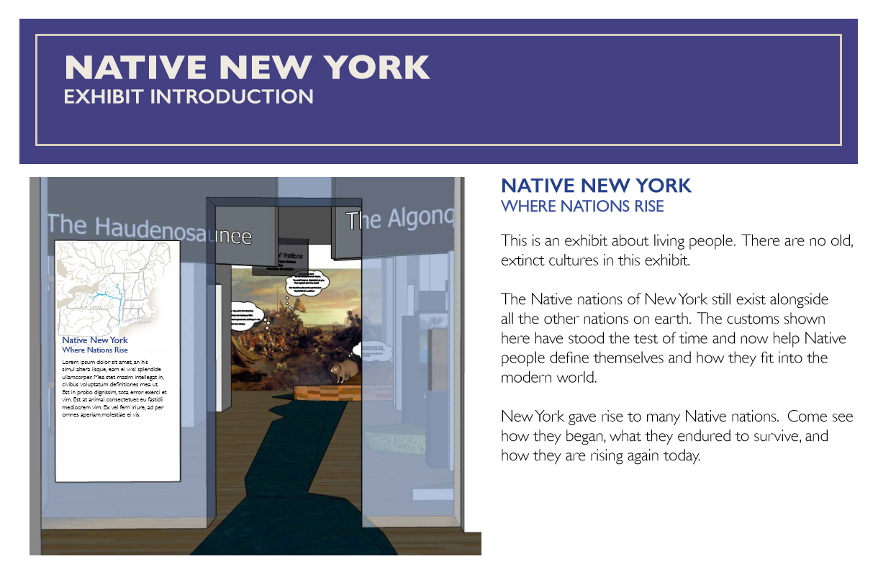
introduction

Slide 107
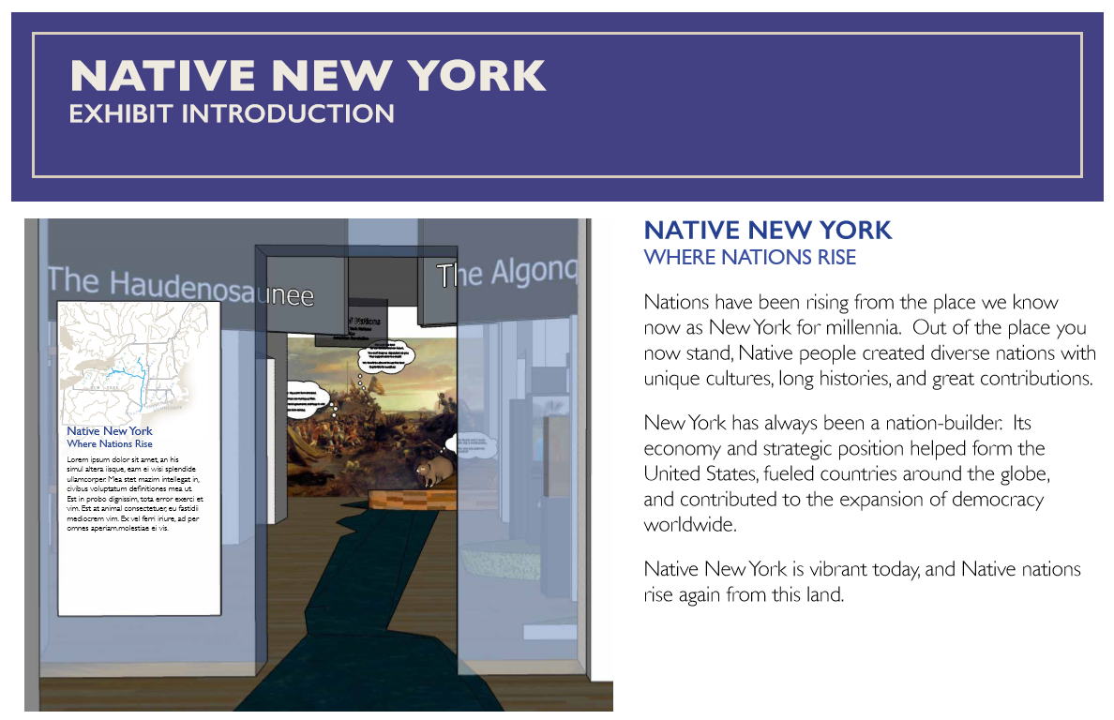
Introduction

Slide 108
Exhibition introduction
Option 1 | This is an exhibit about living people. There are no extinct cultures in this exhibit. The Native nations of New York still exist alongside all of the other nations on earth. The customs shown here have stood the test of time. They help Native people define themselves and how they fit into the world. New York gave rise to many of them. Come see how they began, what they endured to survive, and how they are rising again today.
Option 2 | Nations have been rising from the place we know now as New York for millennia. Out of the place you now stand, Native people created diverse nations with unique cultures, long histories, and great contributions. New York has always been a nation-builder. Its economy and strategic position helped form the United States, fueled countries around the globe, and contributed to the expansion of democracy worldwide. Native New York is vibrant today, and Native nations rise again from this land.

Slide 109
Diversity of nations map

Slide 110
Diversity of nations

Slide 111
Diversity of nations

Slide 112
Diversity of nations

Slide 113
Wealth of nations

Slide 114
Power of nations

Slide 115
Survival of nations

Slide 116
Pride of nations

