Slide 1
Online Infrastructure for the Informal Science Education Field
October 19th, 2014
Presenters:
Kalie Sacco, CAISE
Bronwyn Bevan, Exploratorium
Sarah Cohn, Science Museum of Minnesota
Jennifer Shirk, Cornell University
Images courtesy of ISE PI Meeting 2012 attendees
From left to right: Geoffrey Haines-Stiles; Mohini Patel Glanz, NWABR; Scot Osterweil; April Luehmann
Notes:
Why are we having this session:
-There are a lot of online resources out there for people working across different informal learning organizations and institutions that help them get their work done. People use online infrastructure to build proposals, collaborate, manage projects, disseminate them to the public and to other professionals… all kinds of things. Even as these resources are proliferating, they are becoming even more connected, and project leaders are trying to find ways to make them more accessible and usable to our audiences. And, we still know that there is a lot of work to be done. Half the battle is just knowledge building about these resources.
-This session is to help you learn more about some of the online resources that are out there specifically for our field, as well as help us as managers and developers of these projects learn more about what you are using might find useful. We also wanted to give you all a chance to share with each other what’s working for you. We will start with a short introduction to each of our website projects, and then do a whole group discussion for you to share the resources that you are currently using and those that you would like to see. We’ll take detailed notes during that discussion, and the results will be posted in a blog post on CAISE’s website informalscience.org.
-The people here today represent a variety of projects that are creating online, accessible resources to help museum and science center professionals connect with each other as well as other sectors of informal learning.
Kalie Sacco, CAISE
Bronwyn Bevan, Director at the Institute for Research and Learning at the Exploratorium in SF, and is also the PI on an National Science Foundation funded project called Relating Research to Practice
Sarah Cohn, Evaluation and Research Manager at SMM, working on a project called BISE that has looked across 100s of eval reports and is creating online accessible resources for evalutors based on their findings
Jennifer Shirk, who is based at the Cornell Lab of Ornithology where she supports citizen science activities in many informal learning venues via CitizenScience.org. Jennifer also serves as Communication Coordinator for the new Citizen Science Association.
Before we hear more about these projects, I wanted to contextualize the presentation with some work regarding online infrastructure that CAISE has been doing over the last 7 or so years.

Slide 2
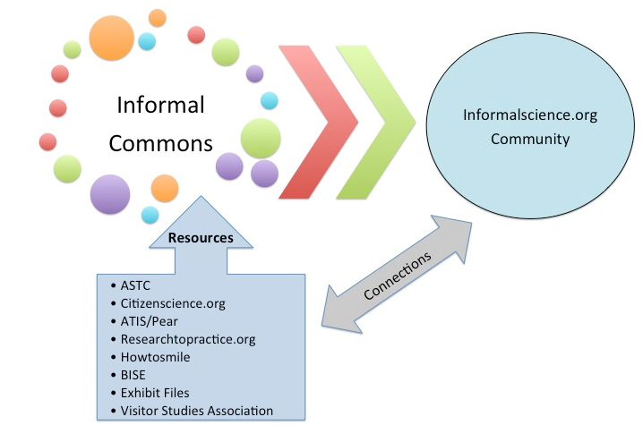
The Infrastructure Coordination Roundtable (ICR)
Image conceptualized by ICR member Tina Phillips of citizenscience.org
Notes:
The Infrastructure Coordination Roundtable, or ICR, is 1 ex of an effort to coordinate resources across online platforms. This group was first convened by CAISE in 2010 and has contributed to a variety of web development activities, most notably contributing resources to a single searchable repository as well as the development of a metadata standard on ISDO that organizes those search results.
[flip to ISDO]
Although we each have our own unique activities and priorities, we continue to talk and communicate about what we’re doing, and resources from all of these sites are available via the online collection on InformalScience.org. Worth noting that ISDO is the site that you go to to do the search, but it also contributes data—projects, research and evaluation resources.
So, how did we get here?

Slide 3
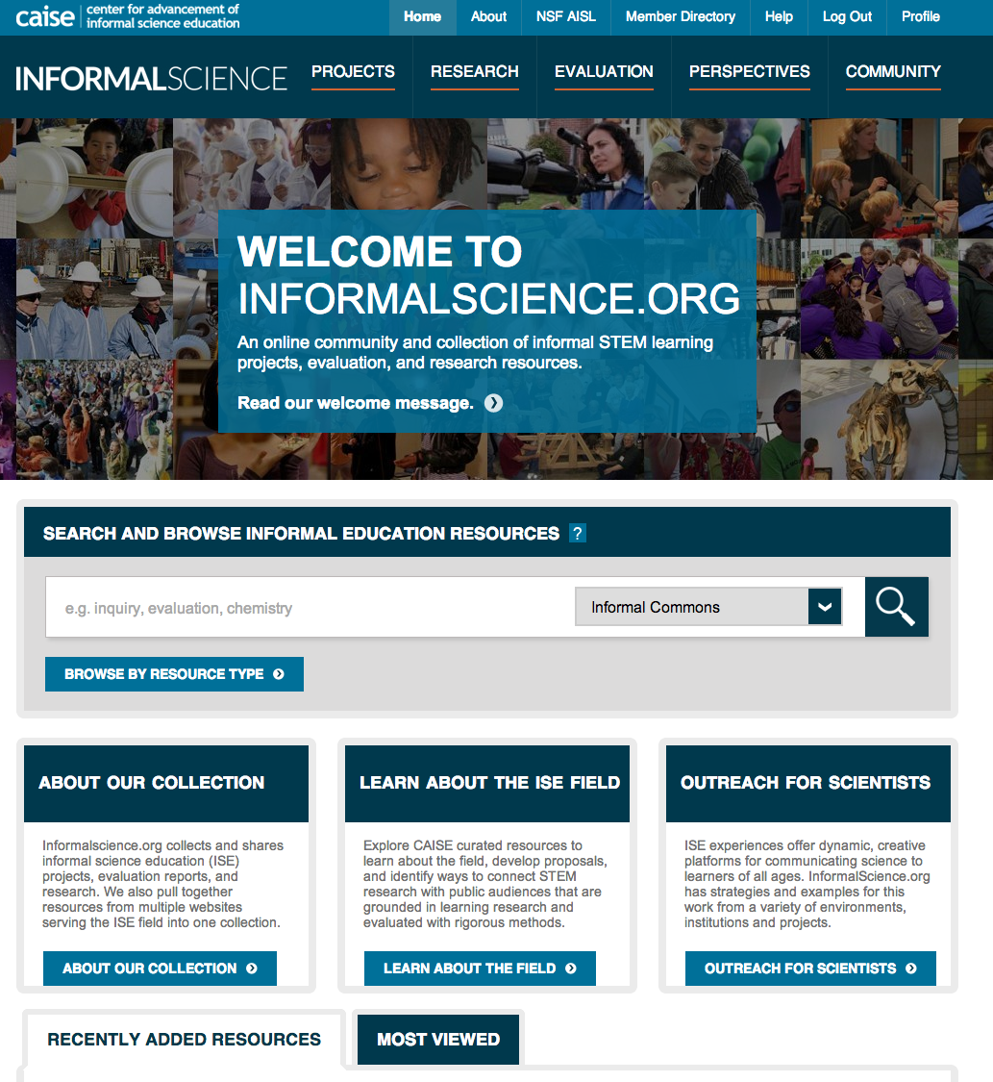
Archive InformalScience.org site
Original content and site features
Informal Commons standalone search
caise.insci.org and related content
ISE Evidence Wiki
Notes:
-Challenge: at the time of our refunding, CAISE and others offering different websites working toward a common purpose. [name websites]
-Combined sites that had been in operation for several years, but building on a decade’s worth of work that went into the first version of ISDO
-Vision: a single point of access for people looking to understand and interact within the ISE field
-Designed for a professional audience, adhering to CAISE’s audiences as defined by our funders at the NSF
-Site is designed to be contributed by the community—users contribute content, edit wiki articles, post news on the calendar, start and join groups, etc.

Slide 4
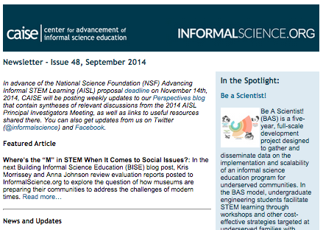
What can you do on InformalScience.org?
Find collaborators
Access resources
Disseminate your work
Be a part of events
Build proposals
Get news & updates from the field
Notes:
Access resources: we have a growing number of resources on the site that you can use

Slide 5
Since site launch:
150,000 visits | 97,000 users | 592,000 page views
The searchable online collection includes:
1,622 project descriptions
674 evaluation reports and 355 instruments
1,596 peer-reviewed research articles, research briefs, and case studies, and dissertations/theses
1,396 “grey literature” resources, such as conference proceedings, mass media articles, and reports
3,622 instructional materials, such as lesson plans and activities
2,130 members from an international audience of diverse ISE professionals

Slide 6
InformalScience.org Use
Majority from big, English-speaking cities
Site traffic driven by communication / outreach
Usage tends to spike at key times (i.e. AISL proposal deadline)
Members can select multiple categories
Approximately 45% of users have supplied profile information

Slide 7
What do we want to do next?
What other resource databases/sources are you using?
What kinds of resources—project abstracts, research, etc.—are useful to you as a professional?
How can we help the newbies and the veterans?
Notes:
We are concentrating on making the resources as usable and useful as possible. We are working with our evaluators at Inverness research to understand the use cases—how are people using the site? We’ve heard anecdotal evidence about building proposals, doing doctoral research, etc. but we really want to learn more.

Slide 8
relatingresearchtopractice Bronwyn Bevan, Exploratorium

Slide 12
Uses of Research
Instrumental
Tactical
Conceptual
Imposed
(WTGrantF, 2012, Weiss et al)

Slide 13
Connected Collections
Overview of the Topic
Abstracts of 4-5 Related Briefs and How Connected
Key Questions, Tensions, Ideas
How To Use Collection in Staff Reflective Discussions/PD (sequencing of ideas, question prompts, discussion protocols)

Slide 14
Connected Collections
STEM Practices & Learning
Culture / Sociocultural Perspectives
Discourse & Learning
Interest and identity development across everyday experiences

Slide 15
Questions
Is professional reflection an interest, and could these resources be useful?
Why do you or would you want to access research results?

Slide 16
The Building Informal Science Education (BISE) Project
University of Pittsburgh Science Museum of Minnesota
Visitor Studies Association

Slide 17
In what ways might we use a collection of evaluation reports to generate useful new knowledge about the field of informal science education?
Notes:
Within the field of evaluation, there are a limited number of places evaluators can share their evaluation reports.
We are fortunate that one such resource exists in the informal learning community, informalscience.org.
Informalscience.org provides evaluators access to a rich collection of reports they can use to inform their practice and learn about a wide variety of designs, methods, and measures used in evaluating informal education projects.
The Building Informal Science Education (BISE) project set out to being to answer this question.

Slide 18
To Answer Our Question
Developed a coding framework
Applied coding framework to 521 reports posted to informalscience.org through May 2013
Authors conducted syntheses based on the coded reports

Slide 19
Notes:
Reviewed
Evaluation reporting literature
We looked to the Center for Advancement of Informal Science Education (CAISE) Portfolio Inquiry Group’s codebook, which was developed to analyze publicly available NSF informal science education (ISE) award data
We referred to the categories used in the NSF ISE Online Project Monitoring System’s (OPMS) Baseline Survey, which NSF principal investigators complete annually about their project and related evaluation activities.
Preliminary coding to identify emergent codes
Feedback during the 2011 Visitor Studies Association conference
Input from synthesis authors
Refinement during the coding process

Slide 20
Excel File & Nvivo Database
Notes:
Internal Folders – click on folder, tells you how many reports in it. Combination – explain, different from evaluand
Nodes – what you can learn by looking at nodes – how many reports of each
Double click and see instances of node coding. Can then export these results and look at them more deeply. Can also click on it to get the actual report and coding instance.
View coding stripes to see what is coded within a report.
Classifications – report level attributes. The same as what is in excel

Slide 21
Synthesis Papers
Across the website-related reports in the BISE database, what was the range of evaluation focus areas?
What recommendations and advice are provided through summative evaluations of exhibitions?
Museums are increasingly engaging with their communities in understanding and addressing the complex questions of our society. How is this effort manifested in museum practice, and what is the impact of this work?
Notes:
Three authors were commissioned by VSA to synthesize the findings around a question of interest to them using the BISE database. Here they are.

Slide 22
Notes:
Their reports can be found on the visitorstudies.org website.

Slide 23
BISE Blog
Notes:
The authors have since written a series of blog posts, located on the Perspectives tab of informalscience.org to continue the discussion and raise questions for the field about both the work being done across the field and about the utility of this database.
Talk about how to find the blogs
Upcoming topics – Leslie Goodyear

Slide 24
ADDITIONAL DELIVERABLES
Notes:
Spreadsheet of report level attributes – instead of needing to open Nvivo, you can check within this spreadsheet of whether or not a specific code has been coded per report. This allows folks without Nvivo to still use some of the coding, just not at the line by line level.
Collection of 521 reports – the reports are numbered based on the number they were given in the previous version of informalscience.org. So we ended up using those as id numbers for our project. So throughout all our resources, the report has the same number.
EndNote File – every report has been entered into an EndNote file, so all referencing is completed for you!

Slide 25
Ways to Use the Resources
Understand how evaluations are carried out for various types of ISE projects
Inform the development of an evaluation
Learn from similar types of projects – recommendations, improvements, impacts
Notes:
How many summative evaluations of the media projects?
What kinds of evaluation questions do people ask for in summative evaluations of exhibitions?
What can I learn from the recommendations of evaluations of media projects?

Slide 26
SHOULD THIS WORK CONTINUE?
Would continuation of this type of work be useful for you and your projects?
Similar to the Harvard Family Project, should VSA and/or the BISE team continue analyzing reports generated by the ISE field to provide summary reports on activities of the field?

Slide 27
Online Infrastructure for a Citizen Science Association

Slide 28
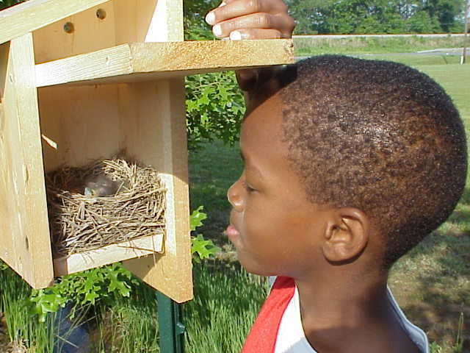
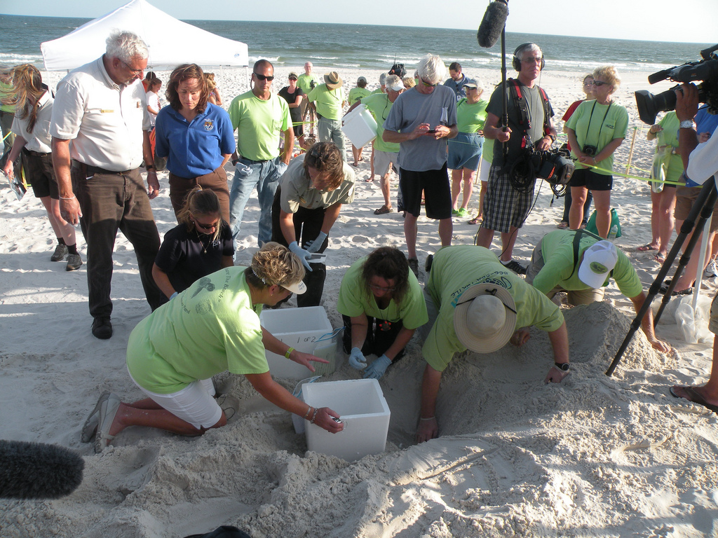
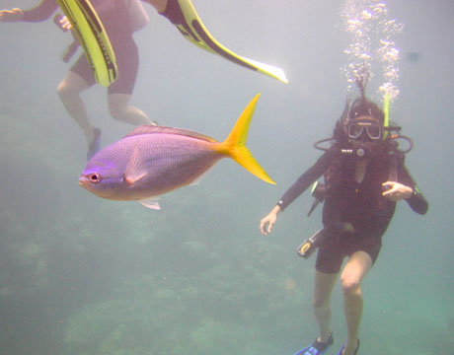
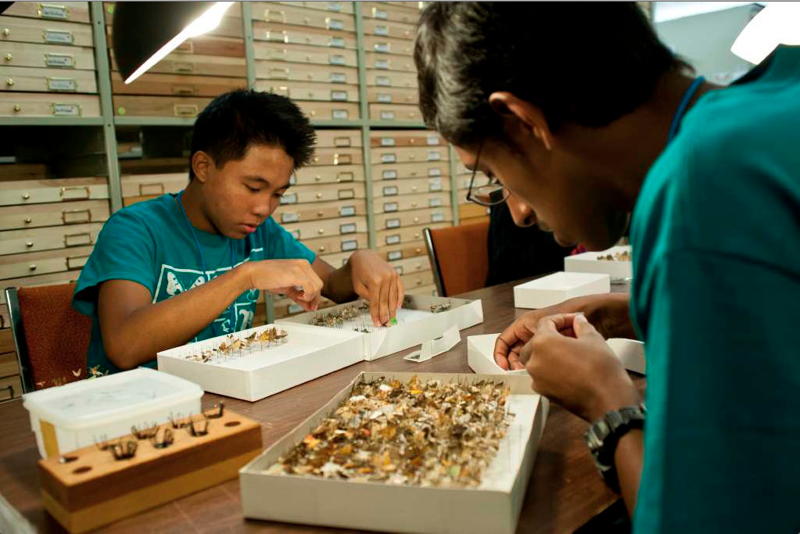
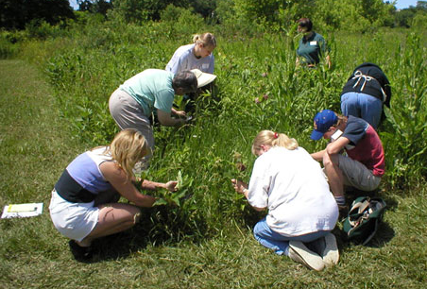
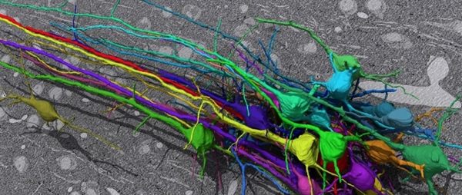
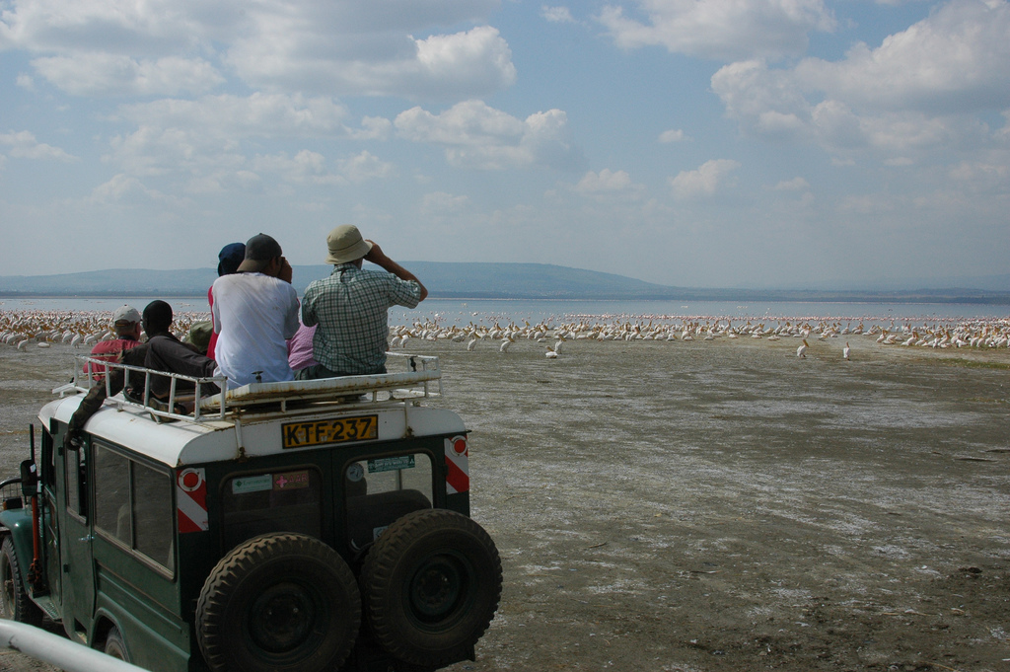
_{Photo, MLMP photo gallery}
http://www.flickr.com/photos/crb/103586567/
Notes:
Oxford English Dictionary. It’s in the dictionary!
What is it good for?

Slide 29
Citizen science goals
Notes:
Here is what we heard from the respondents back in 2009 – that individuals pretty evenly distributed their project goals.
BUT, I would wager that for many working in conservation fields, citizen science is actually more of a means of integrating the first two in order to impact the third.

Slide 31
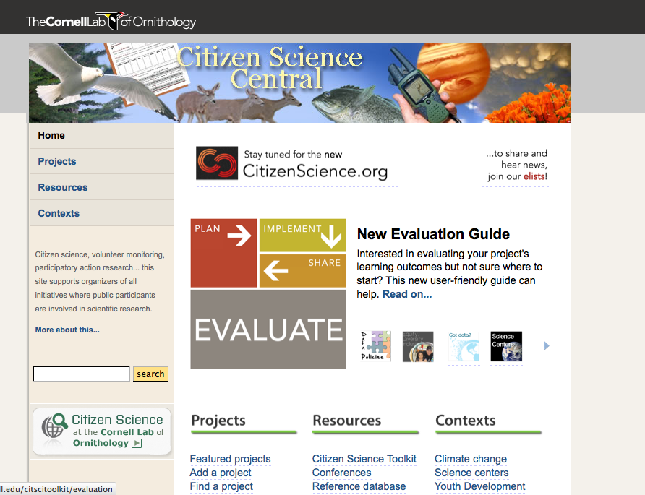

Slide 32
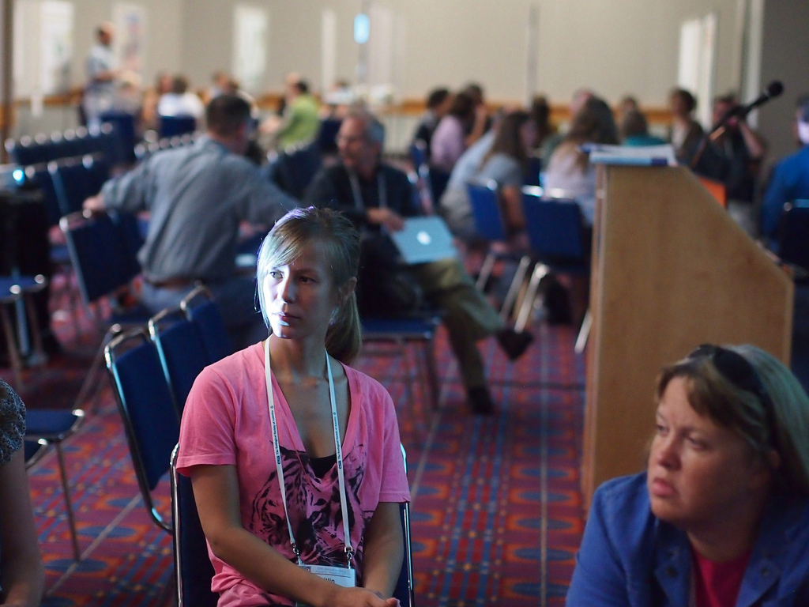
Analytics
“Citizen science”
Projects
People

Slide 33
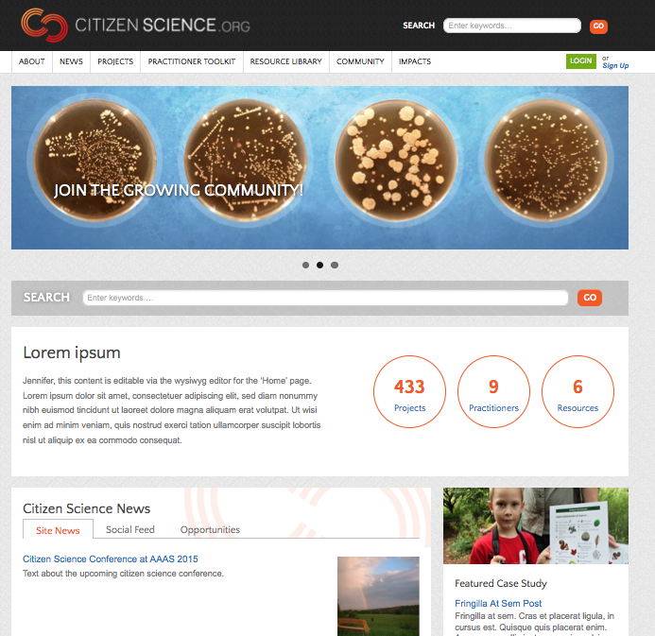
Notes:
Some work to that end...
New look for CitizenScience.org to visually reflect project diversity
Specific solicitation of resources and insights from all

Slide 35
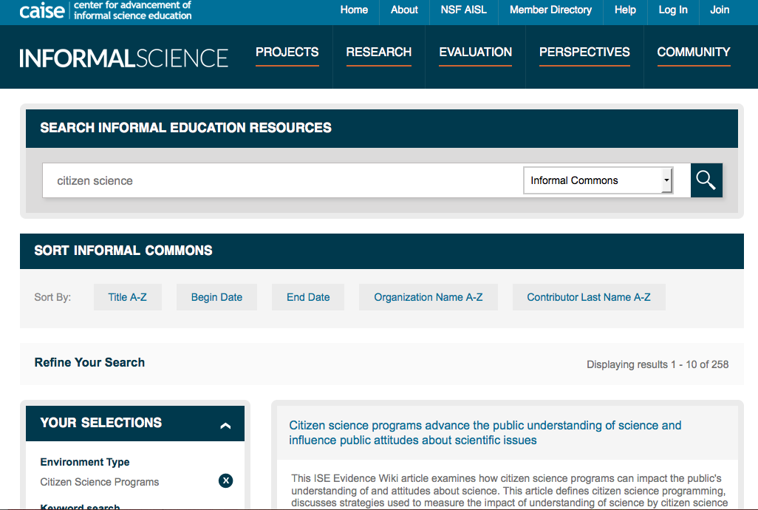

Slide 36
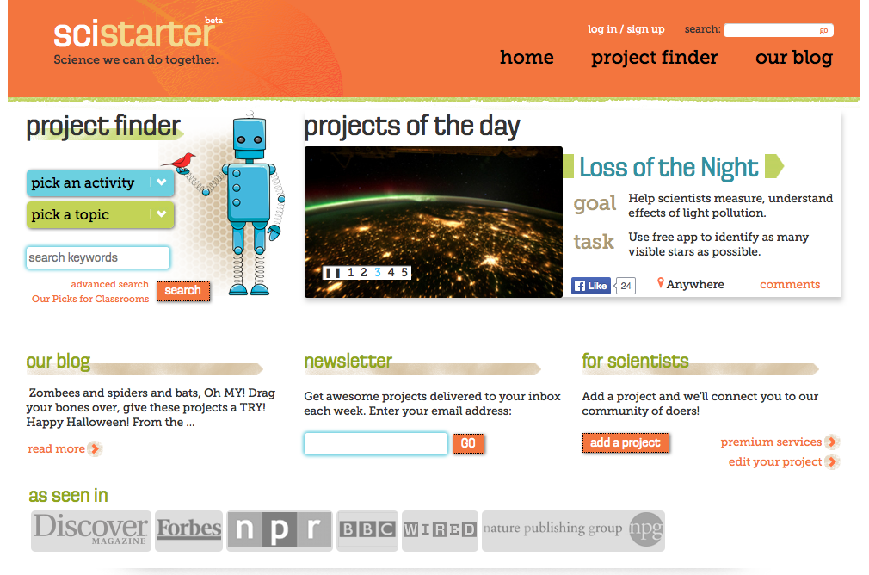

Slide 37
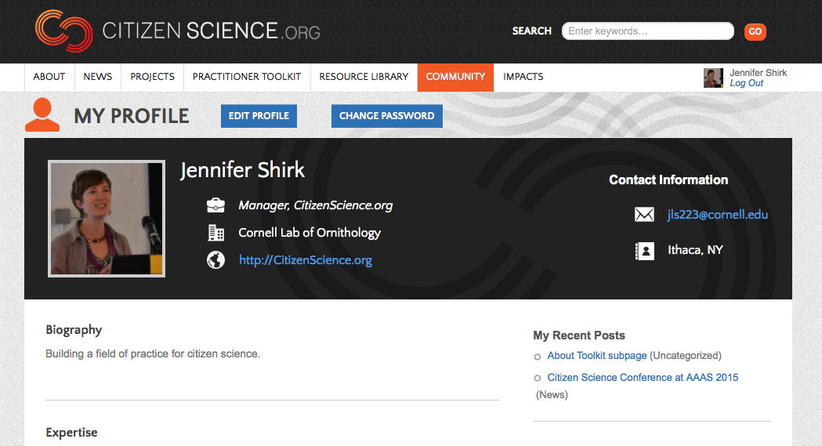

Slide 38
Generate List of Audience Needs
What resources are needed?
How do you find out about existing resources?
What are ways we can make resources more accessible/usable?
What are you currently using?
Visit InformalScience.org/perspectives/blog for a recap of this session.

