Slide 1
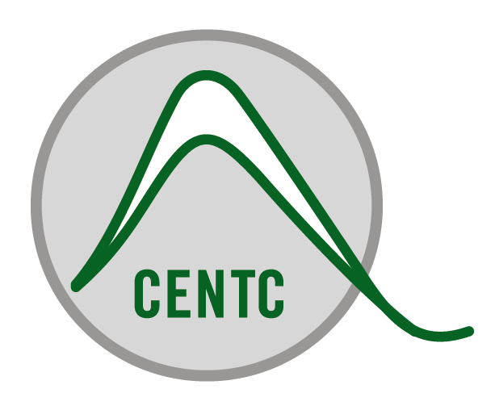


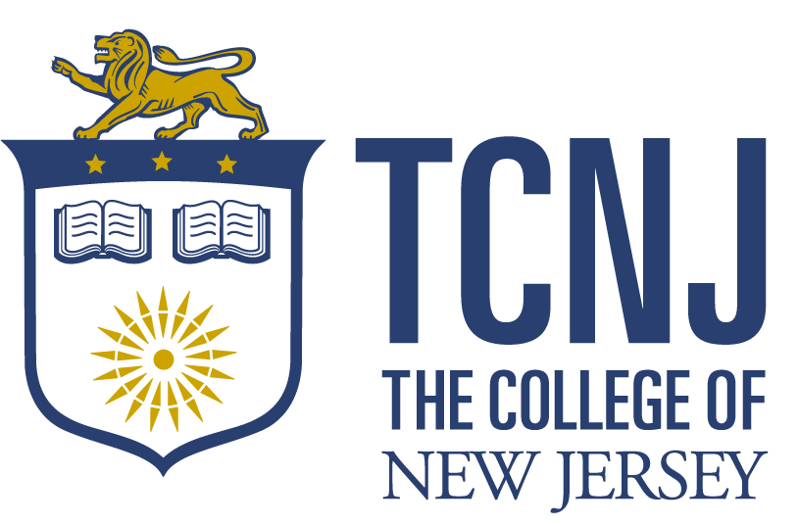

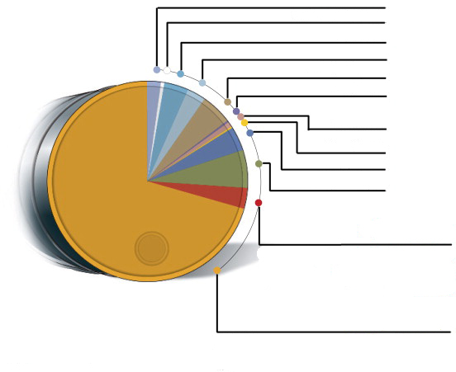
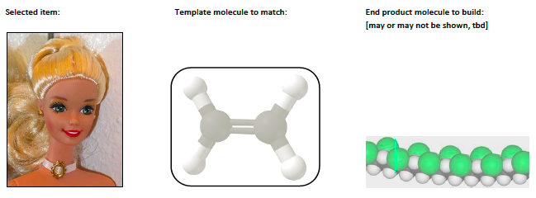
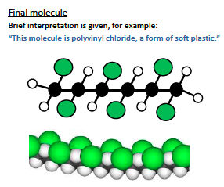
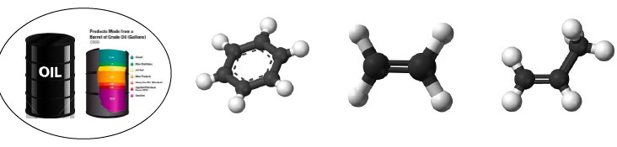

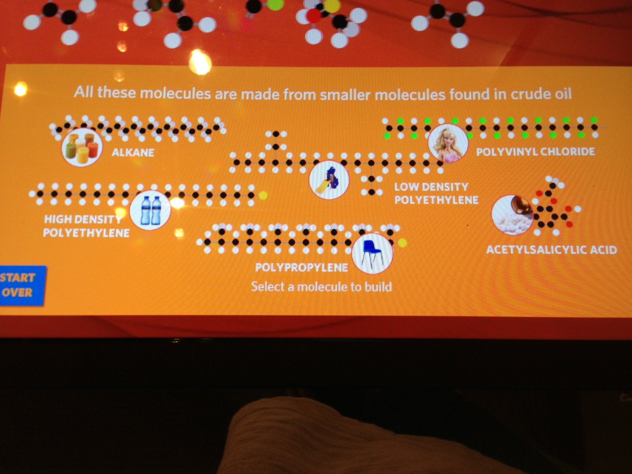
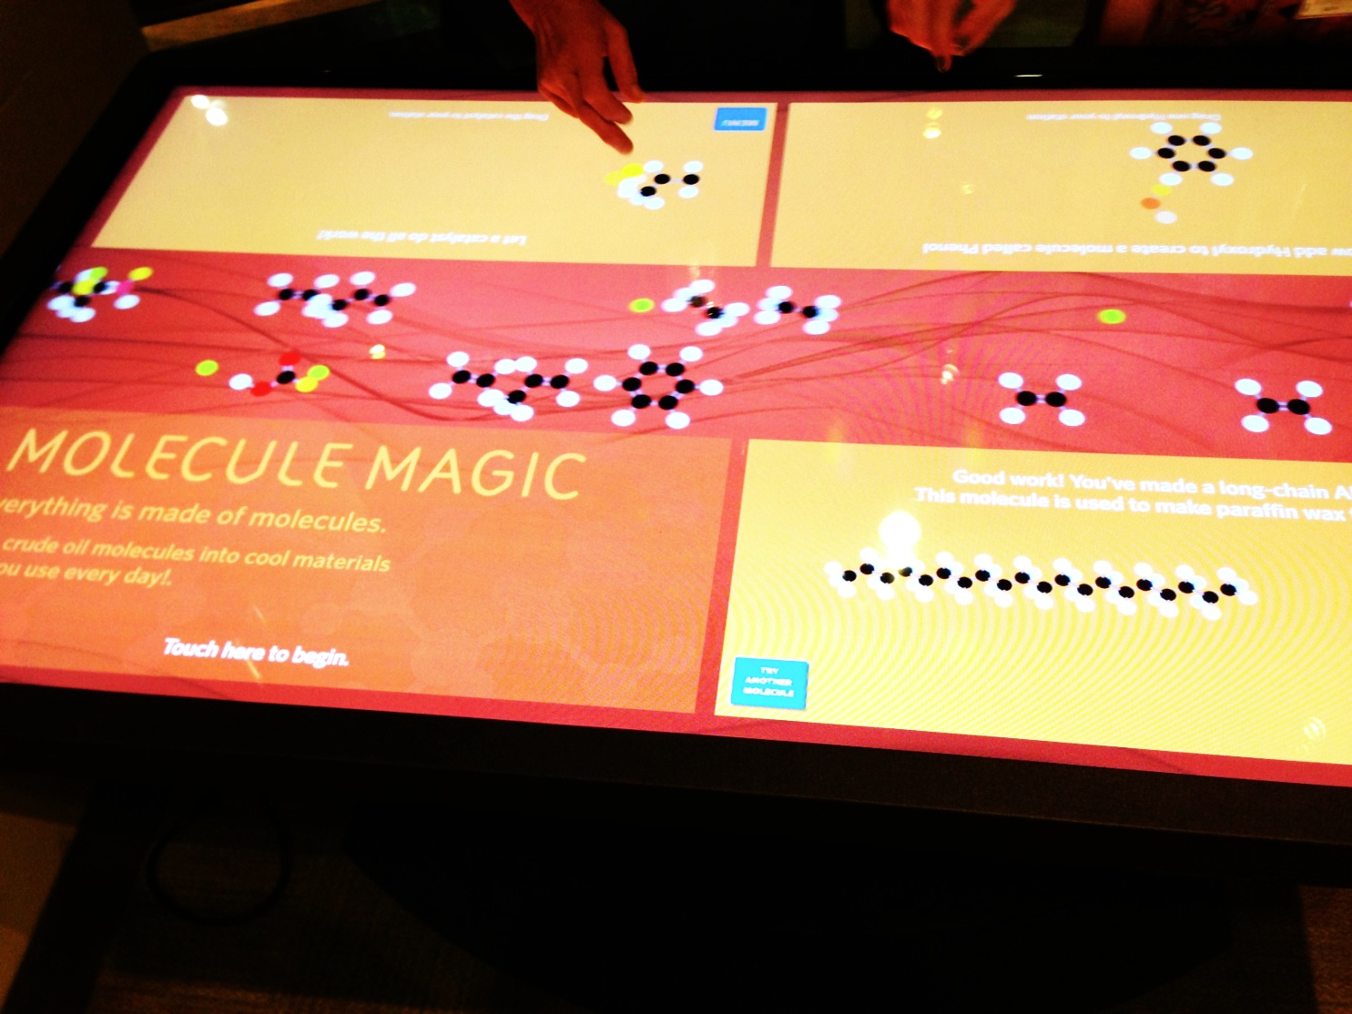
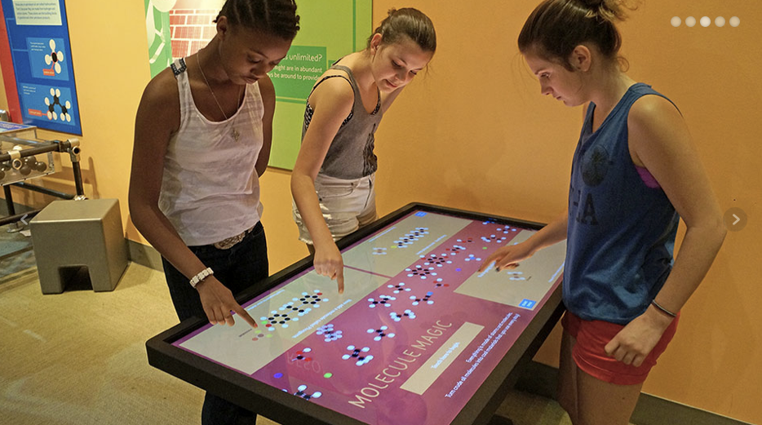
“Molecule Magic” – A collaboration between scientists and informal science institutions to educate the public about chemistry
Project Supported by NSF under the Center for Chemical Innovation (CCI) program, award CHE-0650456
Center for Enabling New Technologies through Catalysis (CENTC), PI Karen I. Goldberg, University of Washington
Overview:
Research chemists from the Center for Enabling New Technologies Through Catalysis (CENTC) worked collaboratively with the Liberty Science Center (LSC) to develop a hands-on activity to educate visitors about how small molecules derived from petroleum feedstocks are used to make larger molecules that are then utilized in the production of everyday consumer goods. Researchers, faculty, and students provided the chemistry content and LSC worked with Blue Telescope Studios to create a user-friendly program for the Ideum Multitouch Table. The resulting “Molecule Magic,” an engaging and intuitive activity, leads visitors through basic chemical processes by which simple petrochemical building blocks are “stitched” together to make make larger molecules used for materials found in everyday objects.
Figure 1
Liquefied refinery gases 2.3%
Methods:
Scientists and students developed content to be delivered: specific chemical reactions involving petrochemicals used in the manufacturing of common products such as plastics, fabrics, cosmetics, etc. Keeping results from the formative evaluation in mind, ISE professionals translated the content to make it more accessible for public audiences. An outside media studio was contracted to develop a program for use on the Ideum Multitouch Table to deliver the content to the public in a dynamic and engaging way.
Miscellaneous products 0.4%
Key challenges addressed by this project:
1) Only about a third of all US science centers and museums have any exhibits related to chemistry.
2) While the economic value of petrochemicals is nearly equal to that of transportation fuels (Figure 1), their importance in the production of everyday consumer goods is not widely appreciated.
3) Scientists are not well-equipped to communicate effectively with the public regarding their research.
Still gas 4.1%
Asphalt and road oil 3.0%
Petroleum coke 5.0%
Waxes 0.1%
People involved:
Jonn McCollum, ISE Lead, Project Director, Liberty Science Center
Eve Perara, PhD, CCI Lead, Director of Diversity, Education and Outreach, CENTC
David Laviska, Assistant Professor of Chemistry, The College of New Jersey
Abby O’Connor, Assistant Professor of Chemistry, The College of New Jersey
Student Chemists Association, The College of New Jersey
Alan Goldman, Professor of Chemistry, Rutgers University
Lubricants 1.0%
Special naphthas 0.2%
Residual fuel oil 3.8%
Heavy fuel oil 6.1%
~ $375bn
Pre-tax value of petrochemical products, such as plastics, cosmetics, pesticides, detergents, paints and adhesives (excluding pharmaceuticals)
Petrochemicals 3.4%
Fuels 70.6%
~$385bn
Pre-tax value of transport fuels such as gasoline and diesel
Results:
Molecule Magic: an engaging digital program that has been enthusiastically received by visitors and the ISE and scientific communities. This project is a model for future successful collaborations between research scientists and ISE professionals.
New Scientist, July 2007.
Data: US Department of Energy 2005, American Institute of Chemistry
Formative Evaluation:
A formative evaluation of LSC visitors provided the following information:
1) Visitors are interested in chemistry and want to know more!
2) They want to understand how smaller molecules are stitched together to make larger molecules in order to produce consumer goods used in their daily lives.
3) The notation and language chemists normally use to explain chemical reactions are not meaningful to most visitors.
Working storyboard for “Molecule Magic”
Step 1. Select end product molecule based on shape and name.
Step 2. Match basic, smaller target molecules, derived from petroleum, with corresponding shape on surface.
Step 3. Stitch target molecules together to build end product.
Step 4. Final molecule built and consumer product pops up.
Goals:
1) To bring active chemistry researchers together with experts in informal education to advance public understanding of chemistry.
2) To demonstrate basic chemical processes in which simple molecules are stitched together to create new and more complex molecules.
3) To communicate the role of crude oil in the manufacturing of familiar consumer goods other than gasoline (Figure 1).
4) To use leading edge digital technology to create a dynamic hands-on activity to engage a wide range of users.
Molecule Magic: Turning Crude Oil Into Useful Stuff!

